Slide 1


Information Security
Unit-2 Week-3

Slide 2

Information Security
Information security is to prevent unauthorized or unauthorized access, use, modification, disclosure, destruction, replacement and damage to information. It consists of three basic elements called Confidentiality, Integrity and Accessibility. If any of these three basic security elements is damaged, a security vulnerability occurs.

Slide 3
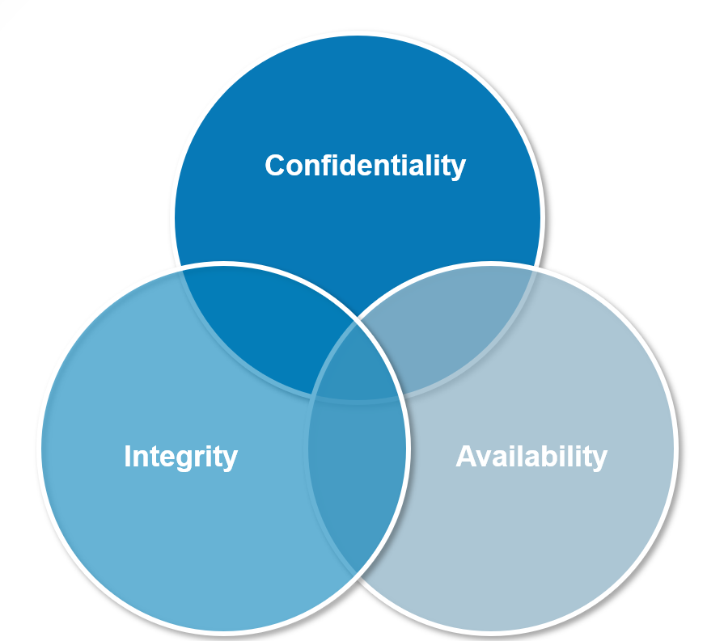
Information Security
Confidentiality: It is the protection of information against unauthorized access and unauthorized access.
Integrity: Information is not changed by unauthorized persons.
Accessibility: Information is accessible and usable when needed by authorized persons.

Slide 4
What is an information security policy?
An information security policy (ISP) is a set of rules, policies and procedures designed to ensure all end users and networks within an organization meet minimum IT security and data protection security requirements. An information security policy makes it possible to coordinate and enforce a security program and communicate security measures to third parties and external auditors.

Slide 5

What is the Purpose of an Information Security Policy?
General approach to information security
Implementing security measures
Enforce user access control policies
Detecting and minimizing the impact of compromised information assets
Protect reputation

Slide 6
ICP can have the following benefits for an organization
Facilitates data integrity, availability, and confidentiality: Effective information security policies standardize rules and processes
Protects sensitive data: IS policies prioritize the protection of intellectual property and sensitive data such as personally identifiable information ,
Minimizes the risk of security incidents: An IS policy helps organizations define procedures for identifying and mitigating vulnerabilities and risks.
Executes security programs across the organization: IS policies provide the framework for operationalizing procedures.
Provides a clear security statement to third parties: IS policies summarize the organization’s security posture and explain how the organization protects IT resources and assets.
Helps comply with regulatory requirements: Creating an IS policy can help organizations identify security gaps related to regulatory requirements and address them.

Slide 7
What Should be in an
Information Security Policy?
Acceptable Use Policy: This policy outlines the acceptable use of computer equipment and the internet at your organization. An acceptable use policy should outline what employees are responsible for in regard to protecting the company’s equipment, like locking their computers when they’re away from their desk or safeguarding tablets or other electronic devices that might contain sensitive information. It should also outline what the company’s rights are and what activities are not prohibited on the company’s equipment and network.
Clean Desk Policy: A clean desk policy focuses on the protection of physical assets and information. This policy should establish the minimum requirements for maintaining a clean desk, such as where sensitive information about employees, intellectual property, customers, and vendors can be stored and accessed. It should also cover things like what kinds of materials need to be shredded or thrown away, whether passwords need to be used to retrieve documents from a printer, and what information or property has to be secured with a physical lock.
Data Breach Response Policy: This is also known as an incident response plan. The purpose of a data breach response policy is to establish the goals and vision for how your organization will respond to a data breach. This plan will help to mitigate the risks of being a victim of a cyber attack. This policy should define who it applies to and when it comes into effect, including the definition of a breach, staff roles and responsibilities, standards and metrics, reporting, remediation, and feedback mechanisms.
Disaster Recovery Plan Policy: This policy is different from a data breach response plan because it is a general contingency plan for what to do in the event of a disaster or any event that causes an extended delay of service. This policy should describe the process to recover systems, applications, and data during or after any type of disaster that causes a major outage. This disaster recovery plan should be updated on an annual basis.

Slide 8
What Should be in an
Information Security Policy?
Email Policy: Email is a critical communication channel for businesses of all types, and the misuse of email can pose many threats to the security of your company, whether it’s employees using email to distribute confidential information or inadvertently exposing your network to a virus.
End-User Encryption Key Protection Policy: Certain documents and communications inside your company or distributed to your end users may need to be encrypted for security purposes. Have a policy in place for protecting those encryption keys so they aren’t disclosed or fraudulently used.
Password Protection Policy: Your employees likely have a myriad of passwords they have to keep track of and use on a day-to-day basis, and your business should have clear, explicit standards for creating strong passwords for their computers, email accounts, electronic devices, and any point of access they have to your data or network.

Slide 9

Exercises of Information
Security Policy
1. Lock your session: Strengthen your online accounts by activating the strongest authentication tools available, such as biometrics (a person's measurable biological traces), security keys, or a unique one-time code generated by an application tool on your mobile device. Your usernames and passwords may not be sufficient to protect accounts such as e-mail, banking and social media.
Exercises-1:
To have the computer lock automatically when you get up from the computer.
Step-1: Click the Windows Settings button.

Slide 10
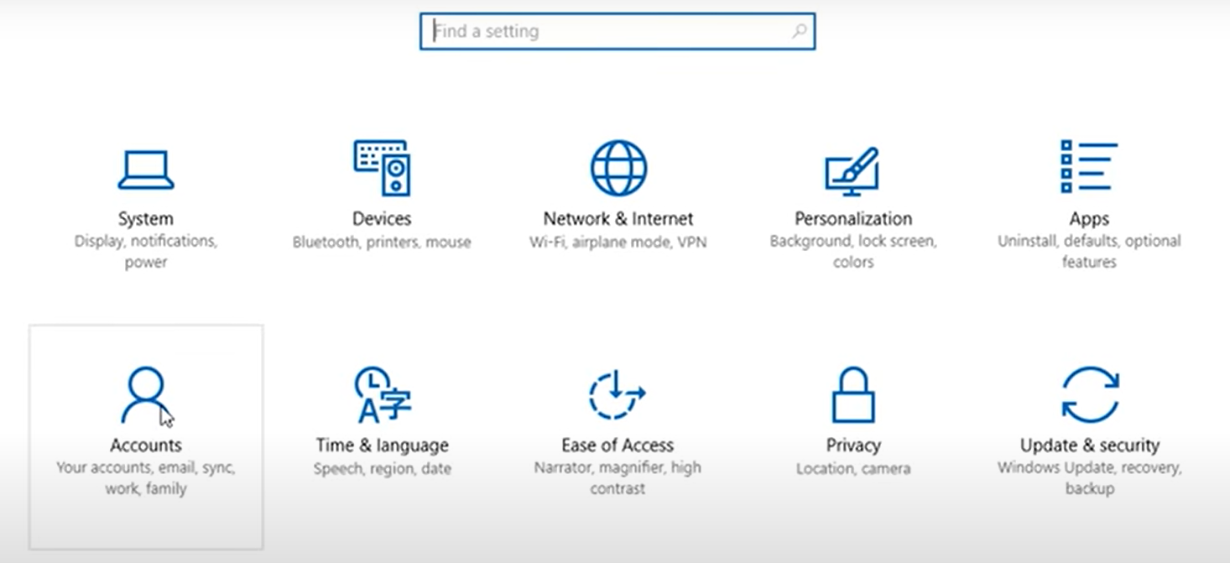
Sample-1 (Continues)
Step-2: Click the Accounts tab.

Slide 11
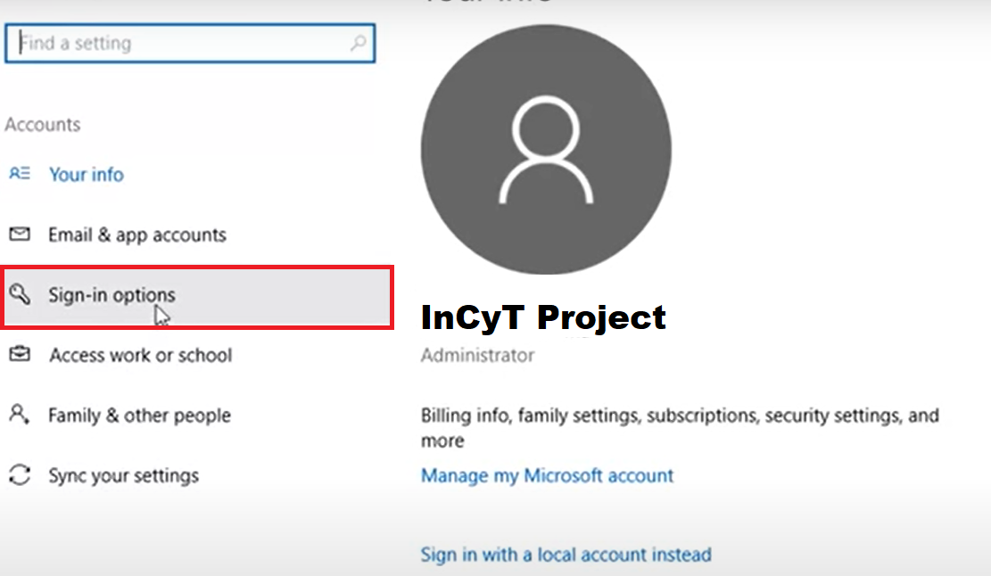
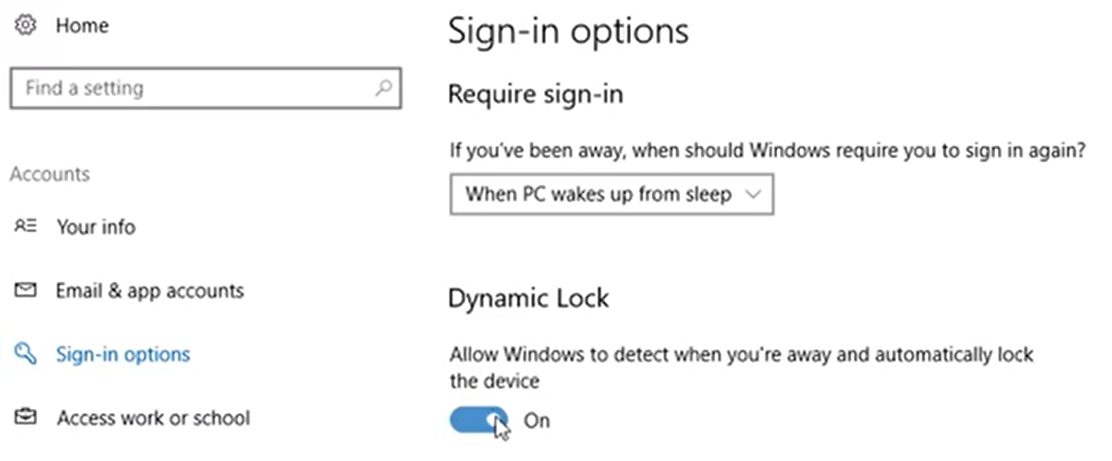
Sample-1 (Continues)
Step-3: Click on Sign-in section
Step-4: Enable to the Dynamic Lock speficication

Slide 12
Exercises of Information
Security Policy
2- Create a strong password: Password has an important place in information security. Weak passwords can be solved in a short time with password cracking programs. We use a password when creating an e-mail account, setting a password on the computer log in. Passwords should be created according to the following criteria:
    Passwords must be at least 8 characters long and contain at least one uppercase letter, one lowercase letter, one number, and one special character (.-+=_,!@$#*%<>[]{}).
    The password field should not be left blank or default; 123456, 01062022, qwerty, password etc. Passwords should not contain personal information (your child's name, date of birth, or institution name).
    Different passwords should be created for different systems and accounts.
    Passwords should be changed frequently (at least every 6 months).

Slide 13
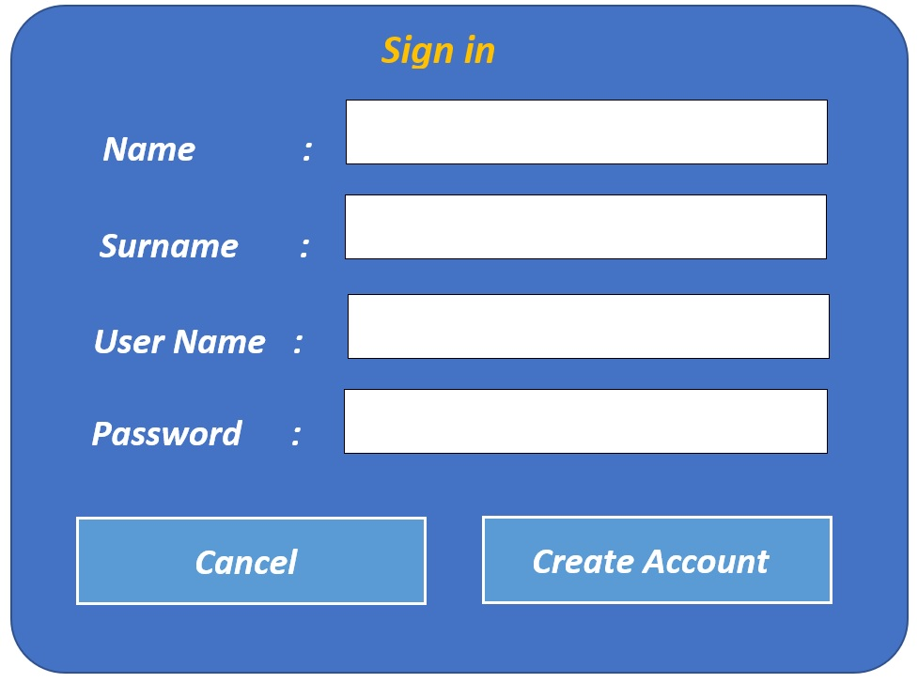
Exercises-2:
Password security when creating an email account through your corporate email service provider or a public email service provider's application or website
Step-1: Open the website or application.
Step-2: Enter your personal information to create an account.

Slide 14
Exercises-2 (Continues)
Step-3: When creating a password, use uppercase, lowercase, digit, symbol combinations together.
  Some coding can be done to make the password easy to remember by the user. For example, you can write a sentence suitable for the subject and use the first characters, numbers and special characters of the sentence you wrote.
  This cybersecurity project is supported by Erasmus+ 2021
Step-4: We set our password; TcpisbE+2021
Step-5: Make sure that the password consists of at least 8 characters. 12 characters are preferred. It can be said that the password we use is suitable because it has 12 characters.

Slide 15
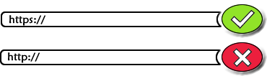
Exercises of Information
Security Policy
3- Access to secure sites (Safe Browser): When you go online to shop or read news, you are using a browser. Browsers are one of the primary ways to interact with the Internet. As a result, browsers are primary targets for cyber attackers. Always use the latest version of your browser and keep your security shield strong against browser attacks.
Updated browsers have the latest security patches and are much harder for cyber attackers to exploit.
Modern browsers can recognize certain malicious websites that are designed to harm. If your browser notifies you that the website you are about to visit is dangerous, close that web page and try to find the information you are looking for on a safer website.
Before sending sensitive information online, for example when sending your credit card information for online shopping, make sure your browser is using HTTPS, which is a sign of encryption. For a secure connection, look for encryption marks such as the website address that starts with HTTPS and a padlock icon in the status bar.

Slide 16
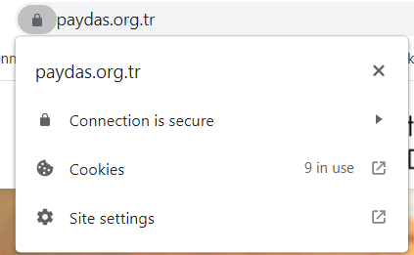
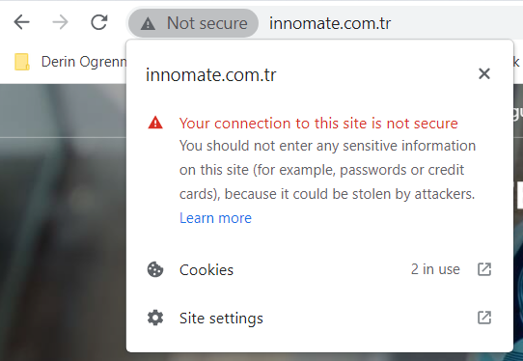
Exercises of Information
Security Policy
Secure web site
Not secure web site

Slide 17
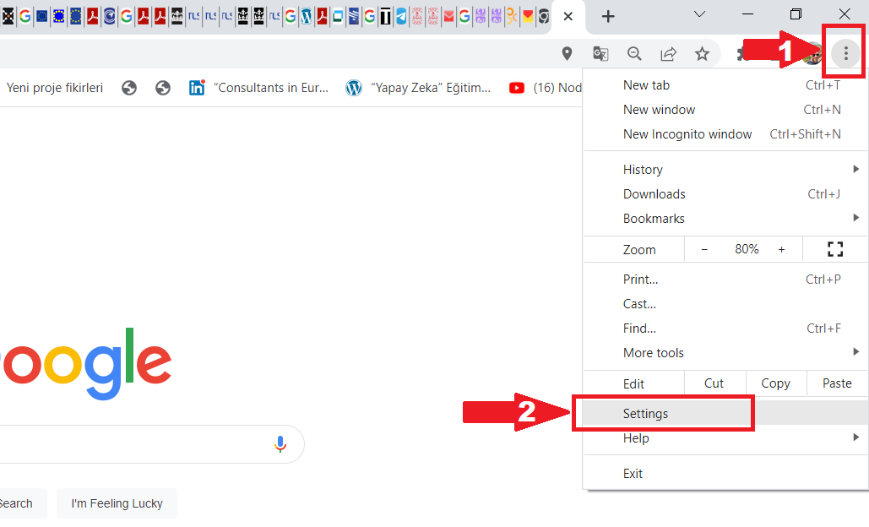
Exercises-3:
Follow the steps below to edit plug-ins in the web browser.
Step-1: Open your web browser and click the “Costume and Control…” button in the upper left corner (1). Click on the “Settings” tab from the drop-down menu (2).

Slide 18
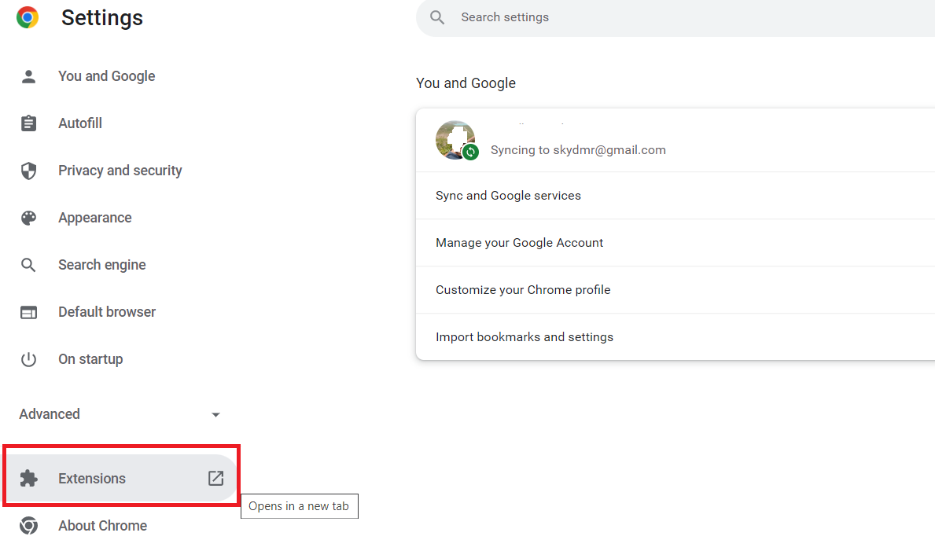
Exercises-3 (Continues):
Step-2: Click the "Extensions" button in the window that comes up.

Slide 19
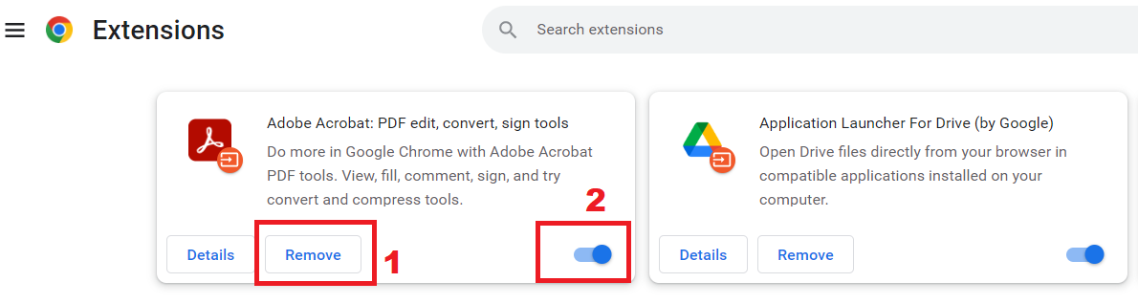
Exercises-3 (Continues)
Step-3: You can see the add-ons installed on your browser on this screen. If you want to delete the add-on, you can delete it (1) by pressing the “Romove” button. If you want the plugin to remain inactive, you can deactivate it from the "On-Off" button (2).

Slide 20
Exercises of Information
Security Policy
4. Email, Messaging, and Phishing: Have an email in your inbox or a message on your phone. “There is a problem with your account and your account should be updated immediately. All you have to do is click a link.” When you get a message with content, stop and think before you click! “Phishing” is a social engineering attack that uses emails or messaging as bait, similar to using bait for fishing. Cyber attackers send thousands of emails in hopes that someone will take the bait. Emails prompt you to take an action, such as clicking a link, opening an attachment, or filling out a form. Cyber attackers aren't sure exactly who will receive these emails, but performing one of these seemingly harmless actions could get you hooked. A more sophisticated form of phishing called "Spear phishing" targets specific individuals. For example, when everyone in our Organization receives a generic phishing email regarding an undelivered package; like five people in our purchasing unit being targeted with a fake invoice request.

Slide 21
Exercises of Information
Security Policy
How do we know if an email or message is a phishing attack? Some signs to look for:
  Messages beginning with “Dear Customer” or other general greeting entries.
  Messages that require immediate action or create a sense of urgency, such as threatening to close your account.
  Messages that claim to be from an official organization but have grammatical or spelling mistakes or use a personal email address such as @gmail.com, @yahoo.com, or @hotmail.com.
  Any message that asks for highly sensitive information, such as your credit card number or password. Be suspicious of such messages. If someone you know, such as a coworker, sends you a message that requires urgent action, reach out through different channels to verify that it is really him who sent you, for example by phone call Try to confirm if the message is his.

Slide 22
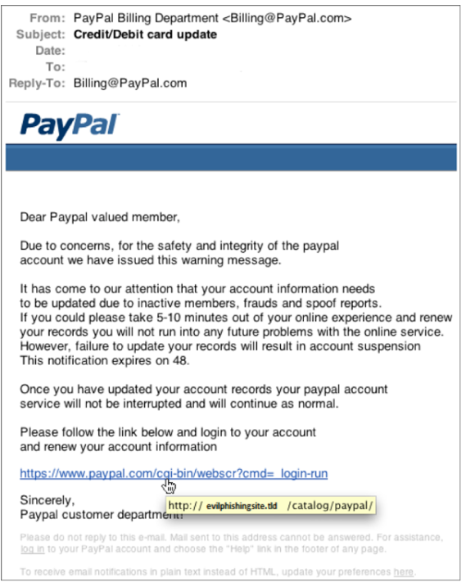
Samples of the Phishing
Sample-1: In this example, the email looks like it was sent from PayPal.com, but is sent through a fake server. If we look only at the web address to which it is directed, without clicking on the given link, we can detect that it is an e-mail harvested by an attacker who wants to obtain credentials.

Slide 23
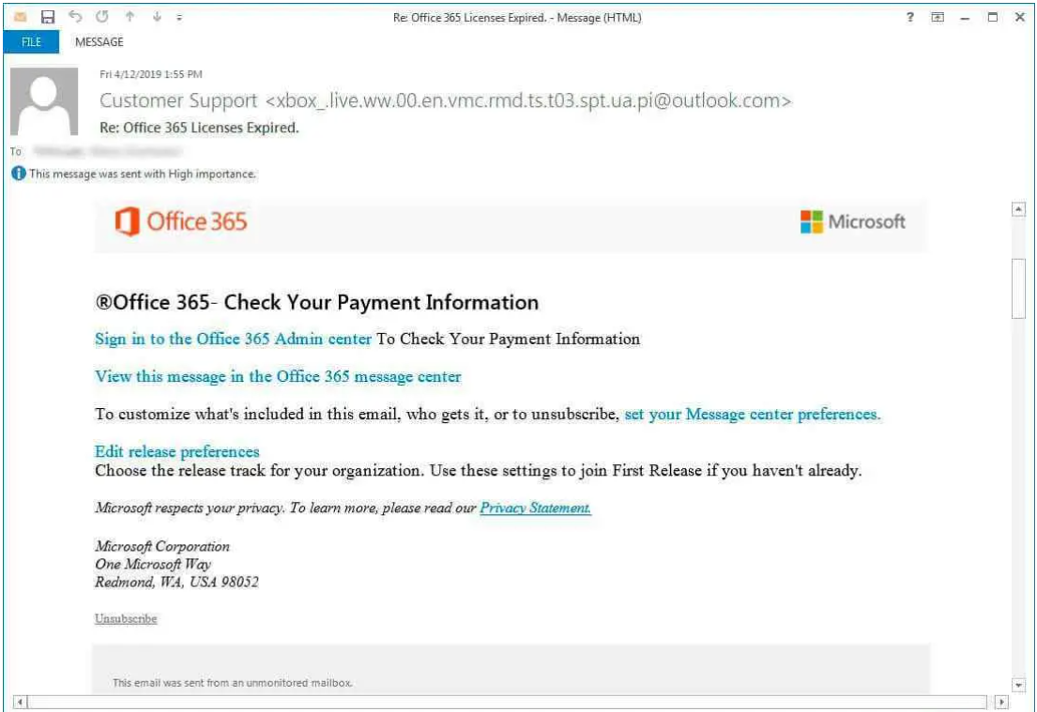
Samples of the Phishing
Sample-2: In this example, an incoming email is an example indicating that an organization's Office 365 licenses have expired. The mail then keeps telling the user to login to Office 365 Admin Center to check their payment information.
However, when the sender e-mail address is carefully examined, it should be noted that such an address will not exist. In short, it is obvious that this email was not sent by Office365.

Slide 24
Exercises of Information
Security Policy
5. Social networks
Social networking sites help us share information and communicate with others. Unfortunately, these sites also make it easier for cyber attackers to track you down and learn what you're doing. Protect yourself by protecting each account with a strong, unique password. Better still, use a different password for each account and use two-factor authentication if available.
Only install apps you need from trusted sources and only. Check any app's rating, comments and permissions before installing it.
Just like email and messaging, cyber attackers can try to scam you on social networking sites. He can send messages pretending to be your friend. If you receive a strange or suspicious message from a friend, contact them via email or phone, not by replying to the message. Finally, to protect our Institution, do not post any confidential information about our Institution on any website. If you have any questions about what you can post or share about the job, please ask your supervisor.

Slide 25
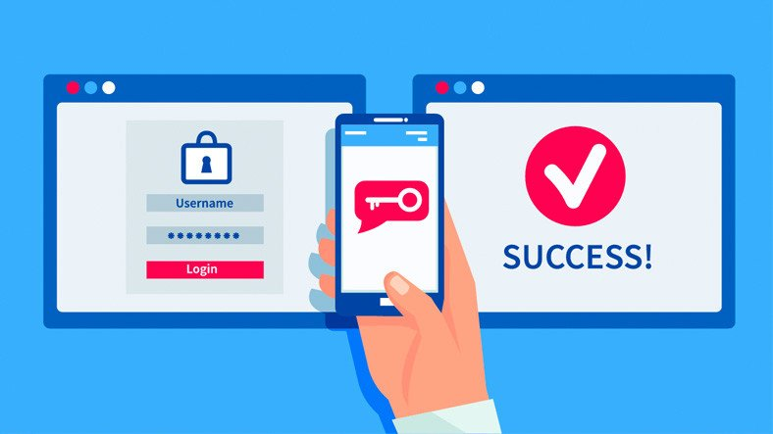
Exercises of Information
Security Policy
After enabling two-factor authentication (verification), a security code will be sent to your phone or authentication app every time you log into your account from a new device or browser. You have to enter this code and you will be allowed to login. If a cybercriminal tries to log into your account, they cannot do so if they do not have access to your mobile phone.
You will also be able to notice an attempt to log into your account as you will receive a notification with a code. Never share this code with others! An attacker will try to take it. If you received the code but did not try to log in, delete the code message and change your password as soon as possible.

Slide 26
Exercises-4:
Perform two-factor authentication- verification to access the email account you created. The first of these processes is the password you use to access the account. The other can be a verification code (SMS) to be sent to your phone or a confirmation link to be sent to another email address.
The screenshot below shows how to activate the two-factor authentication feature of the gmail account.
Complete the process and try to access your email account again.
Step-1: Open your Google Account.
Step-2: Click to the “Settings” section.

Slide 27
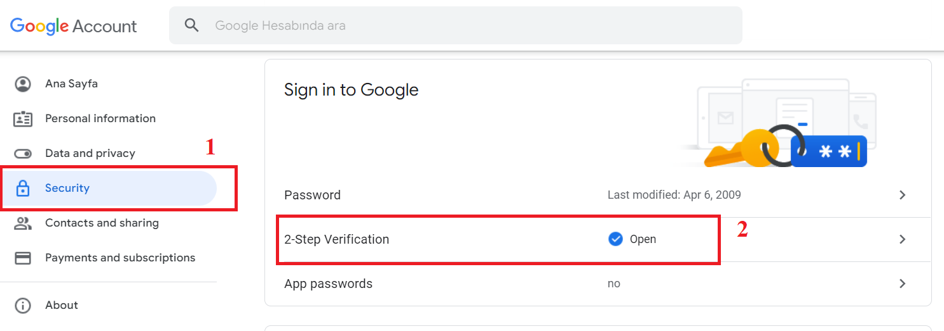
Exercises-4 (Continues):
Step-3: Select the "Security" tab from the menu on the left side of the page that opens (1). Then activate the "2-Step Varification" feature in the middle of the page.

