Slide 1


Securitatea furnizorilor terți
Unitatea-3 pentru Manageri 1 – Săptămâna 6

Slide 2


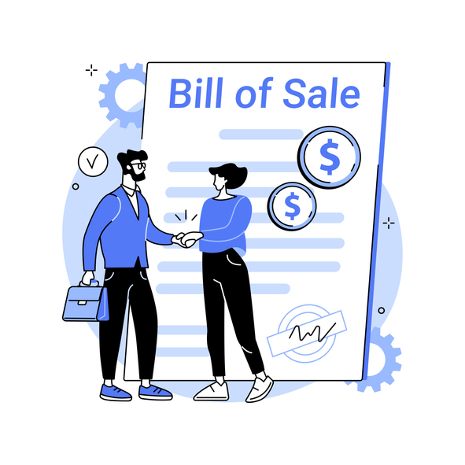
Securitatea informațiilor pentru manageri
Numele unității (modulului). :
Securitatea furnizorilor terți
Cerințele de achiziții se referă la bunurile și serviciile care trebuie achiziționate de la organizații din afara organizației executante. Din mai multe motive, uneori organizațiile performante se bazează pe furnizori pentru a oferi ceea ce este necesar pentru a finaliza un proiect.
Notes:
Procurement requirements refer to the goods and services that must be acquired from organizations outside the performing organization. For a variety of reasons, sometimes performing organizations rely on vendors to provide what’s needed to complete a project.
For example, consider the widget manufacturer that undertakes a project to automate their inventory tracking system. Some of the project work activities involve the relocation of storage bins in their main warehouse. Some of the work activities involve custom software development. As to the software development activities, widget manufacturer doesn’t have a human resource who knows how to develop the software application. Regarding the software development activities, widget manufacturer must procure those services.

Slide 3

WBSNs
Rețelele sociale bazate pe web (WBSN) sunt comunități online care permit utilizatorilor să publice resurse (de exemplu, date personale, adnotări, bloguri) și să stabilească relații, eventual de alt tip, în scopuri care pot viza afaceri, divertisment, religie, întâlniri, si asa mai departe.
Notes:
Web-based social networks (WBSNs) are online communities that allow users to publish resources (e.g., personal data, annotations, blogs) and to establish relationships, possibly of a different type for purposes that may concern business, entertainment, religion, dating, and so forth.
In the last few years, the usage and diffusion of WBSNs has been increasing, with about 300 Web sites collecting the information of more than 400 million registered users. As a result, the “net model” is today used more and more to communicate, share information, make decisions, and ‘do business’ by companies and organizations.

Slide 4

Furnizor terță parte
Un furnizor terț este o persoană sau o companie care furnizează servicii pentru o altă companie (sau pentru clienții acelei companii).
Cooperarea este cheia succesului. Lucrul cu terți ajută companiile să-și crească productivitatea și eficiența, să producă produse și servicii mai bune, să angajeze experți cu înaltă calificare și să reducă costurile.
Notes:
A third party vendor is a person or company that provides services for another company (or that company’s customers). While vendors are considered “third parties,” some industries differentiate a “third-party vendor” specifically as a vendor under written contract, but not all vendors work under a contract. For clarity’s sake, the term “third-party vendor” in this article refers to any individual or company that provides services to another company with or without a contract.
Cooperation is the key to success. Working with third parties helps businesses increase their productivity and efficiency, produce better products and services, employ highly qualified experts, and cut costs. But all these benefits come at the price of increased cybersecurity risks. Minor flaws in your third-party vendor’s security and privacy routines may turn into cybersecurity weaknesses for your company.

Slide 5
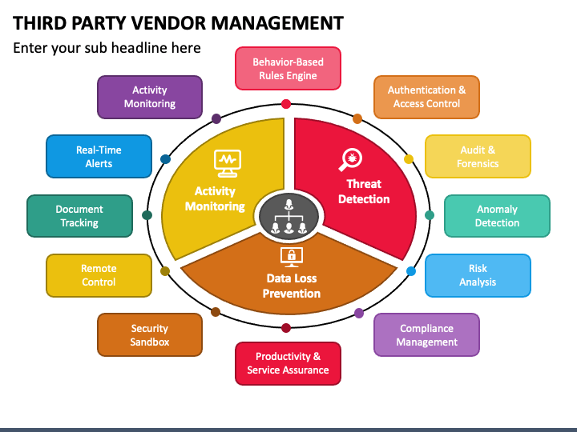
Managementul furnizorilor terți
Bunuri si servicii obtinute de lafurnizorii
terți pot include,dar nu se limitează la :
Servicii de găzduire web în cloud
Soluții software bazate pe cloud
Intretinere de echipamente
Antreprenori de orice fel
Furnizori de call center
Contabilitate/auditori financiari
Avocați
Notes:
Goods and services obtained from third-party vendors can include, but aren’t limited to:
Cloud web hosting services. A cloud hosting vendor might provide everything from disk space and bandwidth to encryption and high-tech security solutions.
Cloud-based software solutions. SaaS software vendors provide access to software programs either for your business or your customers. For example, marketing automation platforms, CRMs, accounting packages, etc.
Equipment maintenance. The company that fixes your copy machine and the team that manages your network security are third-party vendors.
HVAC servicing. The local HVAC company that services your unit is providing third-party vendor services.
Contractors of any kind. Any contractor, short- or long-term, is a third-party vendor.
Call centre providers. If you host your call centre with another company, it is considered a third-party vendor.
Bookkeeping/financial auditors. Any person or business hired to manage your finances, budget or audit your finances is a third-party vendor.
Lawyers. Sometimes it’s necessary to consult a lawyer before signing contracts or making big purchases. All legal services are considered third-party vendors.

Slide 6
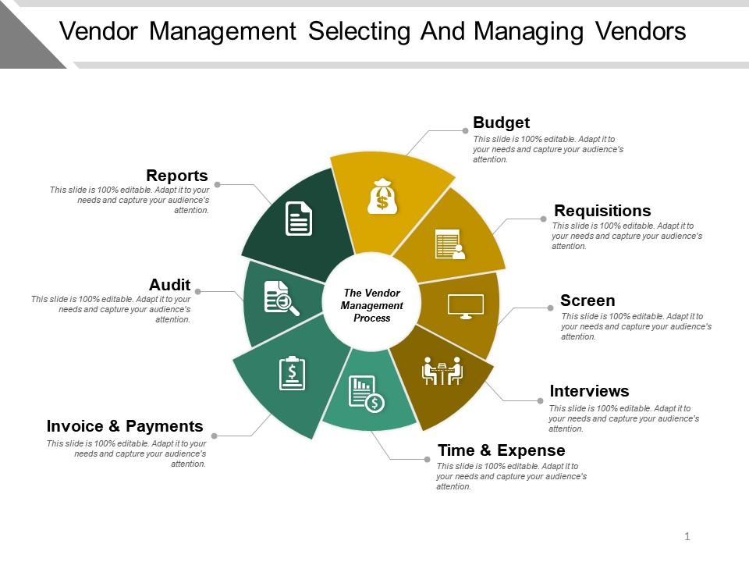
Selectarea și gestionarea furnizorilor
Care sunt beneficiile utilizării furnizorilor terți pentru furnizorii de servicii?
Vei economisi timp
Vei economisi bani
Veți obține o expertiză valoroasă
Notes:
In today’s world, it’s impossible to avoid using third-party vendors. No matter how many departments your company creates, you’ll never cover every service you’ll ever need. Nor should you, as companies must determine the right balance of skills that are essential to the business versus those that can be outsourced.
What are the benefits of using third-party vendors for service providers?
You will save time
Nobody has time to learn every skill or hire every person necessary to run a business. Third-party vendors make business processes run smoothly by obtaining all the professional services required to operate and fulfil orders for your customers
You will save money
Perhaps the biggest benefit is the cost savings. Contracting a third-party provider for work as needed can be significantly less expensive than always having professionals on company payroll. For instance, it’s far less expensive to hire a lawyer when you need one rather than keep a lawyer on retainer.
You will get valuable expertise
Your company doesn’t have time to develop a new team of experts. The time and cost of doing so would be enormous. Hiring a third-party vendor for expertise you don’t have in-house will likely yield better results.

Slide 7
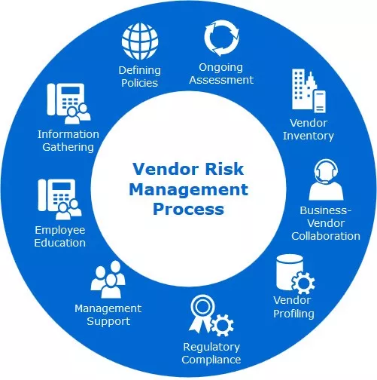
Managementul riscului furnizorilor
Care sunt riscurile utilizării furnizorilor terți?
Este posibil ca terții să nu ia securitatea rețelei lor atât de în serios pe cât doriți.
Cel mai mare risc este alegerea unei relații cu o terță parte care nu se aliniază cu standardele dvs. de securitate.
Aveți nevoie de un furnizor care înțelege reglementările și este dispus să se adapteze pentru a respecta aceste reglementări.
Notes:
As organizations increasingly rely on third-party vendors to provide essential services, they also become more vulnerable to vendor related cybersecurity risks. A recent study found that nearly 60% of companies experienced a data breach due to a third-party vendor in the past year. But what are the most common vendor cyber gaps that organizations should be aware of?
What are the risks of using third-party vendors?
Third parties may not take their network security as seriously as you want them to. Knowing this, hackers may choose not to attack your company directly. Instead, they may look for an easier target among your third-party vendors. A compromised subcontractor can easily be turned into an entry point for cybercriminals.
If your vendors fail to deliver, you will fail to deliver. However, risk is inherent in any business relationship. Using third-party vendors comes with many risks, most of which can be mitigated.
The biggest risk is choosing a third-party relationship that does not align with your security standards. For instance, your network security team needs to follow security protocols that live up to your specific standards. If your company is bound by regulations such as health insurance, you cannot afford to hire a network security company that does not comply with the health insurance regulations. You need a vendor that understands regulations and is willing to adapt to meet those regulations.

Slide 8
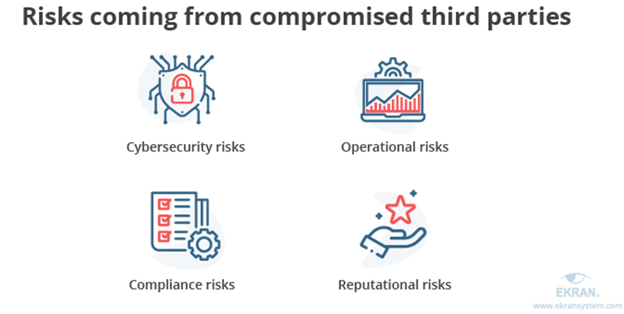
Managementul riscului furnizorilor
INCALCAREA DATELOR SUNT EXTREM DE DISRUPTIVE
În special când protejezi informațiile personale.
Un furnizor terț compromis poate duce la mai multe riscuricare
poate fi împărțit în patru mari categorii :
Notes:
Data breaches are extremely disruptive, especially when you’re protecting personal information. Unfortunately, data breaches are on the rise and are more common than ever before. Data breaches can cause disruptions to operations, devastating financial consequences, legal action and a damaged reputation. To avoid these, you cannot let your guard down when it comes to your own security or that of your vendors.
Depending on the nature of third-party vendor compromise, an organization may face different risks. Let us look at the most common risk categories and the threats you need to be prepared to mitigate. A compromised third-party vendor may lead to multiple risks that can be split into four major categories
Cybersecurity risks — Subcontractors usually have legitimate access to different environments, systems, and data of their clients. Attackers may use a third-party vendor as an entry point to try to get a hold of your valuable assets.
Operational risks — Cybercriminals may target your internal systems and the services you use instead of just your data. This can lead to partial interruptions of your operations or even halt them altogether.
Compliance risks — International, local, and industry-specific standards and regulations set strict cybersecurity criteria that organizations should meet. Furthermore, third parties working with these organizations also have to comply with these requirements. Non-compliance usually leads to substantial fines and reputational damage.
Reputational risks — Having your valuable data and systems compromised serves as a red flag for your partners and customers, both current and future. Regaining their trust will take a lot of time and effort. And unfortunately, there’s no guarantee that you’ll be able to successfully recover your reputation after a severe cybersecurity incident.

Slide 9
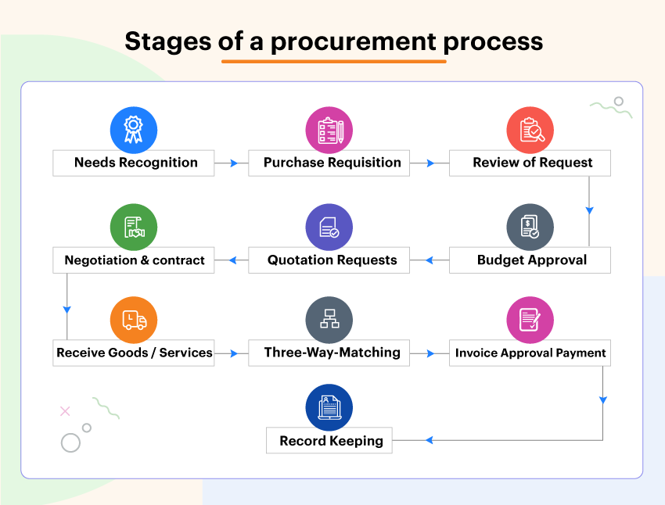
Managementul riscului furnizorilor
Cerințe de achiziții.
Etapa 1: Identificați nevoia de produse și/sau servicii.
Etapa 2: Creați și trimiteți o cerere de achiziție.
Etapa 3: Evaluarea și selectarea furnizorilor/furnizorilor.
Etapa 4: Negociați termenii unui contract cu furnizorul selectat.
Etapa 5: Finalizați o comandă de achiziție.
Etapa 6: Gestionarea comenzilor
Notes:
For a variety of reasons, sometimes performing organizations rely on vendors to provide what’s needed to complete a project. Especially, the SMEs. Procurement requirements are therefore of utmost importance to work with third party vendor security.
Procurement requirements refer to the goods and services that must be acquired from organizations outside the performing organization. For a variety of reasons, sometimes performing organizations rely on vendors to provide what’s needed to complete a project.
While it’s true that procurement is a highly individualized process, there are also several foundational stages that will generally be utilized across the board.
The first step in the procurement process is to identify requirements. All procurement requirements begin with the perception of a need. The need to cross a body of water could create a requirement to build a bridge, a ferry, or other transportation systems.

Slide 10
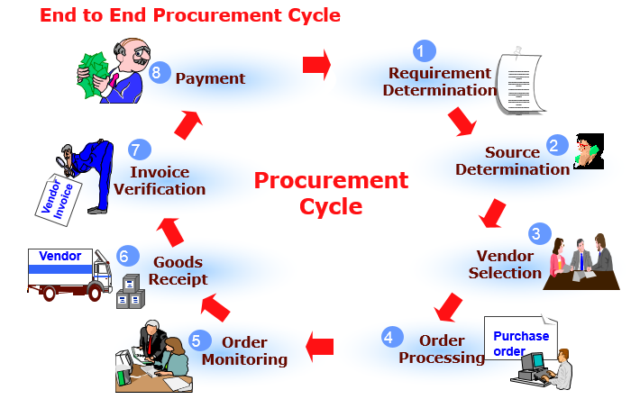
Cerințe de achiziții
Etapa 1: Identificați nevoia de produse și/sau servicii.
Înainte ca procesul de achiziție să poată începe, trebuie recunoscută o nevoie specifică.
În această etapă este necesar să se definească clar nevoia.
Notes:
Before the procurement process can begin, a specific need must be recognized. For example, an organization may be interested in purchasing new computer monitors, re-ordering their monthly supply of paper products, or acquiring updated software. Depending on the company structure, this step might be managed by the business owners, department heads, executive team, staff, and/or procurement managers. In this stage, a budget will be set and a comprehensive view of spending will often be assessed.
At this stage it is necessary to clearly define the need, and this may be done by way of a study to determine the best mode to cross the body of water (given the present situation and forecasted future need), then the type of bridge to be constructed, or a comparative cost/benefit analysis to determine the best solution between a bridge and other alternatives. The study should include if the need can be satisfied in-house or contracted out, quantification of the initial budgetary estimate, and an idea of the procurement lead-time.

Slide 11

Cerințe de achiziții
Etapa 2: Creați și trimiteți o cerere de achiziție.
O cerere de achiziție (sau o cerere de achiziție) este o cerere formală de bunuri sau servicii
Notes:
A purchase request (or purchase requisition) is a formal request for goods or services and is generally submitted using specialized procurement software. Oftentimes, the purchase request will originate with an employee or manager, then be reviewed by the organization’s procurement team.
When a purchase request is approved, it becomes a purchase order. However, should the request be denied, it will typically be returned to the submitter with a brief explanation. A rejected purchase order, while not ideal, can be a good learning opportunity.

Slide 12
Cerințe de achiziții
Etapa 3: Evaluarea și selectarea furnizorilor/furnizorilor
Următorul pas este evaluarea diferiților furnizori, apoi alegerea unuia care îndeplinește cerințele cheie.
Pentru cele mai bune rezultate, luați în considerare „imaginea de ansamblu” a ceea ce poate oferi un furnizor, inclusiv:
Ușurința comunicării
Etica companiei
Responsabilitate
Capabilitati de productie
Notes:
The next step is to assess various vendors, then choose one that meets key requirements. Some organizations maintain a catalogue of approved vendors, featuring various suppliers that have already proven themselves.
Soliciting vendors is a process that can range from simple to complex, with its scope determined by the requirement(s) at hand. Usually, several requests for quotation (RFQ) will be sent to various vendors, so that the organization/procurement team can compare prices and options.
Remember that price should not be the only determinant when choosing a vendor. For best results, consider the “big picture” of what a vendor can offer, including:
Ease of communication
Company ethics
Accountability
Production capabilities
After a vendor has been selected, investing time and energy into the relationship is important. A good relationship with a supplier can unlock better savings and service, delivering maximum value in the long term.

Slide 13
Cerințe de achiziții
Etapa 4: Negociați termenii unui contract cu furnizorul selectat
Notes:
Stage 4: Negotiate the terms of a contract with the selected supplier
Once you have chosen the best-fit vendor, it’s time to move on to contract negotiations. In terms of successful procurement, this is one of the most critical stages by far. It is in this stage that you will outline – and agree to – pricing, as well as details such as delivery schedules, specific terms and conditions, and more. It can often be useful to assess previous contracts to pinpoint opportunities for improvement, allowing you to take a more informed approach going forward.

Slide 14
Cerințe de achiziții
Etapa 5 și Etapa 6: Gestionarea comenzilor
Pe măsură ce bunurile/serviciile sunt livrate, ar trebui să existe cineva responsabil, în mod ideal utilizatorul final al produsului sau serviciilor, pentru a verifica dacă toate standardele au fost respectate termenele de livrare, cantitățile și calitatea produselor etc.
Notes:
Stage 5 and 6: Finalize a purchase order / Order management
As the goods/services are delivered, there should be someone responsible, ideally the end-user of the product or services, for checking that all standards have been met delivery deadlines, product quantities, and quality, etc. If there are issues with the items (e.g. damaged products), you have the option to reject the delivery. Clear communication with the vendor is key in the event of any delivery problems.
As technology and communications allow businesses to expand their supply chains, the complexity of vendor risk management increases. Your business is likely working with more vendors than ever before, and each of those vendors is going to pose some level of risk to your organization

Slide 15
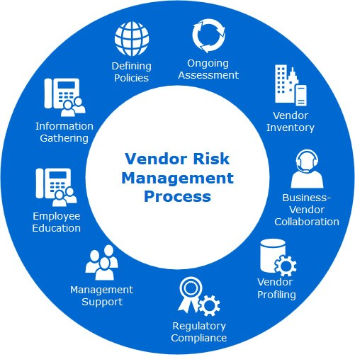
Managementul riscului furnizorilor
Managementul riscului de securitate al furnizorilor este o strategie concepută pentru a limita numărul de amenințări, vulnerabilități și puncte slabe cu care se confruntă organizația dvs. din cauza furnizorilor din lanțul dvs. de aprovizionare..
Un furnizor este de obicei o organizație terță care vinde un produs, un serviciu sau un echipament de care afacerea dvs. are nevoie pentru a opera.
Notes:
Vendor security risk management is a strategy designed to limit the number of threats, vulnerabilities, and weaknesses your organization faces due to the vendors in your supply chain. A vendor is typically a third-party organization that sells a product, service, or piece of equipment that your business needs to operate.
As technology and communications allow businesses to expand their supply chains, the complexity of vendor risk management increases. Your business is likely working with more vendors than ever before, and each of those vendors is going to pose some level of risk to your organization
Each vendor, upon being connected to your organization, is going to carry some level of cybersecurity risk. If they fail to uphold their end of the deal, or if they’re the victim of a cyberattack, it could impact your organization directly. An effective risk assessment, as part of a greater vendor risk management plan, strives to identify these potential failure points long before they become a problem and fix them.

Slide 16
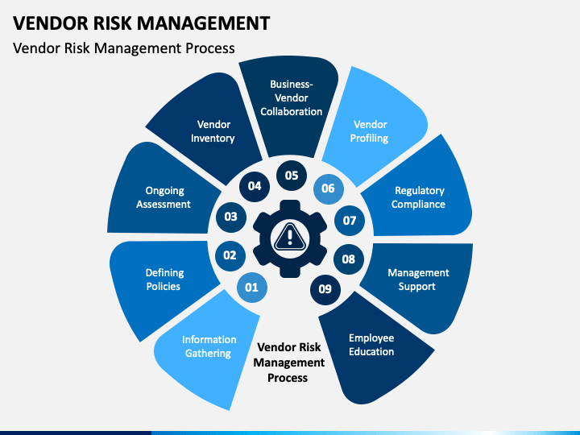
Managementul riscului furnizorilor
Ciclul managementului riscului furnizorilor.
Pasul 1: Analiză – Compania identifică riscul inerent al relației și nivelul de due diligence care trebuie efectuat. În consecință, compania evaluează postura de securitate a terței părți și efectuează o analiză a decalajului.
Notes:
Vendor security risk management is an ongoing process, and one you’ll execute with every vendor you bring into your supply chain. Typically, the process looks like this:
Step 1: Analysis – The company identifies the inherent risk of the relationship and the level of due diligence to be performed. Accordingly, the company evaluates the third party’s security posture and performs a gap analysis.

Slide 17
Managementul riscului furnizorilor
Ciclul managementului riscului furnizorilor.
Pasul 2: Implicare – Compania și terțul colaborează pentru a remedia lacunele.
Pasul 3: Remediere – Terțul remediază lacunele cibernetice.
Notes:
Vendor security risk management is an ongoing process, and one you’ll execute with every vendor you bring into your supply chain. Typically, the process looks like this:
Step 2: Engagement – The company and third party collaborate on how to remediate gaps.
Step 3: Remediation – The third party fixes the cyber gaps.

Slide 18
Managementul riscului furnizorilor
Ciclul managementului riscului furnizorilor.
Pasul 4: Aprobare – Compania aprobă terțul sau îl respinge pe baza toleranței la risc.
Pasul 5: Monitorizare – Compania continuă să monitorizeze terța parte pentru a detecta eventualele lacune cibernetice
Notes:
Vendor security risk management is an ongoing process, and one you’ll execute with every vendor you bring into your supply chain. Typically, the process looks like this:
Step 4: Approval – The company approves the third party or rejects it based on risk tolerance.
Step 5: Monitoring – The company continues to monitor the third party to detect any cyber gaps.

Slide 19

Rețelele sociale și riscurile de securitate ale furnizorilor
Rețelele sociale sunt foarte populare în lumea de astăzi.
De obicei, o rețea socială este definită ca o rețea de lume mică, constând dintr-un set de indivizi (persoane, grupuri, organizații) conectați prin relații personale, de muncă sau de încredere..
Notes:
Social networks are very popular in today's world. Usually, a social network is defined as a small-world network, consisting of a set of individuals (persons, groups, organizations) connected by personal, work, or trust relationships. Social networking is then a quite broad and generic notion, which in the Web context might be applied to any kind of virtual community. For instance, users registered to a Web service, such as Web mail, online journals, or newspapers requiring a subscription, can be considered as a social network. In the following, we adopt the definition, according to which an online community’s Web site can be considered a Web-based social network only if it satisfies the following conditions:
• Relationships are explicitly specified by its members, and not inferred from existing interactions (e.g., a mailing list can be used to infer implicit relationships).
• Relationships are stored and managed by using technologies, such as database management systems, allowing relationship analysis and regulating access and retrieval of relationship data.
• Members are able to access relationship information, at least partially.

Slide 20
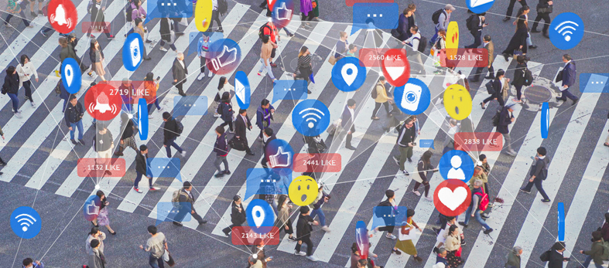
Rețelele sociale și riscurile de securitate ale furnizorilor
Termeni cheie
Notes:
Social media is one area where security teams have faced a steep learning curve. Beyond being used by employees connected to corporate networks, platforms such as LinkedIn, Facebook and Twitter have been harnessed by enterprises as toolkits to conduct brand awareness, customer service, advertising and recruitment processes. However, each user on every platform presents a social media risk for security pros to contend with -- and the risks are plenty.
From social engineering and malicious applications to noncompliance and fraud, organizations must understand the scope and consequences social media.

Slide 21

Rețelele sociale și riscurile de securitate ale furnizorilor
Controlul accesului bazat pe relații:O paradigmă de control al accesului special adaptată rețelelor sociale, conform căreia membrii rețelelor sociale autorizați să acceseze o anumită resursă sunt denumiți în termeni de relațiile la care trebuie să participe pentru a obține accesul.
Notes:
Social media and social networking or messaging applications can pose a number of security and privacy risks to both organizations and individuals when used in an inappropriate or unsafe manner.
Relationship-Based Access Control: An access control paradigm specifically tailored to social networks, according to which social network members authorized to access a given resource are denoted in terms of the relationships they must participate in to get the access.

Slide 22
Rețelele sociale și riscurile de securitate ale furnizorilor
Rețea socială :
O rețea de lume mică constând dintr-un set de indivizi (persoane, grupuri, organizații) conectați prin relații personale, de muncă sau de încredere. De obicei modelat ca un grafic, unde nodurile corespund membrilor rețelei sociale, în timp ce marginile denotă relațiile existente între ele.
Notes:
Social Network: A small-world network consisting of a set of individuals (persons, groups, organization) connected by personal, work, or trust relationships. Usually modelled as a graph, where nodes correspond to social network members, whereas edges denote the relationships existing between them.

Slide 23
Rețelele sociale și riscurile de securitate ale furnizorilor
Retele sociale.
Comunicarea și împărtășirea informațiilor cu cei din jurul nostru face parte din viața fiecăruia și a evoluat de la simple mesaje text la e-mailuri și la ceea ce numim acum platforme de social media. Ceea ce nu este foarte bine cunoscut sau realizat este faptul că expunerea noastră în mediul online vine cu o mulțime de riscuri.
Notes:
Social networks. Communicating and sharing information with those around us is a part of everyone's life and has evolved from simple text messages to emails and to what we now call social media platforms. What is not very well known or realized is the fact that our exposure in the online environment comes with a lot of risks.

Slide 24
Rețelele sociale și riscurile de securitate ale furnizorilor
Controlul accesului în funcție de confidențialitate :
În contextul rețelelor sociale, denotă o paradigmă de control al accesului în care cerințele de control al accesului ale membrilor rețelelor sociale sunt aplicate fără a dezvălui informații private despre relațiile la care participă.
Rețeaua socială bazată pe web :
Un sistem bazat pe web care permite membrilor săi înregistrați să stabilească relații cu alți membri și să partajeze diferite tipuri de informații (de exemplu, date personale, contacte, resurse multimedia).
Notes:
Other key terms are
Privacy-Aware Access Control
Web-Based Social Network

Slide 25
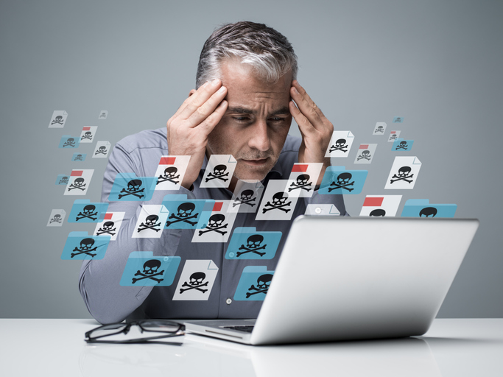
Rețelele sociale și riscurile de securitate ale furnizorilor
Analiza rețelelor sociale :
O disciplină care vizează colectarea datelor statistice din analiza topologiei rețelelor sociale.
Perturbarea marginilor :
Tehnica de anonimizare a graficelor care vizează ascunderea relațiilor reale de rețea socială prin efectuarea unui set de ștergeri/inserții aleatorii ale marginilor în graficul rețelei.
Notes:
Other key terms are
Privacy-Aware Access Control
Web-Based Social Network
Social Network Analysis
Edge Perturbation
Social Network Relationship
And many more – like Graph Anonymization: Technique aimed at hiding private information about social network members when performing social network analysis. Node anonymization and edge perturbation are the two main graph anonymization techniques currently used.
Also, the term Node Anonymization, which is a Graph anonymization technique aimed at hiding social network members’ identities by labelling the corresponding nodes with random identifiers (naïve anonymization), or, in case nodes are associated with attributes which can be used to identify the corresponding user, by using techniques based on k-anonymity.

Slide 26

Rețelele sociale și riscurile de securitate ale furnizorilor
Relația de rețea socială :
O relație cu doi membri ai unei rețele de socializare. În WBSN, pe lângă relațiile personale/de muncă (de exemplu, prieten/coleg), pot fi acceptate și relațiile de încredere care indică cât de mult are încredere un membru în altul. În reprezentarea grafică a unei rețele sociale, relațiile sunt de obicei notate prin margini, etichetate cu un tip de relație și/sau un nivel de încredere în relație.
Notes:
Social Network Relationship
And many more – like Graph Anonymization: Technique aimed at hiding private information about social network members when performing social network analysis. Node anonymization and edge perturbation are the two main graph anonymization techniques currently used.
Also, the term Node Anonymization, which is a Graph anonymization technique aimed at hiding social network members’ identities by labelling the corresponding nodes with random identifiers (naïve anonymization), or, in case nodes are associated with attributes which can be used to identify the corresponding user, by using techniques based on k-anonymity.

Slide 27
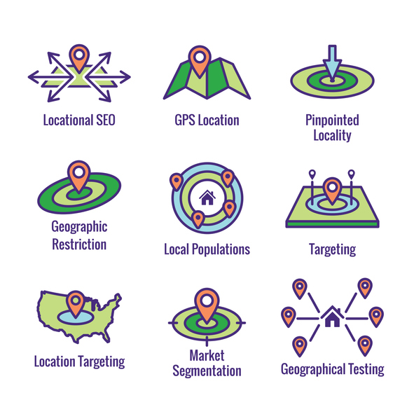
Rețelele sociale și riscurile de securitate ale furnizorilor
Riscuri, 1
Geoetichetarea
• Reprezintă adăugarea de date de identificare geografică la fotografii, videoclipuri, site-uri web și mesaje text de către aplicații care vă pot citi locația sau care au voie să facă acest lucru în setările dvs.;
• Asigurați-vă că dezactivați funcțiile de geoetichetare în locații sensibile pentru a evita dezvăluirea locației dvs. exacte, unde lucrați sau unde locuiți.
Notes:
Geotagging is the process of appending geographic coordinates to media based on the location of a mobile device. Geotags can be applied to photos, videos, websites, text messages, and QR codes, and could also include time stamps or other contextual information.
Why is Geotagging Important?
Geotagging provides helpful insight into consumer activity. By using geotags to analyze where and how consumers interact with their brands, organizations can provide specialized offers and messaging. Geotags also reveal where individuals are when engaging with a website, or where they move throughout the day with their mobile device.

Slide 28
Rețelele sociale și riscurile de securitate ale furnizorilor
Riscuri,2
" Public "
• Este un termen general care se referă la cine poate să vadă și/sau să comenteze postările tale;
• Grupul tău de prieteni se poate schimba oricând și poate vedea o postare care conține informații despre tine. S-ar putea să le împărtășiți în mod intenționat „prietenilor”, dar ceea ce fac aceștia cu postarea este în afara controlului dumneavoastră personal.
Notes:
"Audience“ is a general term that refers to who is able to see and/or comment on your posts.

Slide 29

Rețelele sociale și riscurile de securitate ale furnizorilor
Riscuri, 3
Identitate
• Descrie gama de informații care se referă în mod specific la o persoană;
• Trebuie reținut că există persoane care folosesc rețelele sociale ca metodă de cercetare pentru a căuta informații de identitate, cu posibile intenții rău intenționate, cum ar fi furtul de identitate, frauda, delapidarea sau intimidarea.
Notes:
The term “identity” is defined as “The effort to recognize and understand individual audience members (including customers, prospects, and other visitors) across channels and devices such that brands can interact with those individuals in ways that are relevant to, meaningful to, and supportive of overarching business objectives.” Businesses can benefit from greater customer engagement and loyalty by providing customers with a platform that keeps their shared information safe. Customers, on the other hand, get the assurance of a secure and confidential experience.

Slide 30
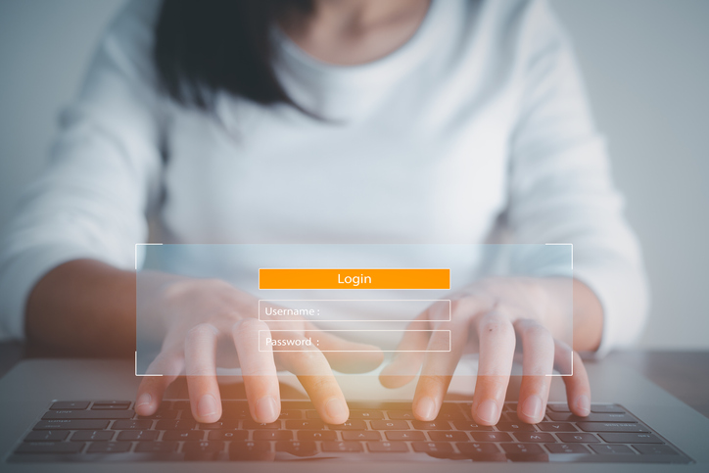
Măsuri - Îmbunătățirea securității cibernetice
Parola
• Este recomandat să utilizați o parolă diferită pentru fiecare cont online;
• Ar trebui să aibă cel puțin 10 caractere și să conțină litere mari, litere mici, cifre și caractere speciale;
• Nu trebuie dezvăluit nimănui, indiferent cât de apropiată sau de încredere este persoana pe care vrem să o spunem;
To be continued
Notes:
Password
• It is recommended to use a different password for each online account;
• It should be at least 10 characters long and contain uppercase letters, lowercase letters, numbers and special characters;
• It must not be disclosed to anyone, no matter how close or trusted the person we want to tell is

Slide 31
Măsuri - Îmbunătățirea securității cibernetice
Parola
• Se recomandă să nu folosiți informații personale la crearea unei parole (ex: numele părinților, data nașterii, numele animalului de companie etc.);
• Schimbați-vă parola periodic;
• Deconectați-vă de la cont atunci când utilizați un dispozitiv care nu este al dvs. sau este folosit de altcineva.
Notes:
Password
• It is recommended not to use personal information when creating a password (eg: parents' names, date of birth, pet's name, etc.);
• Change your password periodically;
• Sign out of your account when you're using a device that's not yours or is being used by someone else.

Slide 32
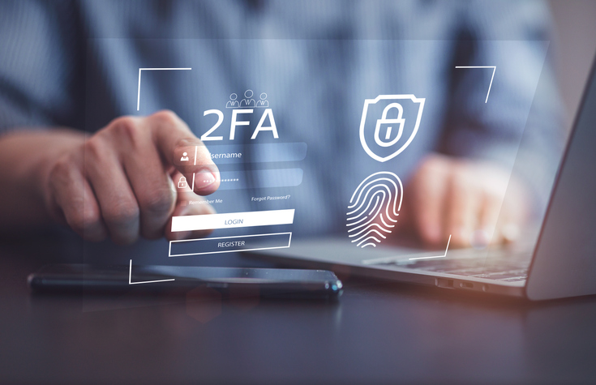
Măsuri - Îmbunătățirea securității cibernetice
Faceți actualizările de securitate la timp!
• Platformele de social media introduc în mod regulat noi setări de confidențialitate și securitate. Acestea pot fi găsite în setările contului și este recomandat să le verificați în mod regulat;
• Utilizați opțiunea de autentificare cu doi factori (2FA) pentru a vă asigura că cineva nu încearcă să vă pirateze contul.
Notes:
Do your security updates on time!
• Social media platforms regularly introduce new privacy and security settings. These can be found in your account settings and it is recommended that you check them regularly;
• Use the two-factor authentication (2FA) option to make sure someone isn't trying to hack your account.

Slide 33
Măsuri - Îmbunătățirea securității cibernetice
Nu accepta cereri de prietenie de la nimeni!
• Acceptați sau trimiteți cereri de prietenie numai de la/către persoane pe care le întâlniți în viața reală sau către persoane publice care vă interesează, având grijă să le urmăriți profilurile oficiale;
• NU UITA! Dacă te simți atașat de anumite conturi, le poți restricționa accesul la postările tale sau poți bloca contul.
• NU faceți clic!
Notes:
Do not accept friend requests from anyone!
• Accept or send friend requests only from/to people you meet in real life or to public people you are interested in by taking care to follow their official profiles;
• DO NOT FORGET! If you feel attached to certain accounts you can restrict their access to your posts or you can block the account. You also have the option to report accounts or posts for reasons such as: fake account, fake name, posts with inappropriate content, incitement to violence, false information, etc.
• DO NOT click!
• Many attackers use social engineering to gain a person's trust in order to later gain access to information;
• Do not open links and attachments from social media if you are not 100% sure of the source (e.g. websites offering prizes are often intended to steal information);
• If from the chats, a friend seems to be behaving differently (asks a lot of questions, becomes very curious about his personal life, asks for money) there is a possibility that his account has been hacked and an attacker is using it for malicious purposes.

Slide 34

Măsuri - Îmbunătățirea securității cibernetice
Gândește-te de două ori înainte de a posta!
• Social media oferă la fel de mult o oportunitate de a crea o reputație online pozitivă ca și una negativă, în plus, chiar dacă „ștergem” o postare, odată ce a apărut online aceasta nu poate fi ștearsă definitiv;
• Nu dezvălui prea multe detalii personale pe rețelele de socializare! Câmpurile „Despre mine” sunt opționale.
Notes:
Think twice before posting!
• Social media offers as much an opportunity to create a positive online reputation as a negative one, in addition, even if we "delete" a post, once it has appeared online it cannot be permanently deleted;
• Don't reveal too many personal details on social media! "About Me" fields are optional.

Slide 35

Măsuri - Îmbunătățirea securității cibernetice
• Granița dintre viața profesională și cea personală în mediul online
• Nu dezvăluiți online informații despre angajatorul dvs
• Nu postați fotografii de serviciu sau mesaje negative care pun angajatorul într-o lumină proastă.
• Gândește-te înainte de a posta și nu-ți risca jobul.
Notes:
Again, Think twice before posting!
• The boundary between professional and personal life in the online environment
• Do not disclose information about your employer online
• Don't post work photos or negative messages that put the employer in a bad light.
• Think before you post and don't risk your job.

Slide 36
Măsuri - Îmbunătățirea securității cibernetice
Închideți conturile vechi!
• Dacă aveți conturi vechi pe platformele de socializare pe care nu le mai folosiți, sau chiar conturi vechi pe aceeași platformă, încercați să le închideți. În acest fel creați cât mai puține link-uri, conturile curente fiind mai protejate de posibili atacatori;
• Este posibil ca conturile sau platformele mai vechi să nu fie la fel de sigure ca cele de astăzi.
Notes:
Close old accounts!
• If you have old accounts on social media platforms that you no longer use, or even old accounts on the same platform, try to close them. In this way you create as few links as possible with current accounts being more protected from possible attackers;
• Older accounts or platforms may not be as secure as today's.

Slide 37
Măsuri - Îmbunătățirea securității cibernetice
Rețelele de socializare prezintă mari riscuri
• Rețelele sociale prezintă riscuri mari Rețelele sociale prezintă riscuri ridicate de securitate și confidențialitate datorită arhitecturii lor centralizate, a depozitului lor uriaș de informații de identificare personală pe care orice hacker și-ar plăcea să le aibă și a ignoranței generale a populației cu privire la modul de utilizare adecvată a rețelelor sociale. setări de confidențialitate pentru a le îmbunătăți siguranța online.
Notes:
Social media poses great risks
• Social networks pose high security and privacy risks due to their centralized architecture, their huge store of personally identifiable information that any hacker would love to have, and the general ignorance of the population about how to properly use social media. privacy settings to improve their online safety.

Slide 38
Măsuri - Îmbunătățirea securității cibernetice
Rețelele de socializare prezintă mari riscuri
• Un alt risc foarte mare, în special în rândul adolescenților, este încrederea în alte persoane și tipul de informații personale dezvăluite online.
• Acest lucru poate fi combatet prin mijloace tehnologice și prin aplicarea politicilor de securitate.
Notes:
Social media poses great risks
• Social networks pose high security and privacy risks due to their centralized architecture, their huge store of personally identifiable information that any hacker would love to have, and the general ignorance of the population about how to properly use social media. privacy settings to improve their online safety.
• Another very high risk, especially among teenagers, is trusting other people and the type of personal information disclosed online.
• This can be combated through technological means and the enforcement of security policies.
• We should consider information transmitted through social media to be insecure and therefore not transmit sensitive information through social media, thus the primary responsibility to stay safe rests with the USER

Slide 39
Măsuri - Îmbunătățirea securității cibernetice
Rețelele de socializare prezintă mari riscuri
• Ar trebui să considerăm că informațiile transmise prin intermediul rețelelor sociale sunt nesigure și, prin urmare, nu transmitem informații sensibile prin intermediul rețelelor sociale, astfel că responsabilitatea principală de a rămâne în siguranță revine UTILIZATORULUI
Notes:
Social media poses great risks
• Another very high risk, especially among teenagers, is trusting other people and the type of personal information disclosed online.
• This can be combated through technological means and the enforcement of security policies.
• We should consider information transmitted through social media to be insecure and therefore not transmit sensitive information through social media, thus the primary responsibility to stay safe rests with the USER

Slide 40
Măsuri - Îmbunătățirea securității cibernetice
Obiceiuri proaste în rețelele sociale
• Rețelele sociale sunt platforme utilizate pe scară largă de utilizatori în prezent. Avem o gamă largă de posibilități disponibile.
• Unii sunt mai orientați spre încărcarea de fotografii sau videoclipuri, alții spre părerea noastră și în alte cazuri pur și simplu pentru a păstra legătura cu prietenii și familia. În orice caz, avem de-a face cu platforme care au mulți utilizatori în întreaga lume.
Notes:
Bad social media habits
• Social networks are widely used platforms by users today. We have a wide range of possibilities available.
• Some are more geared towards uploading photos or videos, others towards our opinion and in other cases simply to keep in touch with friends and family. In any case, we are dealing with platforms that have many users around the world.
• This also makes hackers set their sights here. We will talk about these habits that should be changed in social networks if we want to keep our privacy and security.
• There are many types of platforms that we can find on the network that give us the opportunity to send messages to friends or family, commenting on photos, videos ...
• This makes them a very popular environment for both private users and businesses.
• However, this also causes you to have some risk to our security and privacy. Hackers can watch here to carry out their attacks. They can especially take advantage of bad user habits when using these platforms.

Slide 41
Măsuri - Îmbunătățirea securității cibernetice
Obiceiuri proaste în rețelele sociale.
• Acest lucru îi face și pe hackeri să-și pună ochiul aici. Vom vorbi despre aceste obiceiuri care ar trebui schimbate în rețelele sociale dacă vrem să ne păstrăm confidențialitatea și securitatea.
• Există multe tipuri de platforme pe care le putem găsi în rețea care ne oferă posibilitatea de a trimite mesaje prietenilor sau familiei, comentând fotografii, videoclipuri ...
Notes:
Bad social media habits
• Social networks are widely used platforms by users today. We have a wide range of possibilities available.
• Some are more geared towards uploading photos or videos, others towards our opinion and in other cases simply to keep in touch with friends and family. In any case, we are dealing with platforms that have many users around the world.
• This also makes hackers set their sights here. We will talk about these habits that should be changed in social networks if we want to keep our privacy and security.
• There are many types of platforms that we can find on the network that give us the opportunity to send messages to friends or family, commenting on photos, videos ...

Slide 42
Măsuri - Îmbunătățirea securității cibernetice
Obiceiuri proaste în rețelele sociale
• Acest lucru le face un mediu foarte popular atât pentru utilizatorii privați, cât și pentru companii.
• Cu toate acestea, acest lucru vă determină și să aveți un anumit risc pentru securitatea și confidențialitatea noastră. Hackerii pot urmări aici pentru a-și duce atacurile. Ei pot profita în special de obiceiurile proaste ale utilizatorilor atunci când folosesc aceste platforme.
Notes:
• This makes them a very popular environment for both private users and businesses.
• However, this also causes you to have some risk to our security and privacy. Hackers can watch here to carry out their attacks. They can especially take advantage of bad user habits when using these platforms.

Slide 43
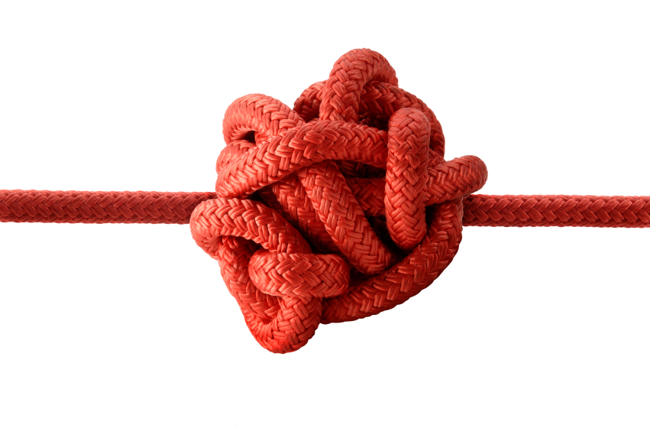
Măsuri - Îmbunătățirea securității cibernetice
Obiceiuri care trebuie schimbate.
• Confidențialitatea și securitatea sunt factori foarte importanți pentru utilizatori.
• Cu toate acestea, ei nu sunt întotdeauna prezenți.
• Putem fi victimele multor tipuri de atacuri care compromit acești doi factori.
• De asemenea, putem face greșeli atunci când folosim rețelele sociale și ne afectează.
Notes:
Habits that need to be changed
• Privacy and security are very important factors for users.
• However, they are not always present.
• We can be victims of many types of attacks that compromise these two factors.
• We can also make mistakes when using social media and it affects us.

Slide 44
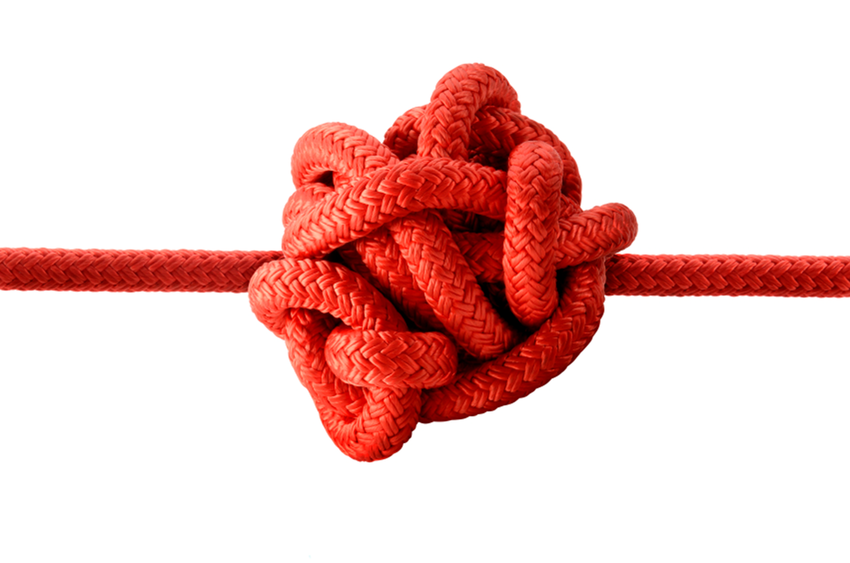
Măsuri - Îmbunătățirea securității cibernetice
Adăugați orice tip de contact.
• O eroare foarte comună în rețelele sociale este adăugarea oricărui tip de contact. Acest lucru se poate întâmpla pe platforme precum Facebook.
• Este posibil ca ceea ce adăugăm să fie mai degrabă un bot decât un utilizator real.
• Trebuie să știi cum să le diferențiezi și să eviți să adaugi orice tip de contact pe care îl primește invitația ta.
Notes:
Add any type of contact
• A very common error in social networks is adding any type of contact. This can happen on platforms like Facebook.
• It is possible that what we are adding is a bot rather than a real user.
• You need to know how to differentiate them and avoid adding any type of contact that your invite receives.

Slide 45
Măsuri - Îmbunătățirea securității cibernetice
Adăugați orice tip de contact(2)
• Uneori, boții sunt proiectați exclusiv pentru a colecta date despre utilizatori. Acest lucru ne poate compromite confidențialitatea. Trebuie să avem un filtru real asupra contactelor pe care le adăugăm.
• Este important ca printre prietenii noștri să avem oameni care nu reprezintă o problemă pentru securitatea și confidențialitatea noastră.
Notes:
• Sometimes bots are designed solely to collect user data. This may compromise our privacy. We need to have a real filter on the contacts we add.
• It is important that we have people among our friends who are not a problem for our security and privacy.

Slide 46
Măsuri - Îmbunătățirea securității cibernetice
Nu vă conectați la rețelele sociale de oriunde.
• Te autentifici adesea prin intermediul rețelelor sociale de pe orice site. Este foarte confortabil, dar nu este cel mai bun pentru confidențialitate.
• Cu siguranță în multe ocazii găsim posibilitatea de a ne înregistra pe o pagină sau de a ne conecta la o platformă prin Facebook sau Twitter. Evităm să ne înregistrăm pe acel site și să completăm un formular lung.
Problema este că furnizăm date personale acelui site prin intermediul Facebook. Aceste date/informații pe care le împărtășim pot fi folosite de terți în scopuri publicitare.
Notes:
Don't connect with social networks from anywhere
• You often log in through social networks on any site. This is very comfortable, but not the best for privacy.
• Certainly on many occasions we find the possibility to register on a page or to connect to a platform through Facebook or Twitter. We avoid registering on that site and filling out a long form. The problem is that we provide personal data to that website through Facebook. This data / information we share can be used by third parties for advertising purposes.

Slide 47

Măsuri - Îmbunătățirea securității cibernetice
Nu furnizați mai multe informații decât este necesar.
• Este cu siguranță unul dintre cele mai rele obiceiuri pe care le au mulți utilizatori. Ei introduc o mulțime de date personale, informații care nu sunt cu adevărat necesare, în rețelele de socializare.
• De exemplu, date precum numărul nostru de telefon, adresa de e-mail, informații despre locul în care locuim... Toate acestea ne afectează publicitatea și ar putea fi folosite în scopuri rele..
Notes:
Do not provide more information than necessary
• It is definitely one of the worst habits that many users have. They enter a lot of personal data, information that is not really necessary, into social networks.
• For example, data such as our phone number, email address, information about where we live ... All this affects our advertising and could be used for bad purposes.
• Don't give more information than is really necessary. In this way we will improve our privacy in the network, and we can even avoid certain security problems.
Psychology discipline
• It is necessary to understand the concept and understand the thoughts and behaviours of both the attacker and the victim.
• The methods are important for social engineering because they are used to bypass protections that may be in place, such as firewalls and systems used to identify intruders.
• It helps to understand employee actions that are one of the main causes of data breaches.

Slide 48
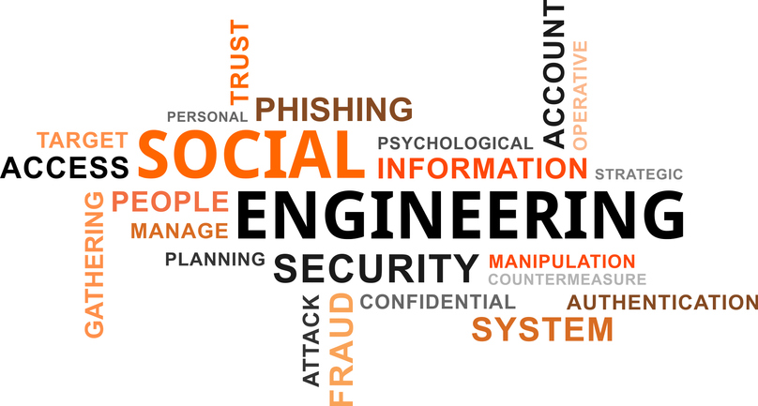
Măsuri - Îmbunătățirea securității cibernetice
Ingineria socială dintr-o perspectivă interdisciplinară.
Datorită tehnicii folosite de hackeri, este necesar să se abordeze o perspectivă interdisciplinară precum tehnologia informației, psihologia, afacerile și etica.
Notes:
We do not protect our privacy
• A final mistake is not properly protecting privacy. For example, we leave our profiles open for anyone to enter.
• We provide information to anyone who might collect it to create a profile for us and even send targeted advertising or perform various attacks that affect our security.
Social engineering from an interdisciplinary perspective
Due to the technique used by hackers, it is necessary to approach an interdisciplinary perspective such as information technology, psychology, business and ethics.

Slide 49
Măsuri - Îmbunătățirea securității cibernetice
Disciplina tehnologiei informației.
• Ingineria socială ar trebui să fie discutată în contextul sistemelor informaționale actuale și apărarea lor utilizată ca formă de atenuare a riscurilor.
• Autentificarea cu mai mulți factori este o modalitate comună și adesea eficientă pentru organizații de a confirma că persoana care accesează sistemele ar trebui să aibă de fapt acel acces
• Un factor suplimentar ar putea fi utilizarea unei rețele private virtuale (VPN), adică autentificarea pentru a valida în continuare utilizatorul.
Notes:
The discipline of information technology
• Social engineering should be discussed in the context of current information systems and their defence used as a form of risk mitigation.
• Multi-factor authentication is a common and often effective way for organizations to confirm that the person accessing systems should actually have that access
• An additional factor could be the use of a virtual private network (VPN), i.e. authentication to further validate the user.

Slide 50
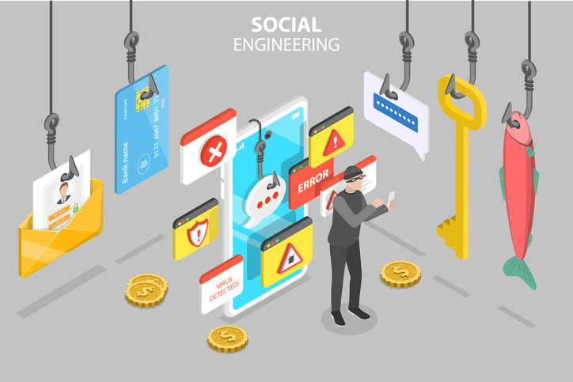
Măsuri - Îmbunătățirea securității cibernetice
Perspectiva afacerii.
• este important deoarece ingineria socială poate afecta multe tipuri de afaceri și poate avea implicații asupra modului în care sunt structurate și gestionate organizațiile.
• ajută la determinarea factorilor care influențează atacurile de inginerie socială și este benefică dacă este luată în considerare în termeni mai specifici în raport cu următoarele domenii de afaceri: instruire și dezvoltare, politici documentate, proceduri de audit intern, bugete și cultură organizațională.
• poate detecta deficiențe în oricare dintre zonele care pot contribui la atacuri.
Notes:
Business perspective
• it is important because social engineering can affect many types of businesses and have implications for how organizations are structured and managed.
• it helps determine the factors that influence social engineering attacks and is beneficial if considered in more specific terms in relation to the following business areas: training and development, documented policies, internal audit procedures, budgets and organizational culture.
• can detect deficiencies in any of the areas that may contribute to attacks.

Slide 51
Măsuri - Îmbunătățirea securității cibernetice
Perspectivă etică.
• este important în contextul ingineriei sociale și al cercetării aferente, deoarece ideea de a manipula o altă ființă umană încalcă multe principii etice.
• ajută, în cazul unui eveniment de inginerie socială, la tratarea victimelor.
Notes:
Ethical perspective
• it is important in the context of social engineering and related research because the idea of manipulating another human being violates many ethical principles.
• helps, in the case of a social engineering event, to treat the victims.
It is important to consider:
• each discipline, providing information on how to understand and interpret the subject, protect against different types of attacks, and understand the impact of social engineering from both a human and organizational perspective.
• that each discipline's interpretation of the subject is useful only when viewed in the context of the other disciplines.

Slide 52
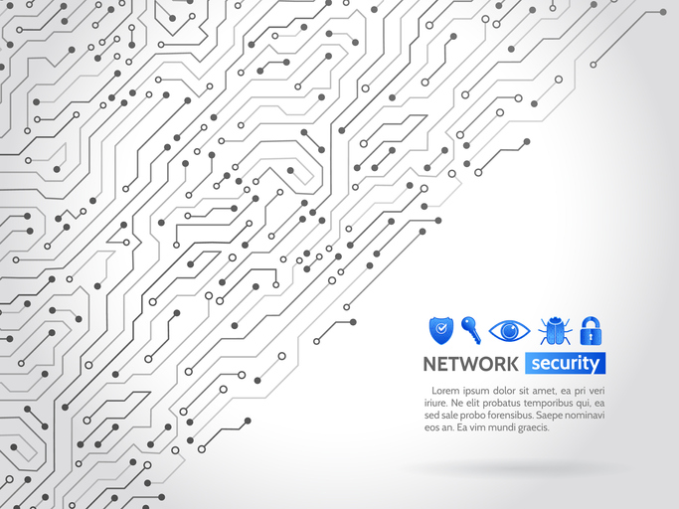
Tehnici de securitate
• Inventarul echipamentelor
• Inventarul de aplicații și sisteme de operare
• Controlul echipamentelor fără fir
• Proiectarea securității rețelei
• Limitarea și controlul porturilor de rețea, protocoalelor de comunicație și serviciilor
Notes:
Security techniques
• Equipment inventory
• Inventory of applications and operating systems
• Wireless equipment control
• Network security design
• Limiting and controlling network ports, communication protocols and services

Slide 53
Tehnici de securitate
• Protecția zonelor perimetrale
• Acces fizic la locații
• Utilizarea controlată a privilegiilor administrative
• Monitorizarea si controlul conturilor de utilizator
• Evaluarea competențelor și formarea în securitate
Notes:
• Protection of perimeter areas
• Physical access to locations
• Controlled use of administrative privileges
• Monitoring and controlling user accounts
• Skills assessment and security training

Slide 54
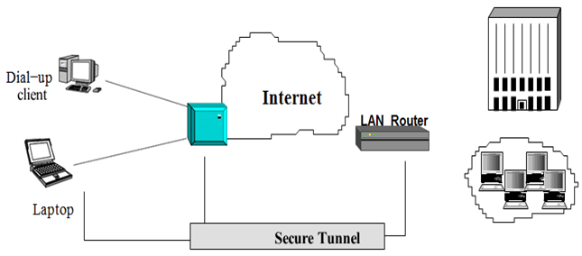
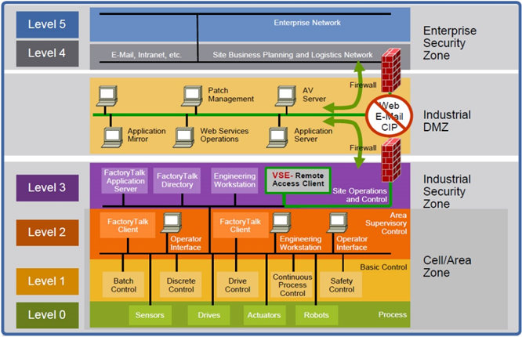
VPN
VPN (Virtual Private Network)
O rețea privată virtuală este o conexiune sigură printr-o rețea nesigură, cum ar fi Internetul. Virtual înseamnă existența unei rețele unice, a unui grup de calculatoare distribuite geografic care comunică și pot fi administrate ca o singură rețea.
Privat înseamnă o rețea virtuală cu control acces.
VPN for remote access
Creating a secure industrial infrastructure
Notes:
VPN (Virtual Private Network)
A virtual private network is a secure connection over an insecure network such as the Internet. Virtual means the existence of a unique network, regardless of topology, that is, a group of geographically distributed computers that communicate and can be administered as a single network.
Private means a virtual network with access control. which provides confidentiality, the integrity of messages and authenticates between the users and the computers participating in the communication.
Defense-in-Depth (DiD) supports this approach. Based on the notion that a single point of protection can and likely will be defeated, DiD security establishes multiple layers of protection through a combination of physical, electronic and procedural safeguards.
• A bank uses multiple security measures—such as video cameras, a guard, and a vault—this helps ensure that threats meet more than one line of defense.
• A security-in-depth approach comprises six main components:
1. Policies and Procedures
2. Physical
3. Network
4. Computer
5. Application
6. The device

Slide 55
Întrebări :
Întrebări Forumul de discuții la care se răspunde cu o scurtă explicație. Răspunsurile vor fi discutate cu mentorul în timpul sesiunilor de mentorat.
1. Care sunt riscurile în rețelele sociale
2. Măsuri pentru a avea Securitate și Confidențialitate în Rețelele Sociale
3. Care sunt principalele tehnici de securitate în rețelele sociale
Întrebări de autoevaluare. După ce răspunde, cursantul poate vedea rezultatele și le poate compara cu cele salvate pe platformă.
• Riscuri în rețelele sociale
• Securitate și confidențialitate în rețelele sociale
• Tehnici de securitate

Slide 56
Vă mulțumim pentru atenție
Notes:
Thank you for your attention

