Slide 1


Information Security
Unit-2 Week-4

Slide 2
1- Assess Management of
Information Security
In the first stage of asset management, it would be useful to first reveal and list what assets we have. What an institution has or does not have should be known first. Then their ownership needs to be defined. No business or transaction should be left unattended. Then, the rules for the use of these assets should be determined.
For the details of the subject, the ISO27002 standard should be examined. The expectations regarding Asset management in ISO27002 are included in the 8th article of the standard:
Asset management and liability for assets
Purpose: To identify the organization's assets and define appropriate protection responsibilities.

Slide 3
A-Asset inventory
Control: Assets related to information and information processing facilities should be identified and an inventory of these assets should be made and maintained.
Application guide: An organization should identify relevant assets in the information lifecycle and document their importance. The information lifecycle should include creation, processing, storage, transmission, deletion and destruction. Documentation should be maintained in accordance with existing inventories or specifically.
Asset inventory; must be current, consistent, accurate and compatible with other inventories.
Asset ownership should be allocated for each identified asset (see Article 2) and its class should be determined.
Other informations: Asset inventory helps to provide effective protection and may also be necessary for other purposes such as health and safety, insurance or financial (asset management) reasons.
The ISO/IEC 27005[11] standard provides examples of assets that may need to be considered by the organization when identifying assets. The process of compiling an asset inventory is an important prerequisite for risk management (see ISO/IEC 27000 and ISO/IEC 27005[11]).

Slide 4
B- Ownership of assets
Control: Owner assignments must be made for all assets held in inventory.
Application guide: Individuals and other entities with approved management responsibility for the asset lifecycle are eligible to be designated as asset owners.
A process is often used to ensure that asset ownership is determined in a timely manner. Ownership must be determined when assets are created or transferred to the organization. The asset owner should be responsible for the proper management of the asset throughout the asset lifecycle.
Asset owner:
  a) Ensure that asset inventory is recorded,
  b) Ensure that assets are properly classified and protected,
  c) Define and periodically review restrictions on access to significant assets and their classification, taking into account the applicable access control policy,
  d) Ensure that appropriate action is taken in deleting or destroying assets.
Other informations: It can be an individual or entity with approval for management responsibility to control an asset throughout its lifecycle. The identified owner has no ownership interest in the asset. Routine tasks may be delegated but the responsibility rests with the asset owner.

Slide 5
C- Acceptable use of assets
Control: Rules regarding the acceptable use of information and assets related to information and information processing facilities should be determined, documented and implemented.
Application guide: Employees and external users who use or have access to the organization's assets should be made aware of the information security requirements of the organization's assets associated with information and information processing facilities and resources. These users should be responsible for the use of all information processing resources and for any use that occurs under their own responsibility.

Slide 6
D- Return of assets
Control: All employees and users of external parties must return all corporate assets in their possession upon termination of employment, contract or agreement.
Application guide: The termination process should be formulated to include the return of ownership of all previously granted physical and electronic assets or escrows of the organization.
When an employee or outside user purchases or uses the organization's equipment, procedures are followed to ensure that all relevant information is transferred to the organization and securely deleted from the equipment.
Where an employee or external user has information that is important to ongoing operations, this information needs to be documented and transferred to the organization.
During the termination notice period, the organization; control the unauthorized copying of related information, such as intellectual property, by terminated employees and contractors.

Slide 7
2. Threat and vulnerability assessment and management
Almost every organization has sensitive and valuable assets that need to be protected. However, not every organization has a comprehensive and fully thought-out strategy for protecting these assets. In cybersecurity, vulnerability management strategies are the foundation of strong defense. Typically, vulnerability management strategies are designed to help an organization's systems, networks, applications, etc. It adopts a holistic and continuous approach to managing security vulnerabilities in these vulnerabilities are then identified, evaluated and fixed as soon as possible.
To identify all potential targets for a breach or attack, its risk must first be mitigated by conducting an asset inventory. The targets must then be classified and continuously monitored for new potential vulnerabilities. A threat model that identifies the organization's most valuable assets at high risk should then be developed and tested.
The primary purpose of the Threat and Vulnerability testing process (assessment) is to best understand the criticality of assets, the vulnerabilities to these assets, and reduce the necessary measures to effectively protect these assets

Slide 8
2.1. What is vulnerability assessment?
Vulnerability assessment is the process of identifying, identifying, classifying, and prioritizing vulnerabilities in computer systems, applications, and network infrastructures.
A vulnerability assessment process aims to identify threats and the risks they pose. Often they involve the use of automated testing tools, such as network security scanners, whose results are listed in a vulnerability assessment report.
Because vulnerabilities can allow hackers to gain access to IT systems and applications, it is critical for organizations to identify and fix vulnerabilities before they are exploited. A comprehensive vulnerability assessment combined with a management program can help companies improve the security of their systems.

Slide 9
2.2. The importance of vulnerability assessments
To better illuminate the importance of vulnerability assessment, let's consider it through the eyes of a physical property owner. If you own a valuable building, you probably take a number of measures to protect it: You maintain it, insure it, and make sure the doors, windows, are locked, and alarms are activated. All of these steps can be termed as managing the risk to the property and its contents.
Now what if you could hire someone to test and report on your alarms and external defenses? Cybersecurity vulnerabilities are approached in a similar way. Vulnerability management is an overarching and ongoing strategy, while vulnerability assessments are a specific tool used in this broader management strategy.
A vulnerability assessment provides an organization with detailed information about any security weaknesses in its environment. It also provides direction on how to assess the risks associated with these weaknesses. This process provides the organization with a better understanding of its assets, security flaws and overall risk, reducing the likelihood of a cybercriminal breaching its systems and catching the business off guard.

Slide 10
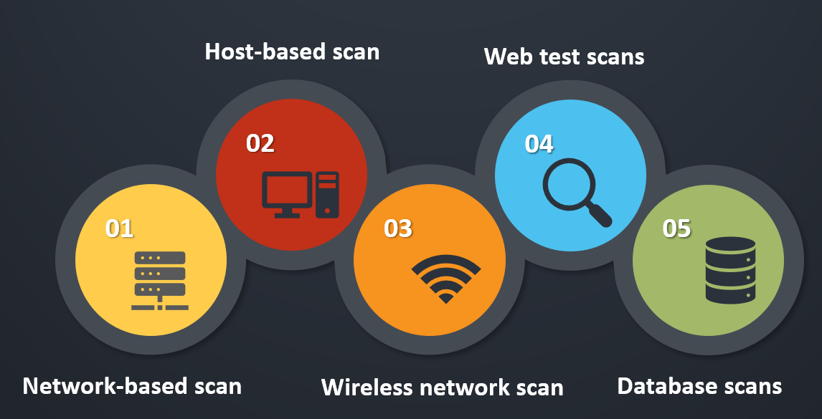
Types of vulnerability assessment

Slide 11
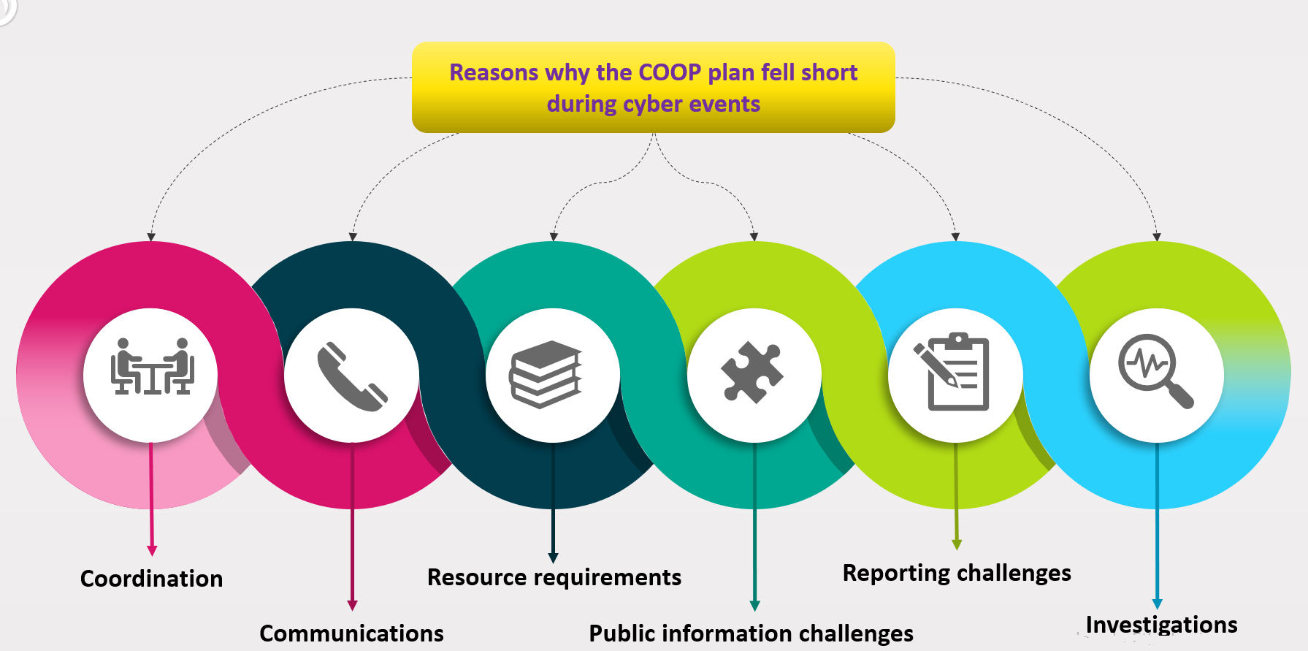
3. Cyber Continuity of
Operations
When cyberattacks do strike, many affected jurisdictions find that that their basic COOP plans don’t hold up. While the plans are adequate for transitioning to an alternate work site, they have much less to offer when it comes to working without access to the systems and data staff need to perform their mission essential functions.

Slide 12
4. Cyber Asset, Change and
Configuration Management
Asset: Let’s start with the definition of an asset. The dictionary definition of an asset is a useful or valuable thing or person.
Configuration Item: Configuration Item is abbreviated as CI and a configuration item is any component that needs to be managed in order to deliver an IT Service. Examples of configuration items are IT services, hardware, software, buildings, people and formal documentation. So briefly, any component or item that helps to deliver an IT service to the customer is classified as a Configuration Item.
Configuration Management Database: Configuration Management database is abbreviated as CMDB. CMDB is a database used to store configuration records throughout their lifecycle. CMDB stores information about your CIs, each distinguished by a unique identifier, including identifying information like its serial number, MAC address or IP address; its current version; its location; and its vendor and supplier information.
Configuration Management System: Configuration Management system is abbreviated as CMS and is a set of tools and databases that are used to manage an IT Service Provider’s Configuration Data. Data about configuration items are stored in configuration records, and configuration records are included in the Configuration Management System Databases. The CMDBs of an IT Service provider to manage the configuration data is included in the service asset and configuration management process

Slide 13
5. Evaluation of cyber security policies effectiveness
Evaluation Security Risks: Risk is defined as the combination of the probabilities of an event and its outcome. Risk assessment, which is a step of risk management, is a process in which risks are defined and the effects and priorities of these identified risks are determined. Risk management is to determine an acceptable level of risk, to evaluate the current risk, to take the necessary steps to reduce this risk to an acceptable level, and to maintain this risk level.
Risk Assessment, after determining which information assets will be protected, the risk assessment method is selected and the risks are defined. According to the chosen risk assessment method, information assets are positioned on the risk map. After the assessment is made, the risk assessment map covers the processes of improving and controlling risks for threats with high impact and probability.

Slide 14
Ideal configuration of information security
Prevention: It is the process that security systems focus on and work the most. Various measures are being developed to insulate the system against threats and attacks against computer systems, such as security measures used in daily life such as fencing a house's garden and using a steel door.
  Periodically reviewing the service packs and updates of the operating system and software,
  Keeping user rights to a minimum, not running unused protocols, services, components and processes,
  Encryption techniques in data transmission, vulnerability scanners,
  Using Virtual Private Network,
  The use of Public Key Infrastructure and e-signature,
  Use a password-protected screen saver on the computer.

Slide 15
Ideal configuration of information security
Determination: Security is not just a matter of prevention. For example, the fact that a museum is well protected, that the museum is surrounded by fences, that the doors are closed and locked, does not necessitate the use of guards at night in that museum. In the same way, the use of methods to detect attack attempts on computer systems is also increased. Prevention is building a barrier that either makes attacks stronger (but not impossible) or discourages (but does not destroy) attackers.
The first and most basic step in detection is to monitor the entire state and movement of the system and to keep records of this information. In this way, data and evidence are also collected for post-attack analysis. Firewalls, intrusion detection systems, network traffic monitors, port scanners, honeypot usage, real-time protection virus and spyware tools, file checksum control programs and network Sniffer sensors are some of the most common methods used in the detection process.

Slide 16
Ideal configuration of information security
AnswerBack: Rapid response emerges as an essential element that complements the security system to repel these attacks. Response can be defined as the execution of actions that will respond immediately or as soon as possible to attack attempts that cannot be dealt with by the prevention process and determined by detection processes. Intrusion detection systems can make sense if there is someone or a system to respond to this detection. Otherwise, this situation does not go beyond the benefit of a car alarm that no one hears and cares about. In this respect, reciprocation is an important link that completes the security process. Even if the attack is not completely prevented; It allows the system to return to its normal state, to identify the causes of the attack, to catch the attacker when necessary, to identify security system vulnerabilities, and to reorganize the prevention, detection and response processes. Planning the actions to be taken when an attack is detected, in advance, will ensure that this process works effectively and will not waste time and money. Disaster recovery is at the forefront of the major worst-case plans undertaken for this phase.

