Slide 1


Sicherheit von Drittanbietern
Referat 3 für Manager 1 - Woche 6

Slide 2


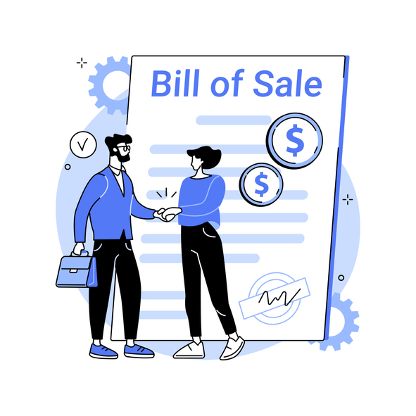
Informationssicherheit für Manager
Name der Einheit (Modul):
Sicherheit von Drittanbietern
Beschaffungsanforderungen beziehen sich auf die Waren und Dienstleistungen, die von Organisationen außerhalb der ausführenden Organisation erworben werden müssen. Aus verschiedenen Gründen sind ausführende Organisationen manchmal auf Lieferanten angewiesen, um die für die Durchführung eines Projekts erforderlichen Leistungen zu erbringen.
Notes:
Procurement requirements refer to the goods and services that must be acquired from organizations outside the performing organization. For a variety of reasons, sometimes performing organizations rely on vendors to provide what’s needed to complete a project.
For example, consider the widget manufacturer that undertakes a project to automate their inventory tracking system. Some of the project work activities involve the relocation of storage bins in their main warehouse. Some of the work activities involve custom software development. As to the software development activities, widget manufacturer doesn’t have a human resource who knows how to develop the software application. Regarding the software development activities, widget manufacturer must procure those services.

Slide 3

WBSNs
Webbasierte soziale Netzwerke (WBSNs) sind Online-Gemeinschaften, die es den Nutzern ermöglichen, Ressourcen (z. B. persönliche Daten, Anmerkungen, Blogs) zu veröffentlichen und Beziehungen zu knüpfen, möglicherweise unterschiedlicher Art für Zwecke, die sich auf Geschäft, Unterhaltung, Religion, Partnersuche usw. beziehen können.
Notes:
Web-based social networks (WBSNs) are online communities that allow users to publish resources (e.g., personal data, annotations, blogs) and to establish relationships, possibly of a different type for purposes that may concern business, entertainment, religion, dating, and so forth.
In the last few years, the usage and diffusion of WBSNs has been increasing, with about 300 Web sites collecting the information of more than 400 million registered users. As a result, the “net model” is today used more and more to communicate, share information, make decisions, and ‘do business’ by companies and organizations.

Slide 4

Drittanbieter
Ein Drittanbieter ist eine Person oder ein Unternehmen, das Dienstleistungen für ein anderes Unternehmen (oder die Kunden dieses Unternehmens) erbringt.
Zusammenarbeit ist der Schlüssel zum Erfolg. Die Zusammenarbeit mit Dritten hilft Unternehmen, ihre Produktivität und Effizienz zu steigern, bessere Produkte und Dienstleistungen zu produzieren, hochqualifizierte Fachkräfte zu beschäftigen und Kosten zu senken.
Notes:
A third party vendor is a person or company that provides services for another company (or that company’s customers). While vendors are considered “third parties,” some industries differentiate a “third-party vendor” specifically as a vendor under written contract, but not all vendors work under a contract. For clarity’s sake, the term “third-party vendor” in this article refers to any individual or company that provides services to another company with or without a contract.
Cooperation is the key to success. Working with third parties helps businesses increase their productivity and efficiency, produce better products and services, employ highly qualified experts, and cut costs. But all these benefits come at the price of increased cybersecurity risks. Minor flaws in your third-party vendor’s security and privacy routines may turn into cybersecurity weaknesses for your company.

Slide 5
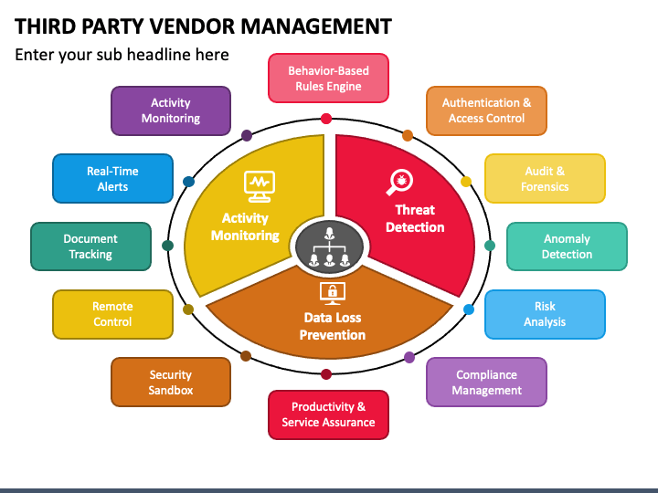
Management von Drittanbietern
Waren und Dienstleistungen, die von
Drittanbieter können sein,
sind aber nicht beschränkt auf:
Cloud-Webhosting-Dienste
Cloud-basierte Software-Lösungen
Wartung der Ausrüstung
Auftragnehmer jeglicher Art
Callcenter-Anbieter
Buchhaltung/Finanzkontrolleure
Anwälte
Notes:
Goods and services obtained from third-party vendors can include, but aren’t limited to:
Cloud web hosting services. A cloud hosting vendor might provide everything from disk space and bandwidth to encryption and high-tech security solutions.
Cloud-based software solutions. SaaS software vendors provide access to software programs either for your business or your customers. For example, marketing automation platforms, CRMs, accounting packages, etc.
Equipment maintenance. The company that fixes your copy machine and the team that manages your network security are third-party vendors.
HVAC servicing. The local HVAC company that services your unit is providing third-party vendor services.
Contractors of any kind. Any contractor, short- or long-term, is a third-party vendor.
Call centre providers. If you host your call centre with another company, it is considered a third-party vendor.
Bookkeeping/financial auditors. Any person or business hired to manage your finances, budget or audit your finances is a third-party vendor.
Lawyers. Sometimes it’s necessary to consult a lawyer before signing contracts or making big purchases. All legal services are considered third-party vendors.

Slide 6
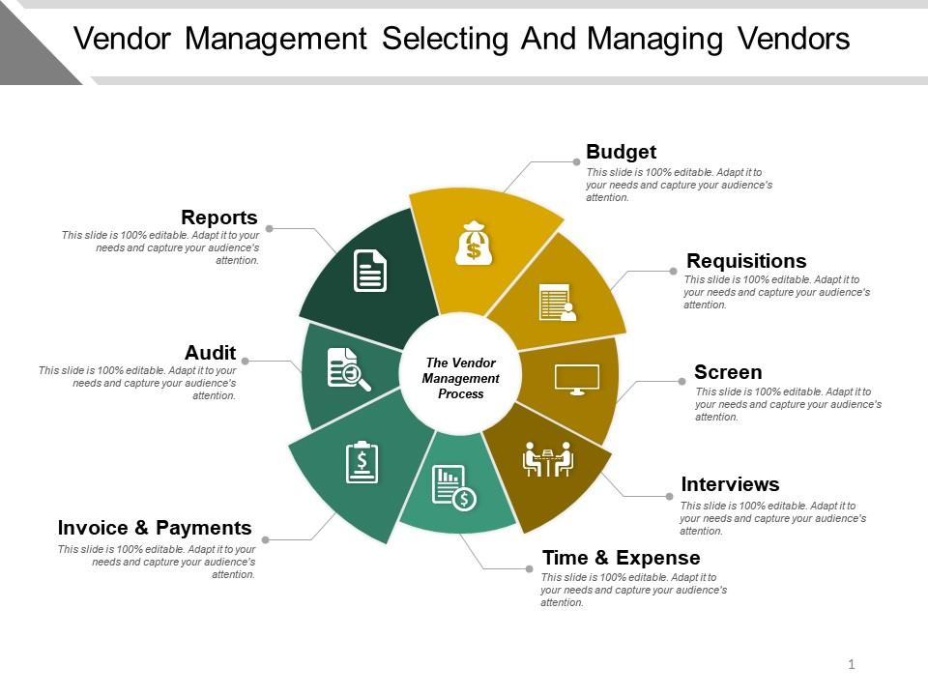
Auswahl und Verwaltung von Anbietern
Was sind die Vorteile des Einsatzes von Drittanbietern für Dienstleister?
Sie werden Zeit sparen
Sie werden Geld sparen
Sie erhalten wertvolles Fachwissen
Notes:
In today’s world, it’s impossible to avoid using third-party vendors. No matter how many departments your company creates, you’ll never cover every service you’ll ever need. Nor should you, as companies must determine the right balance of skills that are essential to the business versus those that can be outsourced.
What are the benefits of using third-party vendors for service providers?
You will save time
Nobody has time to learn every skill or hire every person necessary to run a business. Third-party vendors make business processes run smoothly by obtaining all the professional services required to operate and fulfil orders for your customers
You will save money
Perhaps the biggest benefit is the cost savings. Contracting a third-party provider for work as needed can be significantly less expensive than always having professionals on company payroll. For instance, it’s far less expensive to hire a lawyer when you need one rather than keep a lawyer on retainer.
You will get valuable expertise
Your company doesn’t have time to develop a new team of experts. The time and cost of doing so would be enormous. Hiring a third-party vendor for expertise you don’t have in-house will likely yield better results.

Slide 7
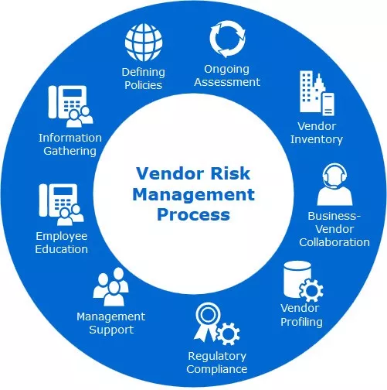
Risikomanagement für Anbieter
Welche Risiken bestehen beim Einsatz von Drittanbietern?
Dritte nehmen die Sicherheit ihres Netzes möglicherweise nicht so ernst, wie Sie es wünschen.
Das größte Risiko besteht in der Wahl eines Drittanbieters, der nicht mit Ihren Sicherheitsstandards übereinstimmt.
Sie brauchen einen Anbieter, der sich mit den Vorschriften auskennt und bereit ist, sie zu erfüllen.
Notes:
As organizations increasingly rely on third-party vendors to provide essential services, they also become more vulnerable to vendor related cybersecurity risks. A recent study found that nearly 60% of companies experienced a data breach due to a third-party vendor in the past year. But what are the most common vendor cyber gaps that organizations should be aware of?
What are the risks of using third-party vendors?
Third parties may not take their network security as seriously as you want them to. Knowing this, hackers may choose not to attack your company directly. Instead, they may look for an easier target among your third-party vendors. A compromised subcontractor can easily be turned into an entry point for cybercriminals.
If your vendors fail to deliver, you will fail to deliver. However, risk is inherent in any business relationship. Using third-party vendors comes with many risks, most of which can be mitigated.
The biggest risk is choosing a third-party relationship that does not align with your security standards. For instance, your network security team needs to follow security protocols that live up to your specific standards. If your company is bound by regulations such as health insurance, you cannot afford to hire a network security company that does not comply with the health insurance regulations. You need a vendor that understands regulations and is willing to adapt to meet those regulations.

Slide 8
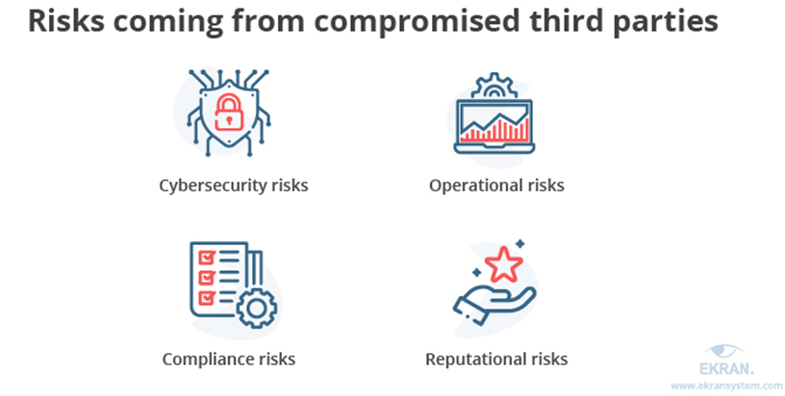
Risikomanagement für Anbieter
DATENSCHUTZVERLETZUNGEN SIND EXTREM STÖREND
BESONDERS WENN ES UM DEN SCHUTZ PERSÖNLICHER DATEN GEHT
Ein gefährdeter Drittanbieter kann zu mehreren Risiken führen
die sich in vier große Kategorien unterteilen lassen:
Notes:
Data breaches are extremely disruptive, especially when you’re protecting personal information. Unfortunately, data breaches are on the rise and are more common than ever before. Data breaches can cause disruptions to operations, devastating financial consequences, legal action and a damaged reputation. To avoid these, you cannot let your guard down when it comes to your own security or that of your vendors.
Depending on the nature of third-party vendor compromise, an organization may face different risks. Let us look at the most common risk categories and the threats you need to be prepared to mitigate. A compromised third-party vendor may lead to multiple risks that can be split into four major categories
Cybersecurity risks — Subcontractors usually have legitimate access to different environments, systems, and data of their clients. Attackers may use a third-party vendor as an entry point to try to get a hold of your valuable assets.
Operational risks — Cybercriminals may target your internal systems and the services you use instead of just your data. This can lead to partial interruptions of your operations or even halt them altogether.
Compliance risks — International, local, and industry-specific standards and regulations set strict cybersecurity criteria that organizations should meet. Furthermore, third parties working with these organizations also have to comply with these requirements. Non-compliance usually leads to substantial fines and reputational damage.
Reputational risks — Having your valuable data and systems compromised serves as a red flag for your partners and customers, both current and future. Regaining their trust will take a lot of time and effort. And unfortunately, there’s no guarantee that you’ll be able to successfully recover your reputation after a severe cybersecurity incident.

Slide 9
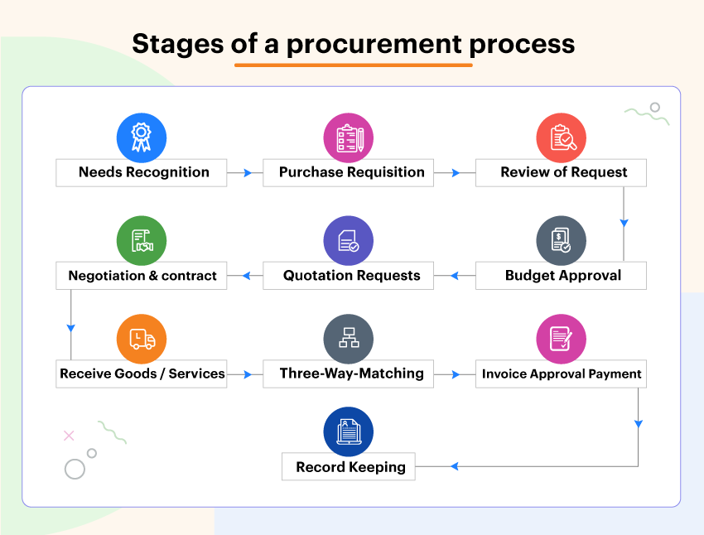
Risikomanagement für Anbieter
Anforderungen an die Auftragsvergabe
Stufe 1: Ermittlung des Bedarfs an Produkten und/oder Dienstleistungen.
Schritt 2: Erstellen und Einreichen eines Kaufantrags.
Stufe 3: Bewertung und Auswahl von Lieferanten/Anbietern.
Phase 4: Verhandlung der Vertragsbedingungen mit dem ausgewählten Anbieter.
Stufe 5: Schließen Sie eine Bestellung ab.
Stufe 6: Auftragsverwaltung
Notes:
For a variety of reasons, sometimes performing organizations rely on vendors to provide what’s needed to complete a project. Especially, the SMEs. Procurement requirements are therefore of utmost importance to work with third party vendor security.
Procurement requirements refer to the goods and services that must be acquired from organizations outside the performing organization. For a variety of reasons, sometimes performing organizations rely on vendors to provide what’s needed to complete a project.
While it’s true that procurement is a highly individualized process, there are also several foundational stages that will generally be utilized across the board.
The first step in the procurement process is to identify requirements. All procurement requirements begin with the perception of a need. The need to cross a body of water could create a requirement to build a bridge, a ferry, or other transportation systems.

Slide 10
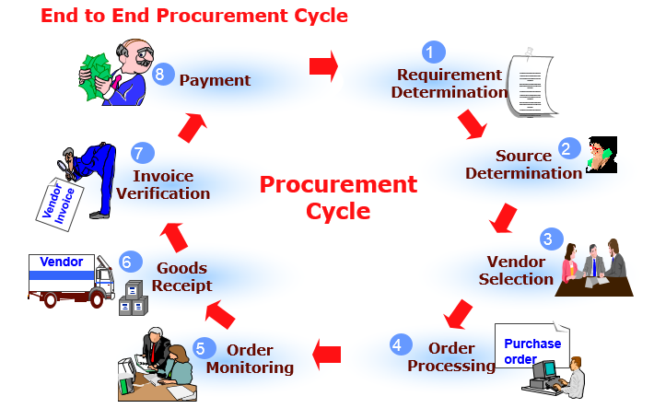
Anforderungen an die Auftragsvergabe
Stufe 1: Ermittlung des Bedarfs an Produkten und/oder Dienstleistungen
Bevor der Beschaffungsprozess beginnen kann, muss ein konkreter Bedarf festgestellt werden.
In dieser Phase ist es notwendig, den Bedarf klar zu definieren
Notes:
Before the procurement process can begin, a specific need must be recognized. For example, an organization may be interested in purchasing new computer monitors, re-ordering their monthly supply of paper products, or acquiring updated software. Depending on the company structure, this step might be managed by the business owners, department heads, executive team, staff, and/or procurement managers. In this stage, a budget will be set and a comprehensive view of spending will often be assessed.
At this stage it is necessary to clearly define the need, and this may be done by way of a study to determine the best mode to cross the body of water (given the present situation and forecasted future need), then the type of bridge to be constructed, or a comparative cost/benefit analysis to determine the best solution between a bridge and other alternatives. The study should include if the need can be satisfied in-house or contracted out, quantification of the initial budgetary estimate, and an idea of the procurement lead-time.

Slide 11

Anforderungen an die Auftragsvergabe
Schritt 2: Erstellen und Einreichen eines Kaufantrags.
Eine Kaufanfrage (oder Bestellanforderung) ist eine förmliche Anfrage für Waren oder Dienstleistungen
Notes:
A purchase request (or purchase requisition) is a formal request for goods or services and is generally submitted using specialized procurement software. Oftentimes, the purchase request will originate with an employee or manager, then be reviewed by the organization’s procurement team.
When a purchase request is approved, it becomes a purchase order. However, should the request be denied, it will typically be returned to the submitter with a brief explanation. A rejected purchase order, while not ideal, can be a good learning opportunity.

Slide 12
Anforderungen an die Auftragsvergabe
Phase 3: Bewertung und Auswahl von Lieferanten/Anbietern
Der nächste Schritt besteht darin, verschiedene Anbieter zu bewerten und dann einen auszuwählen, der die wichtigsten Anforderungen erfüllt.
Die besten Ergebnisse erzielen Sie, wenn Sie das "Gesamtbild" dessen, was ein Anbieter bieten kann, berücksichtigen:
Leichte Kommunikation
Unternehmensethik
Rechenschaftspflicht
Produktionsmöglichkeiten
Notes:
The next step is to assess various vendors, then choose one that meets key requirements. Some organizations maintain a catalogue of approved vendors, featuring various suppliers that have already proven themselves.
Soliciting vendors is a process that can range from simple to complex, with its scope determined by the requirement(s) at hand. Usually, several requests for quotation (RFQ) will be sent to various vendors, so that the organization/procurement team can compare prices and options.
Remember that price should not be the only determinant when choosing a vendor. For best results, consider the “big picture” of what a vendor can offer, including:
Ease of communication
Company ethics
Accountability
Production capabilities
After a vendor has been selected, investing time and energy into the relationship is important. A good relationship with a supplier can unlock better savings and service, delivering maximum value in the long term.

Slide 13
Anforderungen an die Auftragsvergabe
Phase 4: Verhandlung der Vertragsbedingungen mit dem ausgewählten Lieferanten
Notes:
Stage 4: Negotiate the terms of a contract with the selected supplier
Once you have chosen the best-fit vendor, it’s time to move on to contract negotiations. In terms of successful procurement, this is one of the most critical stages by far. It is in this stage that you will outline – and agree to – pricing, as well as details such as delivery schedules, specific terms and conditions, and more. It can often be useful to assess previous contracts to pinpoint opportunities for improvement, allowing you to take a more informed approach going forward.

Slide 14
Anforderungen an die Auftragsvergabe
Stufe 5 und Stufe 6: Verwaltung der Aufträge
Bei der Lieferung von Waren/Dienstleistungen sollte es eine verantwortliche Person geben, idealerweise der Endnutzer des Produkts oder der Dienstleistung, die überprüft, ob alle Standards in Bezug auf Lieferfristen, Produktmengen und Qualität usw. eingehalten wurden.
Notes:
Stage 5 and 6: Finalize a purchase order / Order management
As the goods/services are delivered, there should be someone responsible, ideally the end-user of the product or services, for checking that all standards have been met delivery deadlines, product quantities, and quality, etc. If there are issues with the items (e.g. damaged products), you have the option to reject the delivery. Clear communication with the vendor is key in the event of any delivery problems.
As technology and communications allow businesses to expand their supply chains, the complexity of vendor risk management increases. Your business is likely working with more vendors than ever before, and each of those vendors is going to pose some level of risk to your organization

Slide 15
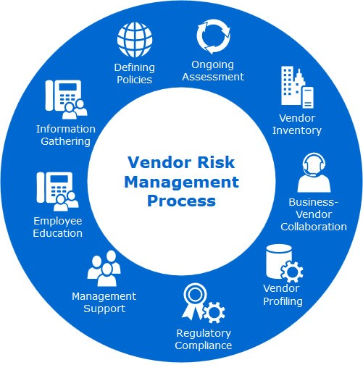
Risikomanagement für Anbieter
Das Sicherheitsrisikomanagement für Lieferanten ist eine Strategie, die darauf abzielt, die Anzahl der Bedrohungen, Schwachstellen und Schwachstellen zu begrenzen, denen Ihr Unternehmen durch die Lieferanten in Ihrer Lieferkette ausgesetzt ist.
Ein Lieferant ist in der Regel ein Drittunternehmen, das ein Produkt, eine Dienstleistung oder ein Gerät verkauft, das Ihr Unternehmen für den Betrieb benötigt.
Notes:
Vendor security risk management is a strategy designed to limit the number of threats, vulnerabilities, and weaknesses your organization faces due to the vendors in your supply chain. A vendor is typically a third-party organization that sells a product, service, or piece of equipment that your business needs to operate.
As technology and communications allow businesses to expand their supply chains, the complexity of vendor risk management increases. Your business is likely working with more vendors than ever before, and each of those vendors is going to pose some level of risk to your organization
Each vendor, upon being connected to your organization, is going to carry some level of cybersecurity risk. If they fail to uphold their end of the deal, or if they’re the victim of a cyberattack, it could impact your organization directly. An effective risk assessment, as part of a greater vendor risk management plan, strives to identify these potential failure points long before they become a problem and fix them.

Slide 16
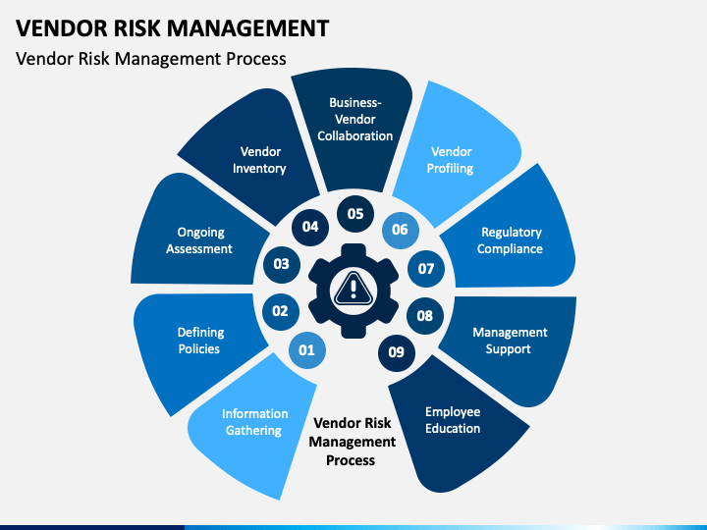
Risikomanagement für Anbieter
Der Kreislauf des Risikomanagements für Lieferanten
Schritt 1: Analyse - Das Unternehmen ermittelt das inhärente Risiko der Beziehung und den Grad der durchzuführenden Sorgfaltspflicht. Dementsprechend bewertet das Unternehmen die Sicherheitslage der dritten Partei und führt eine Lückenanalyse durch.
Notes:
Vendor security risk management is an ongoing process, and one you’ll execute with every vendor you bring into your supply chain. Typically, the process looks like this:
Step 1: Analysis – The company identifies the inherent risk of the relationship and the level of due diligence to be performed. Accordingly, the company evaluates the third party’s security posture and performs a gap analysis.

Slide 17
Risikomanagement für Anbieter
Der Kreislauf des Risikomanagements für Lieferanten
Schritt 2: Engagement - Das Unternehmen und die Drittpartei arbeiten gemeinsam an der Behebung der Lücken.
Schritt 3: Behebung - Die dritte Partei behebt die Cyber-Lücken.
Notes:
Vendor security risk management is an ongoing process, and one you’ll execute with every vendor you bring into your supply chain. Typically, the process looks like this:
Step 2: Engagement – The company and third party collaborate on how to remediate gaps.
Step 3: Remediation – The third party fixes the cyber gaps.

Slide 18
Risikomanagement für Anbieter
Der Kreislauf des Risikomanagements für Lieferanten
Schritt 4: Genehmigung - Das Unternehmen genehmigt die Drittpartei oder lehnt sie je nach Risikotoleranz ab.
Schritt 5: Überwachung - Das Unternehmen überwacht die Drittpartei weiterhin, um etwaige Cyber-Lücken zu erkennen.
Notes:
Vendor security risk management is an ongoing process, and one you’ll execute with every vendor you bring into your supply chain. Typically, the process looks like this:
Step 4: Approval – The company approves the third party or rejects it based on risk tolerance.
Step 5: Monitoring – The company continues to monitor the third party to detect any cyber gaps.

Slide 19

Soziale Netzwerke und Sicherheitsrisiken für Anbieter
Soziale Netzwerke sind in der heutigen Welt sehr beliebt.
In der Regel wird ein soziales Netzwerk als ein Netzwerk in einer kleinen Welt definiert, das aus einer Reihe von Individuen (Personen, Gruppen, Organisationen) besteht, die durch persönliche, berufliche oder vertrauensvolle Beziehungen miteinander verbunden sind.
Notes:
Social networks are very popular in today's world. Usually, a social network is defined as a small-world network, consisting of a set of individuals (persons, groups, organizations) connected by personal, work, or trust relationships. Social networking is then a quite broad and generic notion, which in the Web context might be applied to any kind of virtual community. For instance, users registered to a Web service, such as Web mail, online journals, or newspapers requiring a subscription, can be considered as a social network. In the following, we adopt the definition, according to which an online community’s Web site can be considered a Web-based social network only if it satisfies the following conditions:
• Relationships are explicitly specified by its members, and not inferred from existing interactions (e.g., a mailing list can be used to infer implicit relationships).
• Relationships are stored and managed by using technologies, such as database management systems, allowing relationship analysis and regulating access and retrieval of relationship data.
• Members are able to access relationship information, at least partially.

Slide 20
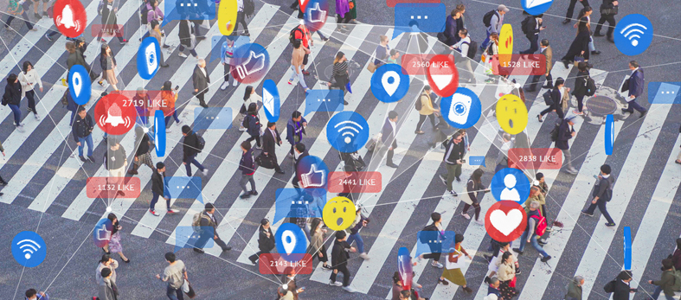
Soziale Netzwerke und Sicherheitsrisiken für Anbieter
Schlüsselbegriffe
Notes:
Social media is one area where security teams have faced a steep learning curve. Beyond being used by employees connected to corporate networks, platforms such as LinkedIn, Facebook and Twitter have been harnessed by enterprises as toolkits to conduct brand awareness, customer service, advertising and recruitment processes. However, each user on every platform presents a social media risk for security pros to contend with -- and the risks are plenty.
From social engineering and malicious applications to noncompliance and fraud, organizations must understand the scope and consequences social media.

Slide 21

Soziale Netzwerke und Sicherheitsrisiken für Anbieter
Beziehungsbasierte Zugangskontrolle:
Ein Paradigma der Zugriffskontrolle, das speziell auf soziale Netzwerke zugeschnitten ist und bei dem die Mitglieder eines sozialen Netzwerks, die zum Zugriff auf eine bestimmte Ressource berechtigt sind, anhand der Beziehungen, an denen sie teilnehmen müssen, um den Zugriff zu erhalten, bezeichnet werden.
Notes:
Social media and social networking or messaging applications can pose a number of security and privacy risks to both organizations and individuals when used in an inappropriate or unsafe manner.
Relationship-Based Access Control: An access control paradigm specifically tailored to social networks, according to which social network members authorized to access a given resource are denoted in terms of the relationships they must participate in to get the access.

Slide 22
Soziale Netzwerke und Sicherheitsrisiken für Anbieter
Soziales Netzwerk:
Ein Netzwerk in einer kleinen Welt, das aus einer Reihe von Individuen (Personen, Gruppen, Organisationen) besteht, die durch persönliche, Arbeits- oder Vertrauensbeziehungen miteinander verbunden sind. In der Regel wird es als Graph modelliert, wobei die Knoten den Mitgliedern des sozialen Netzwerks entsprechen und die Kanten die zwischen ihnen bestehenden Beziehungen bezeichnen.
Notes:
Social Network: A small-world network consisting of a set of individuals (persons, groups, organization) connected by personal, work, or trust relationships. Usually modelled as a graph, where nodes correspond to social network members, whereas edges denote the relationships existing between them.

Slide 23
Soziale Netzwerke und Sicherheitsrisiken für Anbieter
Soziale Netzwerke.
Die Kommunikation und der Austausch von Informationen mit den Menschen um uns herum ist ein Teil unseres Lebens und hat sich von einfachen Textnachrichten über E-Mails bis hin zu den heutigen Social-Media-Plattformen entwickelt. Was nicht sehr bekannt oder bewusst ist, ist die Tatsache, dass unser Engagement in der Online-Umgebung mit einer Menge Risiken verbunden ist.
Notes:
Social networks. Communicating and sharing information with those around us is a part of everyone's life and has evolved from simple text messages to emails and to what we now call social media platforms. What is not very well known or realized is the fact that our exposure in the online environment comes with a lot of risks.

Slide 24
Soziale Netzwerke und Sicherheitsrisiken für Anbieter
Zugriffskontrolle mit Berücksichtigung der Privatsphäre:
Bezeichnet im Zusammenhang mit sozialen Netzwerken ein Zugangskontrollparadigma, bei dem die Zugangskontrollanforderungen von Mitgliedern sozialer Netzwerke durchgesetzt werden, ohne dass private Informationen über die Beziehungen, an denen sie beteiligt sind, offengelegt werden.
Web-basiertes soziales Netzwerk:
Ein webbasiertes System, das es seinen registrierten Mitgliedern ermöglicht, Beziehungen zu anderen Mitgliedern aufzubauen und verschiedene Arten von Informationen auszutauschen (z. B. persönliche Daten, Kontakte, Multimedia-Ressourcen).
Notes:
Other key terms are
Privacy-Aware Access Control
Web-Based Social Network

Slide 25

Soziale Netzwerke und Sicherheitsrisiken für Anbieter
Analyse sozialer Netzwerke:
Eine Disziplin, die darauf abzielt, statistische Daten aus der Analyse der Topologie sozialer Netzwerke zu sammeln.
Störung der Kante:
Eine Technik zur Anonymisierung von Graphen, die darauf abzielt, die tatsächlichen sozialen Netzwerkbeziehungen zu verbergen, indem eine Reihe von zufälligen Löschungen/Einfügungen von Kanten im Netzwerkgraphen vorgenommen werden.
Notes:
Other key terms are
Privacy-Aware Access Control
Web-Based Social Network
Social Network Analysis
Edge Perturbation
Social Network Relationship
And many more – like Graph Anonymization: Technique aimed at hiding private information about social network members when performing social network analysis. Node anonymization and edge perturbation are the two main graph anonymization techniques currently used.
Also, the term Node Anonymization, which is a Graph anonymization technique aimed at hiding social network members’ identities by labelling the corresponding nodes with random identifiers (naïve anonymization), or, in case nodes are associated with attributes which can be used to identify the corresponding user, by using techniques based on k-anonymity.

Slide 26

Soziale Netzwerke und Sicherheitsrisiken für Anbieter
Soziale Netzwerkbeziehungen:
Eine Beziehung zwischen zwei Mitgliedern eines sozialen Netzwerks. In WBSNs können neben persönlichen/beruflichen Beziehungen (z. B. Freund/Kollege) auch Vertrauensbeziehungen unterstützt werden, die angeben, wie sehr ein Mitglied einem anderen vertraut. In der grafischen Darstellung eines sozialen Netzwerks werden Beziehungen in der Regel durch Kanten dargestellt, die mit einem Beziehungstyp und/oder einer Vertrauensstufe gekennzeichnet sind.
Notes:
Social Network Relationship
And many more – like Graph Anonymization: Technique aimed at hiding private information about social network members when performing social network analysis. Node anonymization and edge perturbation are the two main graph anonymization techniques currently used.
Also, the term Node Anonymization, which is a Graph anonymization technique aimed at hiding social network members’ identities by labelling the corresponding nodes with random identifiers (naïve anonymization), or, in case nodes are associated with attributes which can be used to identify the corresponding user, by using techniques based on k-anonymity.

Slide 27
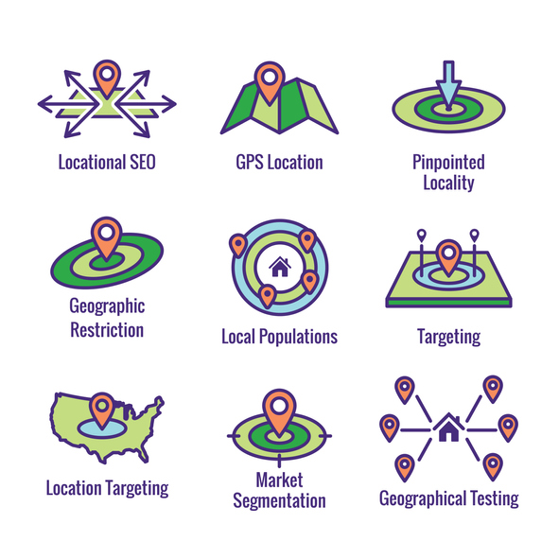
Soziale Netzwerke und Sicherheitsrisiken für Anbieter
Risiken, 1
Geotagging
- Bezeichnet die Hinzufügung von geoidentifizierenden Daten zu Fotos, Videos, Websites und Textnachrichten durch Anwendungen, die Ihren Standort auslesen können oder dies in Ihren Einstellungen erlauben;
- Achten Sie darauf, Geotagging-Funktionen an sensiblen Orten zu deaktivieren, um zu vermeiden, dass Ihr genauer Standort, Ihr Arbeitsort oder Ihr Wohnort preisgegeben wird.
Notes:
Geotagging is the process of appending geographic coordinates to media based on the location of a mobile device. Geotags can be applied to photos, videos, websites, text messages, and QR codes, and could also include time stamps or other contextual information.
Why is Geotagging Important?
Geotagging provides helpful insight into consumer activity. By using geotags to analyze where and how consumers interact with their brands, organizations can provide specialized offers and messaging. Geotags also reveal where individuals are when engaging with a website, or where they move throughout the day with their mobile device.

Slide 28
Soziale Netzwerke und Sicherheitsrisiken für Anbieter
Risiken,2
"Publikum"
- Es ist ein allgemeiner Begriff, der sich darauf bezieht, wer Ihre Beiträge sehen und/oder kommentieren kann;
- Ihre Freundesgruppe kann sich jederzeit ändern und in der Lage sein, einen Beitrag zu sehen, der Informationen über Sie enthält. Sie können absichtlich etwas mit Ihren "Freunden" teilen, aber was sie mit dem Beitrag machen, liegt außerhalb Ihrer persönlichen Kontrolle.
Notes:
"Audience“ is a general term that refers to who is able to see and/or comment on your posts.

Slide 29

Soziale Netzwerke und Sicherheitsrisiken für Anbieter
Risiken, 3
Identität
- Beschreibt den Bereich der Informationen, die sich speziell auf eine Person beziehen;
- Es sollte bedacht werden, dass es Personen gibt, die soziale Medien als Recherchemethode nutzen, um nach Identitätsinformationen zu suchen, möglicherweise in böswilliger Absicht, wie Identitätsdiebstahl, Betrug, Unterschlagung oder Einschüchterung.
Notes:
The term “identity” is defined as “The effort to recognize and understand individual audience members (including customers, prospects, and other visitors) across channels and devices such that brands can interact with those individuals in ways that are relevant to, meaningful to, and supportive of overarching business objectives.” Businesses can benefit from greater customer engagement and loyalty by providing customers with a platform that keeps their shared information safe. Customers, on the other hand, get the assurance of a secure and confidential experience.

Slide 30

Maßnahmen - Verbesserung der Cybersicherheit
Passwort
- Es wird empfohlen, für jedes Online-Konto ein anderes Passwort zu verwenden;
- Er sollte mindestens 10 Zeichen lang sein und Großbuchstaben, Kleinbuchstaben, Zahlen und Sonderzeichen enthalten;
- Es darf niemandem mitgeteilt werden, egal wie nah oder vertrauenswürdig die Person ist, der wir es sagen wollen;
Fortsetzung folgt
Notes:
Password
• It is recommended to use a different password for each online account;
• It should be at least 10 characters long and contain uppercase letters, lowercase letters, numbers and special characters;
• It must not be disclosed to anyone, no matter how close or trusted the person we want to tell is

Slide 31
Maßnahmen - Verbesserung der Cybersicherheit
Passwort
- Es wird empfohlen, bei der Erstellung eines Passworts keine persönlichen Daten zu verwenden (z. B. Name der Eltern, Geburtsdatum, Name des Haustiers usw.);
- Ändern Sie Ihr Passwort regelmäßig;
- Melden Sie sich von Ihrem Konto ab, wenn Sie ein Gerät verwenden, das nicht Ihnen gehört oder von einer anderen Person verwendet wird.
Notes:
Password
• It is recommended not to use personal information when creating a password (eg: parents' names, date of birth, pet's name, etc.);
• Change your password periodically;
• Sign out of your account when you're using a device that's not yours or is being used by someone else.

Slide 32
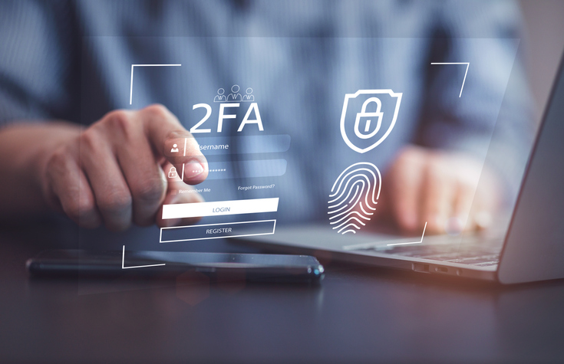
Maßnahmen - Verbesserung der Cybersicherheit
Führen Sie Ihre Sicherheitsaktualisierungen rechtzeitig durch!
- Soziale Medienplattformen führen regelmäßig neue Datenschutz- und Sicherheitseinstellungen ein. Diese finden Sie in Ihren Kontoeinstellungen und es wird empfohlen, sie regelmäßig zu überprüfen;
- Verwenden Sie die Zwei-Faktor-Authentifizierungsoption (2FA), um sicherzustellen, dass niemand versucht, Ihr Konto zu hacken.
Notes:
Do your security updates on time!
• Social media platforms regularly introduce new privacy and security settings. These can be found in your account settings and it is recommended that you check them regularly;
• Use the two-factor authentication (2FA) option to make sure someone isn't trying to hack your account.

Slide 33
Maßnahmen - Verbesserung der Cybersicherheit
Nehmen Sie keine Freundschaftsanfragen von anderen an!
- Akzeptiere oder sende Freundschaftsanfragen nur von/an Personen, die du im wirklichen Leben triffst, oder an öffentliche Personen, an denen du interessiert bist, indem du darauf achtest, ihren offiziellen Profilen zu folgen;
- NICHT VERGESSEN! Wenn Sie sich mit bestimmten Konten verbunden fühlen, können Sie deren Zugriff auf Ihre Beiträge einschränken oder das Konto sperren.
- NICHT klicken!
Notes:
Do not accept friend requests from anyone!
• Accept or send friend requests only from/to people you meet in real life or to public people you are interested in by taking care to follow their official profiles;
• DO NOT FORGET! If you feel attached to certain accounts you can restrict their access to your posts or you can block the account. You also have the option to report accounts or posts for reasons such as: fake account, fake name, posts with inappropriate content, incitement to violence, false information, etc.
• DO NOT click!
• Many attackers use social engineering to gain a person's trust in order to later gain access to information;
• Do not open links and attachments from social media if you are not 100% sure of the source (e.g. websites offering prizes are often intended to steal information);
• If from the chats, a friend seems to be behaving differently (asks a lot of questions, becomes very curious about his personal life, asks for money) there is a possibility that his account has been hacked and an attacker is using it for malicious purposes.

Slide 34

Maßnahmen - Verbesserung der Cybersicherheit
Überlegen Sie es sich zweimal, bevor Sie etwas veröffentlichen!
- Soziale Medien bieten ebenso die Möglichkeit, einen positiven Online-Ruf zu schaffen wie einen negativen, und selbst wenn wir einen Beitrag "löschen", kann er, sobald er online erschienen ist, nicht mehr dauerhaft gelöscht werden;
- Geben Sie nicht zu viele persönliche Details in sozialen Medien preis! "Über mich"-Felder sind optional.
Notes:
Think twice before posting!
• Social media offers as much an opportunity to create a positive online reputation as a negative one, in addition, even if we "delete" a post, once it has appeared online it cannot be permanently deleted;
• Don't reveal too many personal details on social media! "About Me" fields are optional.

Slide 35

Maßnahmen - Verbesserung der Cybersicherheit
- Die Grenze zwischen Berufs- und Privatleben in der Online-Umgebung
- Geben Sie keine Informationen über Ihren Arbeitgeber online bekannt
- Stellen Sie keine Arbeitsfotos oder negative Nachrichten ein, die den Arbeitgeber in ein schlechtes Licht rücken.
- Denken Sie nach, bevor Sie einen Beitrag schreiben, und riskieren Sie nicht Ihren Job.
Notes:
Again, Think twice before posting!
• The boundary between professional and personal life in the online environment
• Do not disclose information about your employer online
• Don't post work photos or negative messages that put the employer in a bad light.
• Think before you post and don't risk your job.

Slide 36
Maßnahmen - Verbesserung der Cybersicherheit
Schließen Sie alte Konten!
- Wenn Sie alte Konten auf sozialen Medienplattformen haben, die Sie nicht mehr nutzen, oder sogar alte Konten auf derselben Plattform, versuchen Sie, diese zu schließen. Auf diese Weise schaffen Sie so wenig Verknüpfungen wie möglich, und die aktuellen Konten sind besser vor möglichen Angreifern geschützt;
- Ältere Konten oder Plattformen sind möglicherweise nicht so sicher wie die heutigen.
Notes:
Close old accounts!
• If you have old accounts on social media platforms that you no longer use, or even old accounts on the same platform, try to close them. In this way you create as few links as possible with current accounts being more protected from possible attackers;
• Older accounts or platforms may not be as secure as today's.

Slide 37
Maßnahmen - Verbesserung der Cybersicherheit
Soziale Medien bergen große Risiken
Soziale Netzwerke stellen aufgrund ihrer zentralisierten Architektur, ihres riesigen Speichers an personenbezogenen Daten, die jeder Hacker gerne hätte, und der allgemeinen Unkenntnis der Bevölkerung darüber, wie man soziale Medien richtig nutzt, hohe Sicherheits- und Datenschutzrisiken dar.
Notes:
Social media poses great risks
• Social networks pose high security and privacy risks due to their centralized architecture, their huge store of personally identifiable information that any hacker would love to have, and the general ignorance of the population about how to properly use social media. privacy settings to improve their online safety.

Slide 38
Maßnahmen - Verbesserung der Cybersicherheit
Soziale Medien bergen große Risiken
- Ein weiteres sehr hohes Risiko, vor allem bei Jugendlichen, ist das Vertrauen in andere Menschen und in die Art der persönlichen Informationen, die online preisgegeben werden.
- Dies kann durch technische Mittel und die Durchsetzung von Sicherheitsmaßnahmen bekämpft werden.
Notes:
Social media poses great risks
• Social networks pose high security and privacy risks due to their centralized architecture, their huge store of personally identifiable information that any hacker would love to have, and the general ignorance of the population about how to properly use social media. privacy settings to improve their online safety.
• Another very high risk, especially among teenagers, is trusting other people and the type of personal information disclosed online.
• This can be combated through technological means and the enforcement of security policies.
• We should consider information transmitted through social media to be insecure and therefore not transmit sensitive information through social media, thus the primary responsibility to stay safe rests with the USER

Slide 39
Maßnahmen - Verbesserung der Cybersicherheit
Soziale Medien bergen große Risiken
- Wir sollten Informationen, die über soziale Medien übermittelt werden, als unsicher betrachten und daher keine sensiblen Informationen über soziale Medien übermitteln; die Hauptverantwortung für die Sicherheit liegt daher beim BENUTZER.
Notes:
Social media poses great risks
• Another very high risk, especially among teenagers, is trusting other people and the type of personal information disclosed online.
• This can be combated through technological means and the enforcement of security policies.
• We should consider information transmitted through social media to be insecure and therefore not transmit sensitive information through social media, thus the primary responsibility to stay safe rests with the USER

Slide 40
Maßnahmen - Verbesserung der Cybersicherheit
Schlechte Gewohnheiten in den sozialen Medien
- Soziale Netzwerke sind heute weit verbreitete Plattformen für Nutzer. Wir haben eine breite Palette von Möglichkeiten zur Verfügung.
- Einige sind eher auf das Hochladen von Fotos oder Videos ausgerichtet, andere auf unsere Meinung und in anderen Fällen einfach darauf, mit Freunden und Familie in Kontakt zu bleiben. In jedem Fall haben wir es mit Plattformen zu tun, die viele Nutzer auf der ganzen Welt haben.
Notes:
Bad social media habits
• Social networks are widely used platforms by users today. We have a wide range of possibilities available.
• Some are more geared towards uploading photos or videos, others towards our opinion and in other cases simply to keep in touch with friends and family. In any case, we are dealing with platforms that have many users around the world.
• This also makes hackers set their sights here. We will talk about these habits that should be changed in social networks if we want to keep our privacy and security.
• There are many types of platforms that we can find on the network that give us the opportunity to send messages to friends or family, commenting on photos, videos ...
• This makes them a very popular environment for both private users and businesses.
• However, this also causes you to have some risk to our security and privacy. Hackers can watch here to carry out their attacks. They can especially take advantage of bad user habits when using these platforms.

Slide 41
Maßnahmen - Verbesserung der Cybersicherheit
Schlechte Gewohnheiten in den sozialen Medien
- Dies führt auch dazu, dass Hacker hier ihr Ziel finden. Wir werden über diese Gewohnheiten sprechen, die in sozialen Netzwerken geändert werden sollten, wenn wir unsere Privatsphäre und Sicherheit bewahren wollen.
- Es gibt viele Arten von Plattformen, die wir im Netz finden können, die uns die Möglichkeit geben, Nachrichten an Freunde oder Familie zu senden, Fotos und Videos zu kommentieren ...
Notes:
Bad social media habits
• Social networks are widely used platforms by users today. We have a wide range of possibilities available.
• Some are more geared towards uploading photos or videos, others towards our opinion and in other cases simply to keep in touch with friends and family. In any case, we are dealing with platforms that have many users around the world.
• This also makes hackers set their sights here. We will talk about these habits that should be changed in social networks if we want to keep our privacy and security.
• There are many types of platforms that we can find on the network that give us the opportunity to send messages to friends or family, commenting on photos, videos ...

Slide 42
Maßnahmen - Verbesserung der Cybersicherheit
Schlechte Gewohnheiten in den sozialen Medien
- Dies macht sie zu einer sehr beliebten Umgebung sowohl für private Nutzer als auch für Unternehmen.
- Dies birgt jedoch auch ein gewisses Risiko für unsere Sicherheit und Privatsphäre. Hacker können hier zusehen, wie sie ihre Angriffe durchführen. Sie können insbesondere schlechte Nutzergewohnheiten bei der Verwendung dieser Plattformen ausnutzen.
Notes:
• This makes them a very popular environment for both private users and businesses.
• However, this also causes you to have some risk to our security and privacy. Hackers can watch here to carry out their attacks. They can especially take advantage of bad user habits when using these platforms.

Slide 43
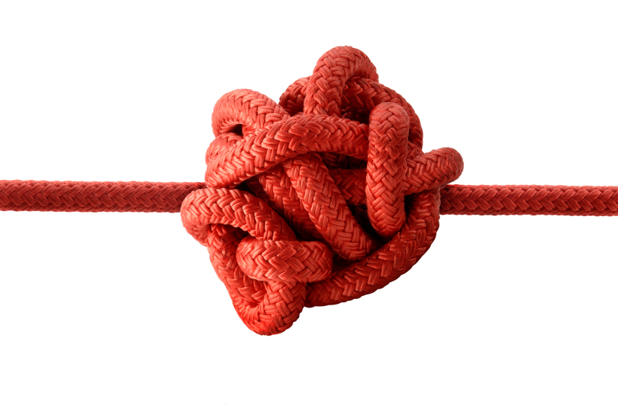
Maßnahmen - Verbesserung der Cybersicherheit
Gewohnheiten, die geändert werden müssen
- Datenschutz und Sicherheit sind sehr wichtige Faktoren für die Nutzer.
- Sie sind jedoch nicht immer vorhanden.
- Wir können Opfer vieler Arten von Angriffen werden, die diese beiden Faktoren beeinträchtigen.
- Wir können auch Fehler machen, wenn wir soziale Medien nutzen, und das wirkt sich auf uns aus.
Notes:
Habits that need to be changed
• Privacy and security are very important factors for users.
• However, they are not always present.
• We can be victims of many types of attacks that compromise these two factors.
• We can also make mistakes when using social media and it affects us.

Slide 44
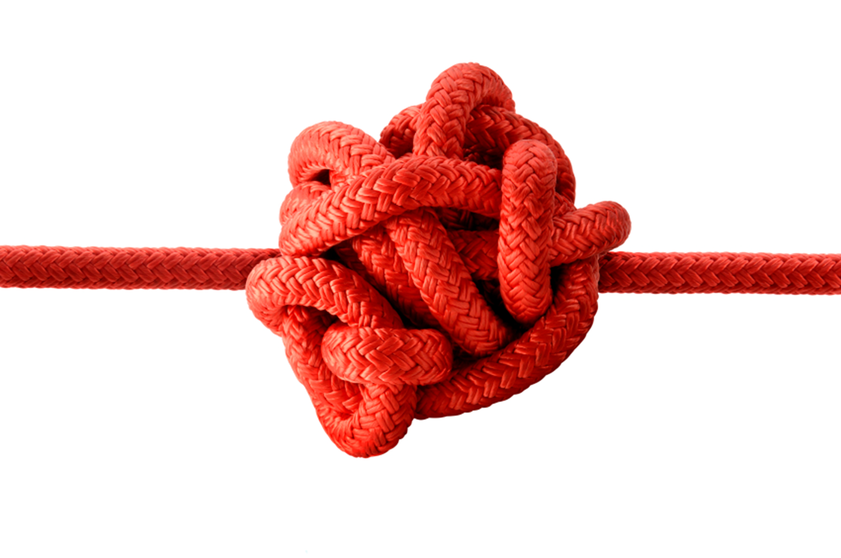
Maßnahmen - Verbesserung der Cybersicherheit
Jede Art von Kontakt hinzufügen
- Ein sehr häufiger Fehler in sozialen Netzwerken ist das Hinzufügen von Kontakten jeglicher Art. Dies kann auf Plattformen wie Facebook passieren.
- Es ist möglich, dass es sich bei dem hinzugefügten Eintrag um einen Bot und nicht um einen echten Benutzer handelt.
- Sie müssen wissen, wie Sie sie unterscheiden können, und vermeiden, dass Sie jede Art von Kontakt hinzufügen, die Ihre Einladung erhält.
Notes:
Add any type of contact
• A very common error in social networks is adding any type of contact. This can happen on platforms like Facebook.
• It is possible that what we are adding is a bot rather than a real user.
• You need to know how to differentiate them and avoid adding any type of contact that your invite receives.

Slide 45
Maßnahmen - Verbesserung der Cybersicherheit
Beliebige Kontaktart hinzufügen (2)
- Manchmal sind Bots nur dazu gedacht, Nutzerdaten zu sammeln. Dies kann unsere Privatsphäre gefährden. Wir müssen einen echten Filter für die Kontakte haben, die wir hinzufügen.
- Es ist wichtig, dass wir Menschen in unserem Freundeskreis haben, die kein Problem für unsere Sicherheit und Privatsphäre darstellen.
Notes:
• Sometimes bots are designed solely to collect user data. This may compromise our privacy. We need to have a real filter on the contacts we add.
• It is important that we have people among our friends who are not a problem for our security and privacy.

Slide 46
Maßnahmen - Verbesserung der Cybersicherheit
Verbinden Sie sich nicht von überall aus mit sozialen Netzwerken
- Oft meldet man sich über soziale Netzwerke auf einer beliebigen Website an. Das ist sehr bequem, aber nicht das Beste für die Privatsphäre.
- Sicherlich finden wir bei vielen Gelegenheiten die Möglichkeit, uns auf einer Seite zu registrieren oder über Facebook oder Twitter mit einer Plattform zu verbinden. Wir vermeiden es, uns auf dieser Seite zu registrieren und ein langes Formular auszufüllen.
Das Problem ist, dass wir dieser Website über Facebook personenbezogene Daten zur Verfügung stellen. Diese Daten/Informationen, die wir weitergeben, können von Dritten für Werbezwecke verwendet werden.
Notes:
Don't connect with social networks from anywhere
• You often log in through social networks on any site. This is very comfortable, but not the best for privacy.
• Certainly on many occasions we find the possibility to register on a page or to connect to a platform through Facebook or Twitter. We avoid registering on that site and filling out a long form. The problem is that we provide personal data to that website through Facebook. This data / information we share can be used by third parties for advertising purposes.

Slide 47

Maßnahmen - Verbesserung der Cybersicherheit
Geben Sie nicht mehr Informationen als nötig
- Es ist definitiv eine der schlimmsten Angewohnheiten, die viele Nutzer haben. Sie geben in sozialen Netzwerken viele persönliche Daten ein, Informationen, die eigentlich nicht notwendig sind.
- Zum Beispiel Daten wie unsere Telefonnummer, E-Mail-Adresse, Informationen darüber, wo wir wohnen ... All dies wirkt sich auf unsere Werbung aus und könnte für schlechte Zwecke verwendet werden.
Notes:
Do not provide more information than necessary
• It is definitely one of the worst habits that many users have. They enter a lot of personal data, information that is not really necessary, into social networks.
• For example, data such as our phone number, email address, information about where we live ... All this affects our advertising and could be used for bad purposes.
• Don't give more information than is really necessary. In this way we will improve our privacy in the network, and we can even avoid certain security problems.
Psychology discipline
• It is necessary to understand the concept and understand the thoughts and behaviours of both the attacker and the victim.
• The methods are important for social engineering because they are used to bypass protections that may be in place, such as firewalls and systems used to identify intruders.
• It helps to understand employee actions that are one of the main causes of data breaches.

Slide 48
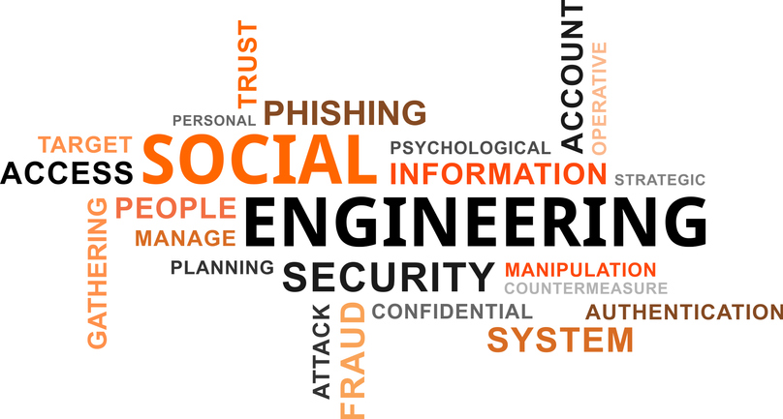
Maßnahmen - Verbesserung der Cybersicherheit
Social Engineering aus einer interdisziplinären Perspektive
Aufgrund der von Hackern verwendeten Technik ist es notwendig, eine interdisziplinäre Perspektive wie Informatik, Psychologie, Wirtschaft und Ethik einzunehmen.
Notes:
We do not protect our privacy
• A final mistake is not properly protecting privacy. For example, we leave our profiles open for anyone to enter.
• We provide information to anyone who might collect it to create a profile for us and even send targeted advertising or perform various attacks that affect our security.
Social engineering from an interdisciplinary perspective
Due to the technique used by hackers, it is necessary to approach an interdisciplinary perspective such as information technology, psychology, business and ethics.

Slide 49
Maßnahmen - Verbesserung der Cybersicherheit
Die Disziplin der Informationstechnologie
- Social Engineering sollte im Zusammenhang mit aktuellen Informationssystemen und deren Verteidigung als eine Form der Risikominderung diskutiert werden.
- Die Multi-Faktor-Authentifizierung ist eine gängige und oft wirksame Methode für Unternehmen, um zu bestätigen, dass die Person, die auf ein System zugreift, auch tatsächlich über diesen Zugriff verfügen sollte.
- Ein zusätzlicher Faktor könnte die Verwendung eines virtuellen privaten Netzes (VPN) sein, d.h. eine Authentifizierung zur weiteren Validierung des Benutzers.
Notes:
The discipline of information technology
• Social engineering should be discussed in the context of current information systems and their defence used as a form of risk mitigation.
• Multi-factor authentication is a common and often effective way for organizations to confirm that the person accessing systems should actually have that access
• An additional factor could be the use of a virtual private network (VPN), i.e. authentication to further validate the user.

Slide 50
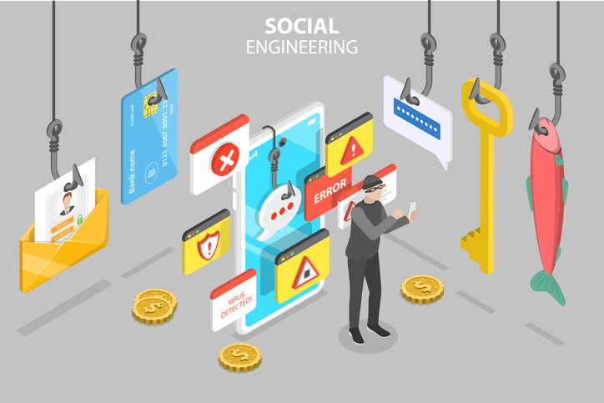
Maßnahmen - Verbesserung der Cybersicherheit
Geschäftliche Perspektive
- Es ist wichtig, weil Social Engineering viele Arten von Unternehmen betreffen kann und Auswirkungen darauf hat, wie Organisationen strukturiert und verwaltet werden.
- Sie hilft bei der Ermittlung der Faktoren, die Social-Engineering-Angriffe beeinflussen, und ist von Vorteil, wenn sie spezifischer in Bezug auf die folgenden Unternehmensbereiche betrachtet wird: Ausbildung und Entwicklung, dokumentierte Richtlinien, interne Prüfverfahren, Budgets und Organisationskultur.
- können Mängel in allen Bereichen aufdecken, die zu Angriffen beitragen können.
Notes:
Business perspective
• it is important because social engineering can affect many types of businesses and have implications for how organizations are structured and managed.
• it helps determine the factors that influence social engineering attacks and is beneficial if considered in more specific terms in relation to the following business areas: training and development, documented policies, internal audit procedures, budgets and organizational culture.
• can detect deficiencies in any of the areas that may contribute to attacks.

Slide 51
Maßnahmen - Verbesserung der Cybersicherheit
Ethische Perspektive
- Sie ist im Zusammenhang mit Social Engineering und verwandter Forschung wichtig, weil die Idee, einen anderen Menschen zu manipulieren, gegen viele ethische Grundsätze verstößt.
- hilft im Falle eines Social Engineering-Ereignisses bei der Behandlung der Opfer.
Notes:
Ethical perspective
• it is important in the context of social engineering and related research because the idea of manipulating another human being violates many ethical principles.
• helps, in the case of a social engineering event, to treat the victims.
It is important to consider:
• each discipline, providing information on how to understand and interpret the subject, protect against different types of attacks, and understand the impact of social engineering from both a human and organizational perspective.
• that each discipline's interpretation of the subject is useful only when viewed in the context of the other disciplines.

Slide 52
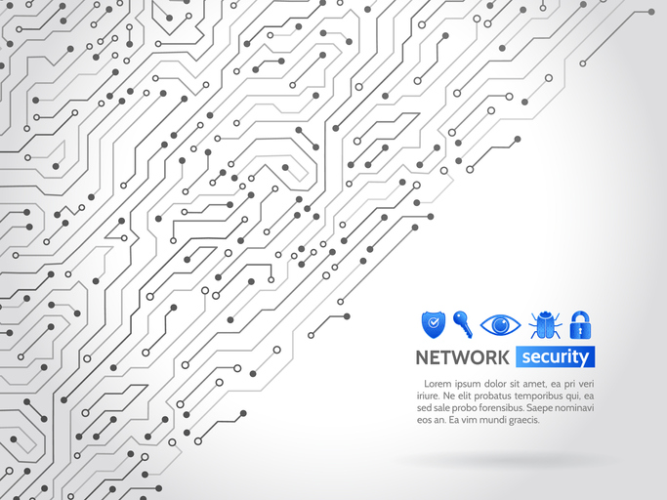
Sicherheitstechniken
- Inventar der Ausrüstung
- Bestandsaufnahme der Anwendungen und Betriebssysteme
- Drahtlose Gerätesteuerung
- Entwurf der Netzsicherheit
- Begrenzung und Kontrolle von Netzwerkanschlüssen, Kommunikationsprotokollen und Diensten
Notes:
Security techniques
• Equipment inventory
• Inventory of applications and operating systems
• Wireless equipment control
• Network security design
• Limiting and controlling network ports, communication protocols and services

Slide 53
Sicherheitstechniken
- Schutz der umliegenden Gebiete
- Physischer Zugang zu den Standorten
- Kontrollierte Nutzung von Verwaltungsrechten
- Überwachung und Kontrolle von Benutzerkonten
- Kompetenzbewertung und Sicherheitsschulung
Notes:
• Protection of perimeter areas
• Physical access to locations
• Controlled use of administrative privileges
• Monitoring and controlling user accounts
• Skills assessment and security training

Slide 54
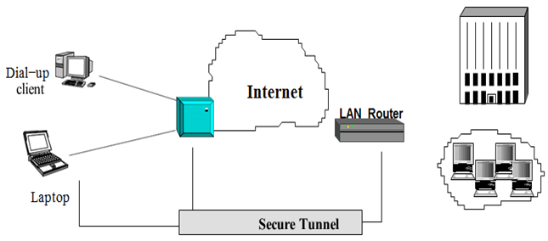
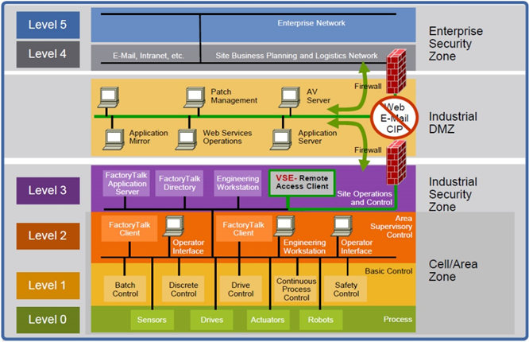
VPN
VPN (Virtuelles Privates Netzwerk)
Ein virtuelles privates Netz ist eine sichere Verbindung über ein unsicheres Netz wie das Internet. Virtuell bedeutet das Vorhandensein eines einzigartigen Netzes, einer Gruppe von geografisch verteilten Computern, die miteinander kommunizieren und als ein einziges Netz verwaltet werden können.
Privat bedeutet ein virtuelles Netz mit Zugangskontrolle.
VPN für Fernzugriff
Schaffung einer sicheren industriellen Infrastruktur
Notes:
VPN (Virtual Private Network)
A virtual private network is a secure connection over an insecure network such as the Internet. Virtual means the existence of a unique network, regardless of topology, that is, a group of geographically distributed computers that communicate and can be administered as a single network.
Private means a virtual network with access control. which provides confidentiality, the integrity of messages and authenticates between the users and the computers participating in the communication.
Defense-in-Depth (DiD) supports this approach. Based on the notion that a single point of protection can and likely will be defeated, DiD security establishes multiple layers of protection through a combination of physical, electronic and procedural safeguards.
• A bank uses multiple security measures—such as video cameras, a guard, and a vault—this helps ensure that threats meet more than one line of defense.
• A security-in-depth approach comprises six main components:
1. Policies and Procedures
2. Physical
3. Network
4. Computer
5. Application
6. The device

Slide 55
Fragen:
Fragen Diskussionsforum, die mit einer kurzen Erklärung beantwortet werden müssen. Die Antworten werden mit dem Mentor während der Mentoring-Sitzungen besprochen
1. welche Risiken es in sozialen Netzwerken gibt
2) Maßnahmen für Sicherheit und Datenschutz in sozialen Netzwerken
3) Welche sind die wichtigsten Sicherheitstechniken in sozialen Netzwerken?
Fragen zur Selbsteinschätzung. Nach der Beantwortung kann der Lernende die Ergebnisse sehen und sie mit den auf der Plattform gespeicherten Ergebnissen vergleichen
- Risiken in sozialen Netzwerken
- Sicherheit und Datenschutz in sozialen Netzwerken
- Sicherheitstechniken

Slide 56
Vielen Dank für Ihre Aufmerksamkeit
Notes:
Thank you for your attention

