Slide 1


Security at business trips

Slide 2
Basic definitions
An IT system is a set of interrelated elements whose function is to process data using computer technology.
It includes:
hardware - computers, devices for data storage, for communication between hardware components of the system and people and computers, for receiving data from the outside world - not from humans (for example, electronic sensors, cameras, scanners), for data processing other than computers

Slide 3
Basic definitions
software - computer programs used for data processing
personnel resources - all people that are able to use computers (hardware and software) to process the data
organizational elements - i.e. procedures (organizational procedures - management deadline) for using the IT system, work instructions, etc.
knowledge bases - for example a manual in the case of a financial and accounting system

Slide 4
Security - definition
It is a set of issues in the field of telecommunications and IT related to the estimation and control of risks arising from the use of computers, computer networks and data transmission to remote locations, considered from the perspective of confidentiality, integrity and availability.

Slide 5
Security - definition
Confidentiality - protecting stored or transmitted data from attack by intruders in order to prevent disclosure of their content.
Integrity - a security feature where data has not been altered, added or removed in an unauthorized way.
Availability - a feature of information which means that only authorized persons can use it at a given place and time. One of the basic properties of information security.

Slide 6
Wireless protocol - WEP
WEP (Wired Equivalent Privacy) is one of the oldest IEEE 802.11 wireless encryption standards. It provides information protection based on the use of the RC4 algorithm.
It is one of the oldest standards for securing WLAN networks (established in 1997). It does not require high computing power of the installed devices.

Slide 7
Wireless protocol - WEP
It uses two user authentication methods: Open Authentication and Shared Key Authentication.
In addition, it enables user verification based on physical MAC addresses using the ACL (Access Control List).

Slide 8
Wireless protocol - WPA
WPA (Wi-Fi Protected Access) is another standard for encryption of IEEE 802.11 wireless networks.
It was introduced to improve the level of security of WLAN networks, replacing known vulnerabilities in the WEP standard.
It is based on the use of protocols: TKIP (Temporal Key Integrity Protocol) and EAP (Extensible Authentication Protocol), 802.1x standard and the MIC (Message Integrity Check) mechanism.
The standard is based on the RC4 algorithm.

Slide 9
Wireless protocol – WPA2
WPA2 (Wi-Fi Protected Access 2) is currently the most powerful encryption standard for wireless networks (also known as 802.11i).
It provides information protection based on the use of the AES (Advanced Encryption Standard).
It was introduced to improve the level of security of WLAN networks.
It implements the 802.1x protocol improving the control of user access to the network.

Slide 10
The main disadvantages of the WEP standard
Lack of a defined key management system (often one network key is used by all nodes of a wireless network);
Insufficient bit size of the network key (the first version of the WEP standard introduces 40-bit keys);
Insufficient user authentication system (there is a possibility of forging authentication messages).

Slide 11
The main disadvantages of the WEP standard
Insufficient bit size of the IV initialisation vector (the WEP standard introduces a 24-bit initialisation vector, which turns out to be insufficient and, due to the relatively high probability of collisions with a small number of received packets, there is a possibility of a cryptographic attack to obtain the value of the WEP key);

Slide 12
The main disadvantages of the WEP standard
Weak ICV checksum based on CRC-32 linear function (there is a possibility of unnoticeable modification of the information sent in the network);
Weak RC4 information encryption algorithm (there are too many dependencies between the network key and the result of information encryption);

Slide 13
The KaliLinux – environment of testing the resistance
 | Description of the application used
airmon-ng | A tool that allows you to start and disable the RF Monitor operating mode on a network interface. The activated RF Monitor mode allows for intercepting network packets directed to any physical MAC address.

Slide 14
The KaliLinux – environment of testing the resistance
 | Description of the application used
airodump-ng | A tool that allows you to capture and store on your storage devices, among other things, network packets directed to any physical address (including a 4-way handshake sequence) and IV initialisation vectors for the WEP encryption algorithm (in the direction of acquiring a network key value).

Slide 15
The KaliLinux – environment of testing the resistance
 | Description of the application used
aireplay-ng | A tool that allows to inject packets into the network, generating network traffic required to obtain key values based on the WEP and WPA-PSK algorithm. The application is also used to intercept 4-way handshake sequences and falsely authenticate network clients.

Slide 16
The KaliLinux – environment of testing the resistance
 | Description of the application used
aircrack-ng | A tool for extracting WEP, WPA and WPA2 network key values. The application implements the majority of WEP-based key generation methods, enables to carry out dictionary and brute-force attacks.

Slide 17
The KaliLinux – environment of testing the resistance
 | Description of the application used
aircrack-ng 1.2 RC1 (Windows) | A tool for extracting WEP, WPA and WPA2 network key values in Windows environment. The application has a graphical user interface, implements most of the WEP-based key generation methods and allows to carry out brute-force attacks against WPA/WPA2.

Slide 18
The KaliLinux – environment of testing the resistance
 | Description of the application used
coWPAtty | A tool that allows to perform the process of acquiring cryptographic key values, offering the possibility of performing a dictionary attack.

Slide 19
The KaliLinux – environment of testing the resistance
 | Description of the application used
crunch | A tool for generating a real-time list of network key positions based on a specified criterion and character space.

Slide 20
The KaliLinux – environment of testing the resistance
 | Description of the application used
hashcat | A tool for extracting network key values. It offers a number of possible attack categories to be implemented.

Slide 21
The KaliLinux – environment of testing the resistance
 | Description of the application used
oclHashcat64.exe | A tool for extracting network key values in a Windows environment using the computing power of AMD graphics cards (also available in a version optimised for NVIDIA graphics cards, i.e. cudaHashcat64.exe). It offers a number of possible attack categories to be implemented.

Slide 22
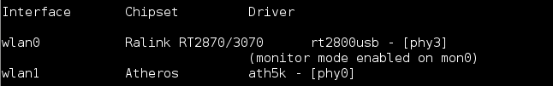
The KaliLinux – environment of testing the resistance
Step 1 - Use of the airmon-ng application
Command syntax:
airmon-ng <start|stop> interface
Usage example (starting the RF Monitor operating mode for the wlan0 interface):
airmon-ng start wlan0

Slide 23
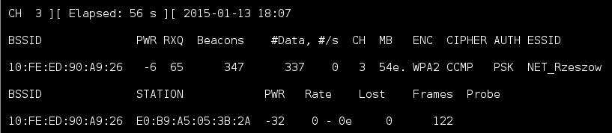
The KaliLinux – environment of testing the resistance
Step 2 - Use of the airodump-ng application
Command syntax:
airmodump-ng <options> <interface>[,<interface>,...]
Usage example (capturing data to file using mon0 interface):
airmodump-ng -bssid 10:FE:ED:90:A9:26 -c 3 -w file_name mon0

Slide 24
The KaliLinux – environment of testing the resistance
BSSID | MAC address of the access point. In the Client section, a BSSID of “(not associated)” means that the client is not associated with any AP. In this unassociated state, it is searching for an AP to connect with.

Slide 25
The KaliLinux – environment of testing the resistance
PWR | Signal level reported by the card. Its signification depends on the driver, but as the signal gets higher you get closer to the AP or the station. If the BSSID PWR is -1, then the driver doesn't support signal level reporting. If the PWR is -1 for a limited number of stations then this is for a packet which came from the AP to the client but the client transmissions are out of range for your card.

Slide 26
The KaliLinux – environment of testing the resistance
RXQ | Receive Quality as measured by the percentage of packets (management and data frames) successfully received over the last 10 seconds. See note below for a more detailed explanation.
Beacons | Number of announcements packets sent by the AP. Each access point sends about ten beacons per second at the lowest rate (1M), so they can usually be picked up from very far.

Slide 27
The KaliLinux – environment of testing the resistance
# Data | Number of captured data packets (if WEP, unique IV count), including data broadcast packets.
#/s | Number of data packets per second measure over the last 10 seconds.
CH | Channel number (taken from beacon packets). Note: sometimes packets from other channels are captured even if airodump-ng is not hopping, because of radio interference or overlapping channels.

Slide 28
The KaliLinux – environment of testing the resistance
MB | Maximum speed supported by the AP. If MB = 11, it's 802.11b, if MB = 22 it's 802.11b+ and up to 54 are 802.11g. Anything higher is 802.11n or 802.11ac. The dot (after 54 above) indicates short preamble is supported. Displays “e” following the MB speed value if the network has QoS enabled.

Slide 29
The KaliLinux – environment of testing the resistance
ENC | Encryption algorithm in use. OPN = no encryption,“WEP?” = WEP or higher (not enough data to choose between WEP and WPA/WPA2), WEP (without the question mark) indicates static or dynamic WEP, and WPA, WPA2 or WPA3 if TKIP or CCMP is present (WPA3 with TKIP allows WPA or WPA2 association, pure WPA3 only allows CCMP).

Slide 30
The KaliLinux – environment of testing the resistance
CIPHER | The cipher detected. One of CCMP, WRAP, TKIP, WEP, WEP40, or WEP104. Not mandatory, but TKIP is typically used with WPA and CCMP is typically used with WPA2. WEP40 is displayed when the key index is greater then 0. The standard states that the index can be 0-3 for 40bit and should be 0 for 104 bit.

Slide 31
The KaliLinux – environment of testing the resistance
AUTH | The authentication protocol used. One of MGT (WPA/WPA2 using a separate authentication server), SKA (shared key for WEP), PSK (pre-shared key for WPA/WPA2), or OPN (open for WEP).

Slide 32
The KaliLinux – environment of testing the resistance
AUTH | The authentication protocol used. One of MGT (WPA/WPA2 using a separate authentication server), SKA (shared key for WEP), PSK (pre-shared key for WPA/WPA2), or OPN (open for WEP).
ESSID | Shows the wireless network name. The so-called “SSID”, which can be empty if SSID hiding is activated. In this case, airodump-ng will try to recover the SSID from probe responses and association requests.

Slide 33
The KaliLinux – environment of testing the resistance
STATION | MAC address of each associated station or stations searching for an AP to connect with. Clients not currently associated with an AP have a BSSID of “(not associated)”.
Rate | Station's receive rate, followed by transmit rate. Displays “e” following each rate if the network has QoS enabled.

Slide 34
The KaliLinux – environment of testing the resistance
Lost | The number of data packets lost over the last 10 seconds based on the sequence number. See note below for a more detailed explanation.
Packets | The number of data packets sent by the client.
Notes | Additional information about the client, such as captured EAPOL or PMKID.
Probes | The ESSIDs probed by the client. These are the networks the client is trying to connect to if it is not currently connected.

Slide 35
The KaliLinux – environment of testing the resistance
Step 3 - Use of the aireplay-ng application
Command syntax:
aireplay-ng<option><interface>
Usage example (injection of artificial traffic into WEP network):
aireplay-ng -3 -b 10:FE:ED:90:A9:26 -h FF:FF:FF:FF:FF:FF -x 30 mon0

Slide 36
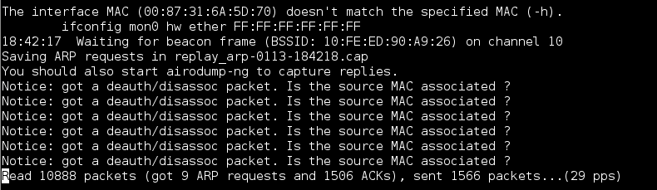
The KaliLinux – environment of testing the resistance

Slide 37
The KaliLinux – environment of testing the resistance
Step 4 - Use the aircrack-ng application
Command syntax:
aircrack-ng -w dictionary_location sequence_location
Usage example (getting WPA / WPA2 key value using a dictionary):
aircrack-ng -w /root/dictionary.txt /root/handshake.cap

Slide 38
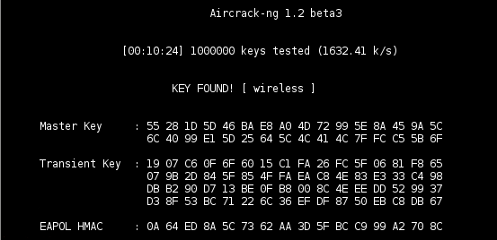
The KaliLinux – environment of testing the resistance

Slide 39
The KaliLinux – environment of testing the resistance
An interesting programme is the application called crunch, which allows you to generate a list of network key positions based on a specific criterion and character space.
It is often used as an input source for the aircrack-ng application. Usage example (forcibly retrieving the value of an 8-character key without using a dictionary, based on the character space: abc0123456789).
crunch 8 8 abc0123456789 -t @@@@@@@@ | aircrack-ng -bssid 10:FE:ED:90:A9:26 -w- /root/handshake.cap

Slide 40
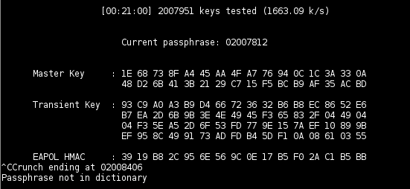
The KaliLinux – environment of testing the resistance

Slide 41
Virtual VPN tunnels
A Virtual Private Network is a tunnel through which private network traffic flows between the sender and recipient over a public network.
A VPN network encrypts all activities on the internet, hides the IP address, protecting the identity of the network user. A VPN connection offers secure access to applications, websites and entertainment platforms from anywhere in the world.

Slide 42
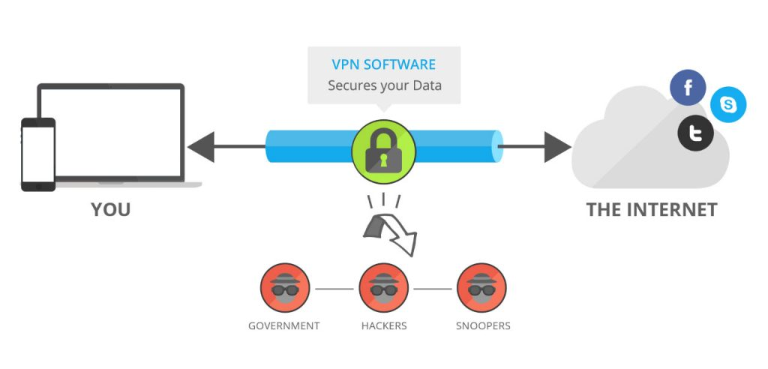
Virtual VPN tunnels
It is possible to optionally compress or encrypt transmitted data to provide better quality or a higher level of security, thus protecting privacy within the network.

Slide 43
Virtual VPN tunnels
VPNs can be divided into two main categories:
A remote access VPN that allows users to connect to a remote network, usually through special software.
- Site-to-site VPNs used by companies, especially large corporations. They allow users in selected locations to securely access other users' networks.

Slide 44
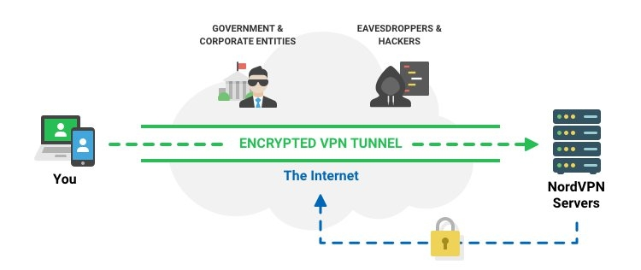
Virtual VPN tunnels

Slide 45
Virtual VPN tunnels
An example of a dedicated VPN development software is FortiClient VPN. VPN Application allows you to create a secure Virtual Private Network (VPN) connection using IPSec or SSL VPN "Tunnel Mode" connections between your Android device and FortiGate Firewall. Your connection will be fully encrypted and all traffic will be sent over the secure tunnel.

Slide 46
Virtual VPN tunnels
This easy to use app supports both SSL and IPSec VPN with FortiToken support. The VPN features included in this free app are limited so upgrade to FortiClient - Fabric Agent for advanced functionality and technical support.

Slide 47
Virtual VPN tunnels
After configuring the settings, you can connect to an external network. To establish a connection, enter the user name and password, and then press the Connect button.

Slide 48
Virtual VPN tunnels
After successful connection, the message and the connection status will be displayed.

Slide 49
Virtual VPN tunnels
IPSec and SSLVPN “Tunnel Mode”
Two-factor Authentication using FortiToken
Client Certificates
English, Chinese, Japanese and Korean Language Support
Documentation Link: http://docs.fortinet.com/forticlient/admin-guides

Slide 50
Email encryption
One of the most widely used communication channels is electronic mail (email), which is increasingly becoming a target for hacking attacks.
Protecting this element is an important part of a cyber security solution package.
Protecting email and encrypting attachments are two very important online security issues. Email encryption not only minimises the risk of confidential data leaking, but prevents unauthorised interception.

Slide 51
Email encryption
Email and its attachments are not secured by default with SSL and TLS protocols, and all messages are sent as plain text.
Encryption algorithms, like cryptography, fall into two categories:
  symmetric encryption algorithms;
  asymmetric encryption algorithms.

Slide 52
Email encryption
The main difference between the two encryption methods is the number of keys used.
Symmetric encryption uses a single key, while asymmetric encryption uses two different but related keys. One of the keys is the private key and the other is the public key. Symmetric encryption algorithms use the same key to perform both encryption and decryption functions.

Slide 53
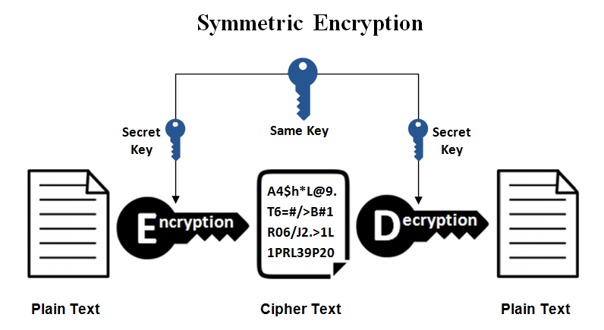
Email encryption

Slide 54
Email encryption
The asymmetric encryption algorithm uses one key to encrypt data and another key to decrypt it.
This means that if we want to send an encrypted message to someone, we encrypt it with the recipient's public key, and the recipient uses his/her private key to decrypt it.

Slide 55
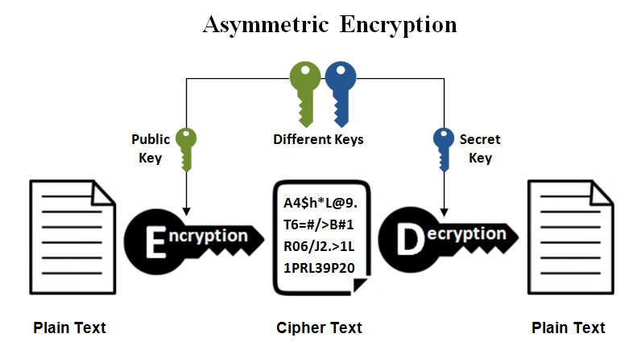
Email encryption

Slide 56
Email encryption
Another criterion for dividing encryption is that of key length.
The length of the key is directly related to the level of security provided by each of the cryptographic algorithms.
The longer the key, the safer the data. In symmetric algorithms, the keys are randomly selected and their length is typically 128 or 256 bits, depending on the level of security required.

Slide 57
Email encryption
One solution is the OpenPGP standard. Defines cryptographic email extensions - encryption and digital signatures.
The standard was based on the existing PGP programme. Currently, there are many different implementations.
The standard is defined in RFC 4880.

Slide 58
Email encryption
Enigmail used GnuPG to store and manage all keys and trusted settings. You can migrate and Enigmail will read the old keys from GnuPG and import them. Thunderbird 78 uses different settings than Enigmail.
With Enigmail, it was possible to enable OpenPGP for an email account, but let it automatically choose which key to use. Thunderbird 78 combines these settings.

Slide 59
Email encryption
GPG4win software will be used for encryption. It is a set of advanced data encryption tools. It enables protection against unauthorised access not only of email, but also of files and folders.
Working with Gpg4win is based on asymmetric encryption, i.e. on the basis of two keys - private and public. The first one is used to encrypt data, the second one should reach the recipients of the message who can access it. Keep the private key in a safe place.

Slide 60
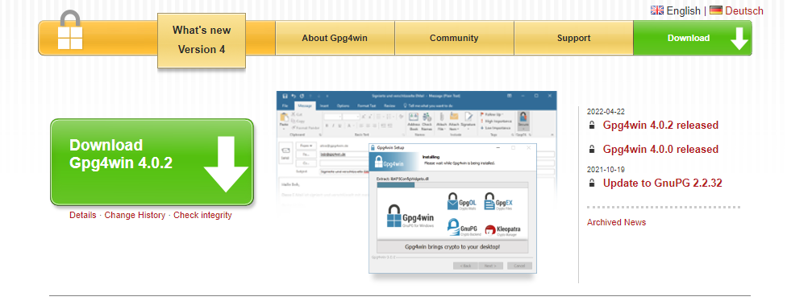
Email encryption
The package includes such elements as the GnuPG encryption tool, Kleopatra certificate manager alternative GPA certificate manager, Claws Mail email client, as well as two plugins that allow integration with Microsoft Outlook (in versions 2003, 2007, 2010 and 2013) and Windows Explorer.

Slide 61
Email encryption
Once the accounts have been configured in Cleopatra, you can directly use Thunderbird to send and receive encrypted messages without using an external programme.
Remember to send your public key when sending your first message to a new recipient.

Slide 62
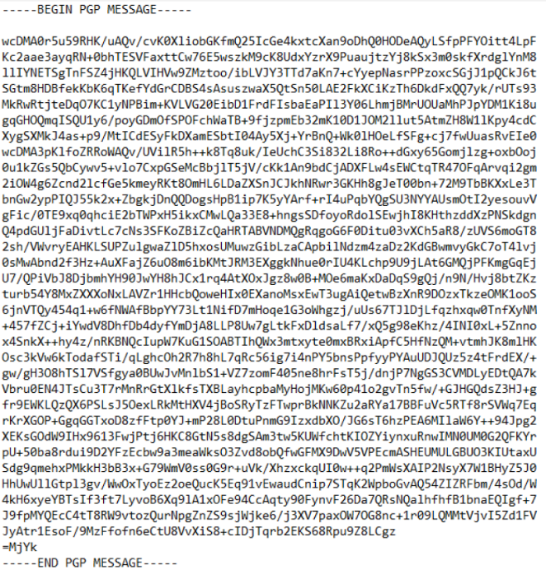
Email encryption
An example of an encrypted message is shown in Fig.

Slide 63
Email encryption
Thunderbird automatically decrypts messages and attachments sent with them.
Remember that you need to know the recipients' public keys before sending encrypted correspondence.
Encryption with the GPG add-on protects not only the content, but also the attachments. Without knowing the recipient's key, we are unable to send an encrypted message.

