Slide 1


Social Engineering

Slide 2
Social Engineering
means manipulating human beings, (often) with the use of psychological methods, to gain access to data, documents, and information interesting for the attacker.
is one of the leading threats to information security today and is an effective form of cybercrime.
could have dangerous repercussions i.e., data breaches, more than any other type of attack.
attacks have financial scops and so organizations lost considerable money amounts.
is particularly dangerous because it is based more on human error, not on vulnerabilities in software and operating systems

Slide 3
Social Engineering
Companies:
could suffer loss of productivity, a decline in employee morale and difficulties to recover.
have damage of reputation because customers are not convincing that the organization can protect itself.
often have to fire an old incident response.
should provide security software to help prevent future attacks.
often should requalify employees to be prepared for attacks.

Slide 4
Social Engineering Training
of employees and managers is important to recognize social engineering attacks because the risk of falling victim is great.
could be included in security awareness programs and protect individuals and their organization.
is missing particularly within SMEs which have less resources so they should be helped to take cyber awareness training seriously and offer their employees possibilities to follow it.

Slide 5
Lifecycle of Social Engineering Attacks
The attacker:
first investigates the intended victim to gather necessary background information, such as points of entry and weak security protocols, which are needed to the attack.
then tries, to gain victim’s trust and provide stimuli for actions not usually security practices, such as become sensitive information or granting access to critical resources. Figure 1 explains the Lifecycle of an attack.

Slide 6

Lifecycle of Social Engineering Attack
Figure 1: Attack Lifecycle (https://www.iacpcybercenter.org/resource-center/what-is-cyber-crime/cyber-attack-lifecycle/)

Slide 7
Social engineering attack techniques
Baiting attack
tries to achieve a victim’s curiosity, attracting users into a trap stealing their personal information or infecting their systems with malware.
often uses physical media to disperse malware (i.e., malware-infected flash drives, i.e., in elevators, the parking lot of a targeted company).
online consists of tempting ads that lead to malicious sites, which encourage users to download a malware-infected application.

Slide 8
Social engineering attack techniques
Scareware
uses false alarms and fictitious threats convincing users to think their system is infected with malware and they must install software without benefit or malware.
is considered as deception software, rogue scanner software and fraud ware.
is also distributed via spam email that makes offers users to buy worthless/harmful services.

Slide 9
Social engineering attack techniques
Pretexting
uses scam (fraud) often initiated by a perpetrator underlying to need sensitive information from a victim so as to perform a critical task.
starts by establishing trust with their victim by impersonating co-workers, police, bank and tax officials, or other persons who have right-to-know authority.
uses questions that are required to confirm the victim’s identity, through which they gather important personal data.

Slide 10
Social engineering attack techniques
Phishing
is one of the most popular social engineering attack types using phishing scams (frauds) which are i.e. emails and text message campaigns.
aims to achieve curiosity or fear in victims and encourage them to give sensitive information, clicking on links to malicious websites, or opening attachments that contain malware.
could be detected and blocked easier for mail servers having access to threat sharing platforms (due to identical, or near-identical, messages sent to many users in phishing campaigns).

Slide 11
Social engineering attack techniques
Spear phishing
is a special form of the phishing attack because an attacker chooses specific individuals or enterprises.
uses messages adapted to characteristics, job positions, and contacts of their victims to make their attack less conspicuous.
requires more effort from the perpetrator (person who commits the illegal act) and could take weeks and months to prepare it.
is much difficult to detect as phishing and has better success rates.

Slide 12
Social engineering attack techniques
How to detect Phishing
Scammers (people making fraudulent business)
use email or text messages to trick persons to communicate their personal information, try to steal passwords, account numbers, or social security numbers.
launch thousands of phishing attacks like every day — and they’re often successful.
often update their tactics, but there are some signs that help victims to recognize a phishing email or text message, like following:

Slide 13
Social engineering attack techniques
How to detect Phishing
Phishing emails and text messages
can look like they’re from a company you know or trust.
or look like they’re from a bank, a credit card company, a social networking site, an online payment website or app, or an online store.
often tell a story to trick victims into clicking on a person link or opening an attachment i.e., claiming there’s a problem with the account or payment information

Slide 14
Social engineering attack techniques
How to detect Phishing
Phishing emails and text messages
say that person must confirm some personal information,
include a fake invoice wanting the person to click on a link to make a payment.
say the person is eligible to register for a government refund, etc.

Slide 15
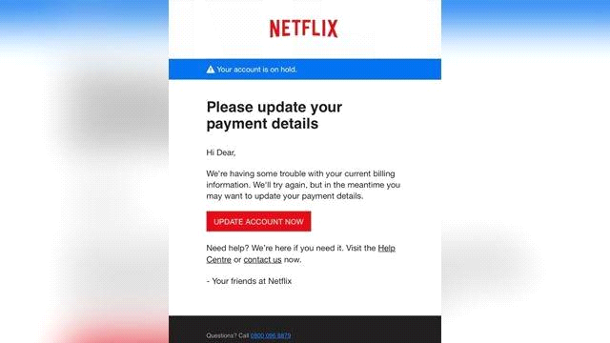
Social engineering attack techniques
Figure 2 shows a real-world example of phishing

Slide 16
Social engineering attack techniques
Protect against phishing means
protect own computer by using security software and software should be updated automatically to deal with security threats.
protect own mobile phone, and software should update automatically.
protect own accounts, i.e, multi-factor authentication should be used which makes it harder for scammers to log in to other accounts if they do get corresponding username and password.
protect own data by backups which aren’t connected to own home network. Own computer files should be copied to an external hard drive or cloud storage. Also, data on own phone should be copied.

Slide 17
Social engineering attack techniques
Act to a Suspect a Phishing Attack
If an email or a text message comes that asks to click on a link or open an attachment, ask: Do I have an account with the company or know the person that contacted me?
If the answer is “No,” it could be a phishing scam. You have to review the tips in How to recognize phishing, look for signs of a phishing scam, report the message and then delete it.
If the answer is “Yes,” contact the company using a phone number or real website without put the information in the email because attachments and links can install harmful malware.

Slide 18
Social engineering attack techniques
Responding to a Phishing Email
There are specific steps to take, based on the information lost
Run a scan.
If a phishing email or text message is received, report it.

Slide 19
Social engineering from an interdisciplinary view
Due to pervasive technique being used by hackers, it is necessary to use an interdisciplinary approach to understand social engineering connected with other disciplines i.e. information technology, psychology, business and ethics.

Slide 20
Social engineering attack techniques
Information technology discipline
Social engineering should be discussed in the context of the actual information systems and their defences be used as a form of risk mitigation.
Multi-factor authentication is a common and often effective way for organizations to confirm that the person accessing the systems should actually have that access.
An additional factor could be the use of a virtual private network (VPN) i.e login to further validate the user.

Slide 21
Social engineering attack techniques
Psychology discipline
is necessary to understand the concept and to grasp the thoughts and behaviours of both the attacker and victim.
Methods are important to social engineering because they are used to bypass the protections that may be in place such as firewalls and systems used to identify intruders.
helps to understand the actions of employees which are one of the leading causes of data breaches.

Slide 22
Social engineering attack techniques
Business Perspective
is important because social engineering can impact several types of businesses and have implications for the way organizations are structured and managed.
helps to determine the factors that impact social engineering attacks and is beneficial if it is considered in more specific terms related to the following areas of business: training and development, documented policies, internal audit procedures, budgets, and organizational culture.
can detect deficiencies in any of areas which can contribute to attacks.

Slide 23
Social engineering attack techniques
Ethical Perspective
is important in the context of social engineering and the related research on the topic because the idea of manipulating another human being violates many ethical principles.
helps, in case of a social engineering occurrence, at treatment of the victims.

Slide 24
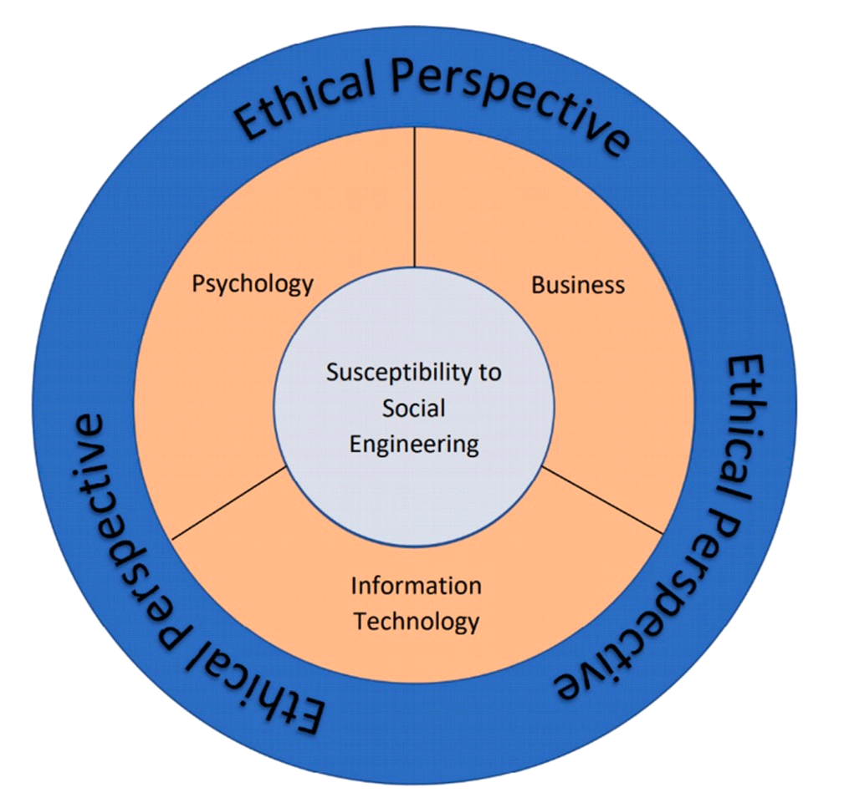
Social engineering attack techniques
Ethical Perspective
Figure 3: Social engineering from an interdisciplinary view (Washo, 2021)

Slide 25
Social engineering attack techniques
It is important to consider:
each discipline, providing information on how to understand and interpret the topic, protect against various types of attacks, and understand the impact of social engineering from both a human and organizational standpoint.
that each discipline’s interpretation of the topic is only useful when viewed in the context of the other disciplines.

