Slide 1


Third party vendor security
Unit-3 for Managers 1 – Week 6

Slide 2


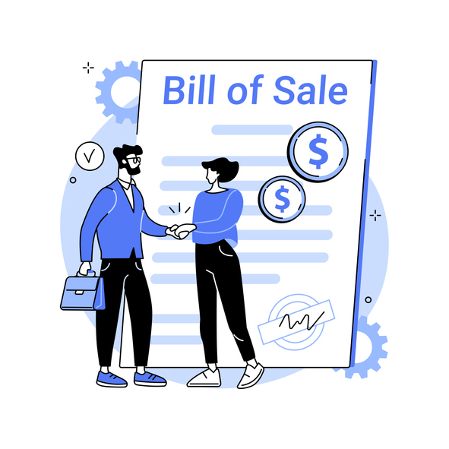
Information Security for Managers
Unit (Module) name:
Third party vendor security
Procurement requirements refer to the goods and services that must be acquired from organizations outside the performing organization. For a variety of reasons, sometimes performing organizations rely on vendors to provide what’s needed to complete a project.
Notes:
Procurement requirements refer to the goods and services that must be acquired from organizations outside the performing organization. For a variety of reasons, sometimes performing organizations rely on vendors to provide what’s needed to complete a project.
For example, consider the widget manufacturer that undertakes a project to automate their inventory tracking system. Some of the project work activities involve the relocation of storage bins in their main warehouse. Some of the work activities involve custom software development. As to the software development activities, widget manufacturer doesn’t have a human resource who knows how to develop the software application. Regarding the software development activities, widget manufacturer must procure those services.

Slide 3

WBSNs
Web-based social networks (WBSNs) are online communities that allow users to publish resources (e.g., personal data, annotations, blogs) and to establish relationships, possibly of a different type for purposes that may concern business, entertainment, religion, dating, and so forth.
Notes:
Web-based social networks (WBSNs) are online communities that allow users to publish resources (e.g., personal data, annotations, blogs) and to establish relationships, possibly of a different type for purposes that may concern business, entertainment, religion, dating, and so forth.
In the last few years, the usage and diffusion of WBSNs has been increasing, with about 300 Web sites collecting the information of more than 400 million registered users. As a result, the “net model” is today used more and more to communicate, share information, make decisions, and ‘do business’ by companies and organizations.

Slide 4

Third party vendor
A third party vendor is a person or company that provides services for another company (or that company’s customers).
Cooperation is the key to success. Working with third parties helps businesses increase their productivity and efficiency, produce better products and services, employ highly qualified experts, and cut costs.
Notes:
A third party vendor is a person or company that provides services for another company (or that company’s customers). While vendors are considered “third parties,” some industries differentiate a “third-party vendor” specifically as a vendor under written contract, but not all vendors work under a contract. For clarity’s sake, the term “third-party vendor” in this article refers to any individual or company that provides services to another company with or without a contract.
Cooperation is the key to success. Working with third parties helps businesses increase their productivity and efficiency, produce better products and services, employ highly qualified experts, and cut costs. But all these benefits come at the price of increased cybersecurity risks. Minor flaws in your third-party vendor’s security and privacy routines may turn into cybersecurity weaknesses for your company.

Slide 5
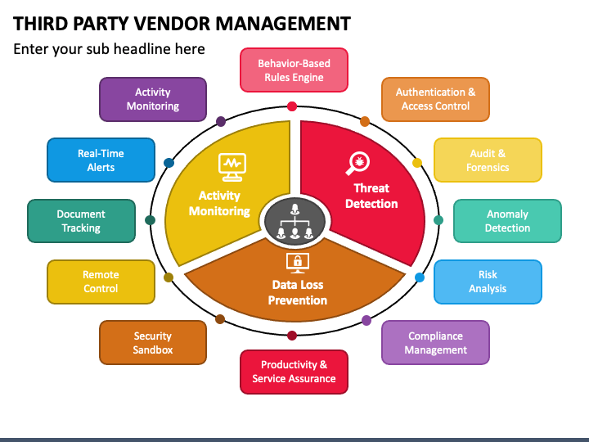
Third Party Vendor Management
Goods and services obtained from
third-party vendors can include,
but aren’t limited to:
Cloud web hosting services
Cloud-based software solutions
Equipment maintenance
Contractors of any kind
Call centre providers
Bookkeeping/financial auditors
Lawyers
Notes:
Goods and services obtained from third-party vendors can include, but aren’t limited to:
Cloud web hosting services. A cloud hosting vendor might provide everything from disk space and bandwidth to encryption and high-tech security solutions.
Cloud-based software solutions. SaaS software vendors provide access to software programs either for your business or your customers. For example, marketing automation platforms, CRMs, accounting packages, etc.
Equipment maintenance. The company that fixes your copy machine and the team that manages your network security are third-party vendors.
HVAC servicing. The local HVAC company that services your unit is providing third-party vendor services.
Contractors of any kind. Any contractor, short- or long-term, is a third-party vendor.
Call centre providers. If you host your call centre with another company, it is considered a third-party vendor.
Bookkeeping/financial auditors. Any person or business hired to manage your finances, budget or audit your finances is a third-party vendor.
Lawyers. Sometimes it’s necessary to consult a lawyer before signing contracts or making big purchases. All legal services are considered third-party vendors.

Slide 6
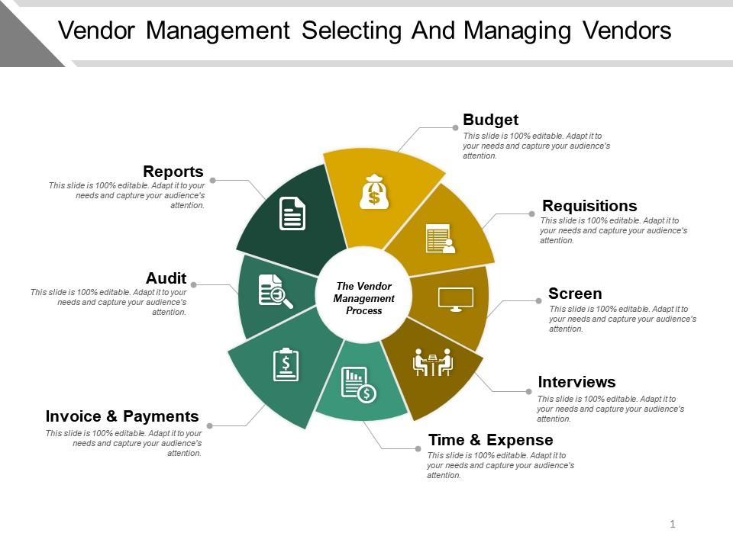
Selecting and Managing Vendors
What are the benefits of using third-party vendors for service providers?
You will save time
You will save money
You will get valuable expertise
Notes:
In today’s world, it’s impossible to avoid using third-party vendors. No matter how many departments your company creates, you’ll never cover every service you’ll ever need. Nor should you, as companies must determine the right balance of skills that are essential to the business versus those that can be outsourced.
What are the benefits of using third-party vendors for service providers?
You will save time
Nobody has time to learn every skill or hire every person necessary to run a business. Third-party vendors make business processes run smoothly by obtaining all the professional services required to operate and fulfil orders for your customers
You will save money
Perhaps the biggest benefit is the cost savings. Contracting a third-party provider for work as needed can be significantly less expensive than always having professionals on company payroll. For instance, it’s far less expensive to hire a lawyer when you need one rather than keep a lawyer on retainer.
You will get valuable expertise
Your company doesn’t have time to develop a new team of experts. The time and cost of doing so would be enormous. Hiring a third-party vendor for expertise you don’t have in-house will likely yield better results.

Slide 7
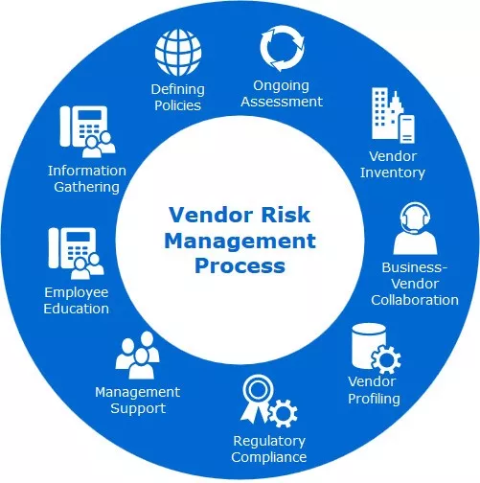
Vendor Risk Management
What are the risks of using third-party vendors?
Third parties may not take their network security as seriously as you want them to.
The biggest risk is choosing a third-party relationship that does not align with your security standards.
You need a vendor that understands regulations and is willing to adapt to meet those regulations.
Notes:
As organizations increasingly rely on third-party vendors to provide essential services, they also become more vulnerable to vendor related cybersecurity risks. A recent study found that nearly 60% of companies experienced a data breach due to a third-party vendor in the past year. But what are the most common vendor cyber gaps that organizations should be aware of?
What are the risks of using third-party vendors?
Third parties may not take their network security as seriously as you want them to. Knowing this, hackers may choose not to attack your company directly. Instead, they may look for an easier target among your third-party vendors. A compromised subcontractor can easily be turned into an entry point for cybercriminals.
If your vendors fail to deliver, you will fail to deliver. However, risk is inherent in any business relationship. Using third-party vendors comes with many risks, most of which can be mitigated.
The biggest risk is choosing a third-party relationship that does not align with your security standards. For instance, your network security team needs to follow security protocols that live up to your specific standards. If your company is bound by regulations such as health insurance, you cannot afford to hire a network security company that does not comply with the health insurance regulations. You need a vendor that understands regulations and is willing to adapt to meet those regulations.

Slide 8
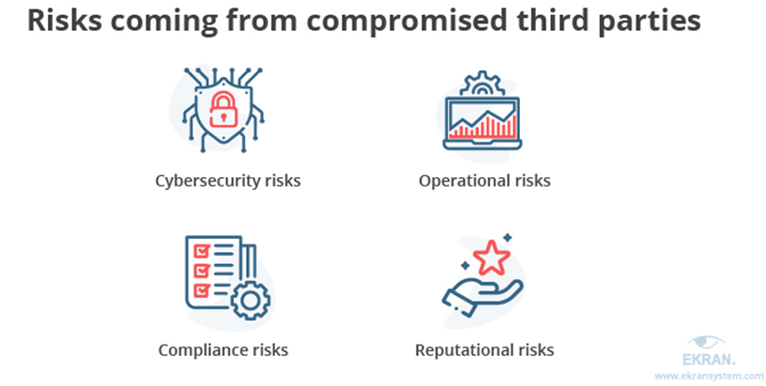
Vendor Risk Management
DATA BREACHES ARE EXTREMELY DISRUPTIVE
ESPECIALLY WHEN YOU’RE PROTECTING PERSONAL INFORMATION
A compromised third-party vendor may lead to multiple risks
that can be split into four major categories:
Notes:
Data breaches are extremely disruptive, especially when you’re protecting personal information. Unfortunately, data breaches are on the rise and are more common than ever before. Data breaches can cause disruptions to operations, devastating financial consequences, legal action and a damaged reputation. To avoid these, you cannot let your guard down when it comes to your own security or that of your vendors.
Depending on the nature of third-party vendor compromise, an organization may face different risks. Let us look at the most common risk categories and the threats you need to be prepared to mitigate. A compromised third-party vendor may lead to multiple risks that can be split into four major categories
Cybersecurity risks — Subcontractors usually have legitimate access to different environments, systems, and data of their clients. Attackers may use a third-party vendor as an entry point to try to get a hold of your valuable assets.
Operational risks — Cybercriminals may target your internal systems and the services you use instead of just your data. This can lead to partial interruptions of your operations or even halt them altogether.
Compliance risks — International, local, and industry-specific standards and regulations set strict cybersecurity criteria that organizations should meet. Furthermore, third parties working with these organizations also have to comply with these requirements. Non-compliance usually leads to substantial fines and reputational damage.
Reputational risks — Having your valuable data and systems compromised serves as a red flag for your partners and customers, both current and future. Regaining their trust will take a lot of time and effort. And unfortunately, there’s no guarantee that you’ll be able to successfully recover your reputation after a severe cybersecurity incident.

Slide 9
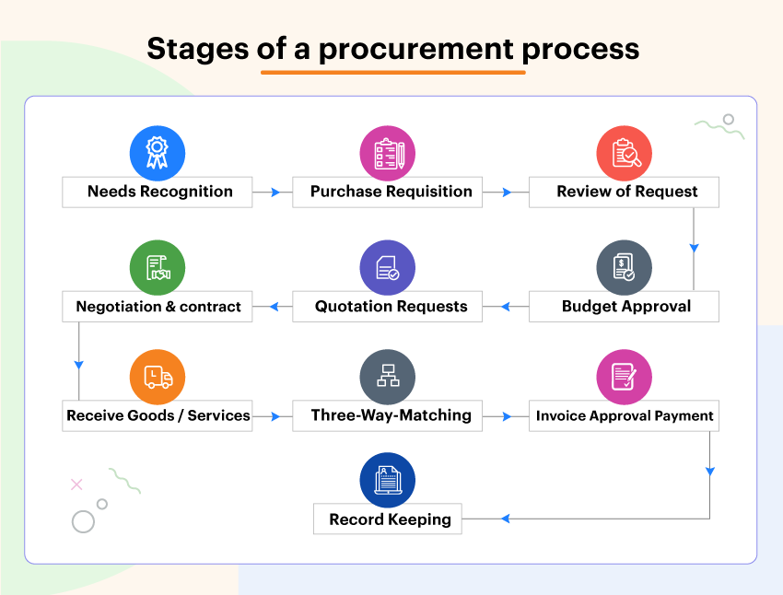
Vendor Risk Management
Procurement requirements
Stage 1: Identify a need for products and/or services.
Stage 2: Create and submit a purchase request.
Stage 3: Evaluate and select suppliers/vendors.
Stage 4: Negotiate the terms of a contract with the selected supplier.
Stage 5: Finalize a purchase order.
Stage 6: Order management
Notes:
For a variety of reasons, sometimes performing organizations rely on vendors to provide what’s needed to complete a project. Especially, the SMEs. Procurement requirements are therefore of utmost importance to work with third party vendor security.
Procurement requirements refer to the goods and services that must be acquired from organizations outside the performing organization. For a variety of reasons, sometimes performing organizations rely on vendors to provide what’s needed to complete a project.
While it’s true that procurement is a highly individualized process, there are also several foundational stages that will generally be utilized across the board.
The first step in the procurement process is to identify requirements. All procurement requirements begin with the perception of a need. The need to cross a body of water could create a requirement to build a bridge, a ferry, or other transportation systems.

Slide 10
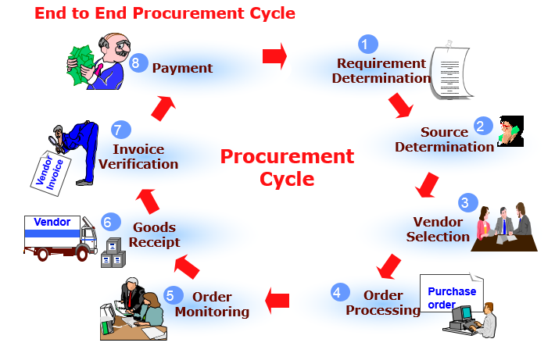
Procurement requirements
Stage 1: Identify a need for products and/or services
Before the procurement process can begin, a specific need must be recognized.
At this stage it is necessary to clearly define the need
Notes:
Before the procurement process can begin, a specific need must be recognized. For example, an organization may be interested in purchasing new computer monitors, re-ordering their monthly supply of paper products, or acquiring updated software. Depending on the company structure, this step might be managed by the business owners, department heads, executive team, staff, and/or procurement managers. In this stage, a budget will be set and a comprehensive view of spending will often be assessed.
At this stage it is necessary to clearly define the need, and this may be done by way of a study to determine the best mode to cross the body of water (given the present situation and forecasted future need), then the type of bridge to be constructed, or a comparative cost/benefit analysis to determine the best solution between a bridge and other alternatives. The study should include if the need can be satisfied in-house or contracted out, quantification of the initial budgetary estimate, and an idea of the procurement lead-time.

Slide 11

Procurement requirements
Stage 2: Create and submit a purchase request.
A purchase request (or purchase requisition) is a formal request for goods or services
Notes:
A purchase request (or purchase requisition) is a formal request for goods or services and is generally submitted using specialized procurement software. Oftentimes, the purchase request will originate with an employee or manager, then be reviewed by the organization’s procurement team.
When a purchase request is approved, it becomes a purchase order. However, should the request be denied, it will typically be returned to the submitter with a brief explanation. A rejected purchase order, while not ideal, can be a good learning opportunity.

Slide 12
Procurement requirements
Stage 3: Evaluate and select suppliers/vendors
The next step is to assess various vendors, then choose one that meets key requirements.
For best results, consider the “big picture” of what a vendor can offer, including:
Ease of communication
Company ethics
Accountability
Production capabilities
Notes:
The next step is to assess various vendors, then choose one that meets key requirements. Some organizations maintain a catalogue of approved vendors, featuring various suppliers that have already proven themselves.
Soliciting vendors is a process that can range from simple to complex, with its scope determined by the requirement(s) at hand. Usually, several requests for quotation (RFQ) will be sent to various vendors, so that the organization/procurement team can compare prices and options.
Remember that price should not be the only determinant when choosing a vendor. For best results, consider the “big picture” of what a vendor can offer, including:
Ease of communication
Company ethics
Accountability
Production capabilities
After a vendor has been selected, investing time and energy into the relationship is important. A good relationship with a supplier can unlock better savings and service, delivering maximum value in the long term.

Slide 13
Procurement requirements
Stage 4: Negotiate the terms of a contract with the selected supplier
Notes:
Stage 4: Negotiate the terms of a contract with the selected supplier
Once you have chosen the best-fit vendor, it’s time to move on to contract negotiations. In terms of successful procurement, this is one of the most critical stages by far. It is in this stage that you will outline – and agree to – pricing, as well as details such as delivery schedules, specific terms and conditions, and more. It can often be useful to assess previous contracts to pinpoint opportunities for improvement, allowing you to take a more informed approach going forward.

Slide 14
Procurement requirements
Stage 5 and Stage 6: Order management
As the goods/services are delivered, there should be someone responsible, ideally the end-user of the product or services, for checking that all standards have been met delivery deadlines, product quantities, and quality, etc
Notes:
Stage 5 and 6: Finalize a purchase order / Order management
As the goods/services are delivered, there should be someone responsible, ideally the end-user of the product or services, for checking that all standards have been met delivery deadlines, product quantities, and quality, etc. If there are issues with the items (e.g. damaged products), you have the option to reject the delivery. Clear communication with the vendor is key in the event of any delivery problems.
As technology and communications allow businesses to expand their supply chains, the complexity of vendor risk management increases. Your business is likely working with more vendors than ever before, and each of those vendors is going to pose some level of risk to your organization

Slide 15
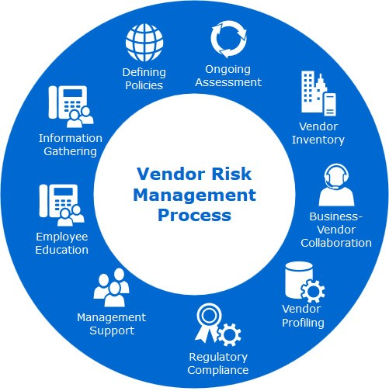
Vendor Risk Management
Vendor security risk management is a strategy designed to limit the number of threats, vulnerabilities, and weaknesses your organization faces due to the vendors in your supply chain.
A vendor is typically a third-party organization that sells a product, service, or piece of equipment that your business needs to operate.
Notes:
Vendor security risk management is a strategy designed to limit the number of threats, vulnerabilities, and weaknesses your organization faces due to the vendors in your supply chain. A vendor is typically a third-party organization that sells a product, service, or piece of equipment that your business needs to operate.
As technology and communications allow businesses to expand their supply chains, the complexity of vendor risk management increases. Your business is likely working with more vendors than ever before, and each of those vendors is going to pose some level of risk to your organization
Each vendor, upon being connected to your organization, is going to carry some level of cybersecurity risk. If they fail to uphold their end of the deal, or if they’re the victim of a cyberattack, it could impact your organization directly. An effective risk assessment, as part of a greater vendor risk management plan, strives to identify these potential failure points long before they become a problem and fix them.

Slide 16
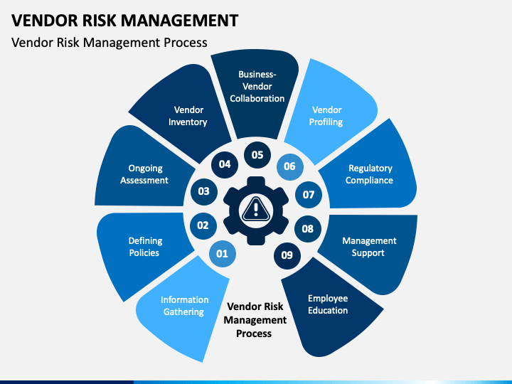
Vendor Risk Management
The Cycle of Vendor Risk Management
Step 1: Analysis – The company identifies the inherent risk of the relationship and the level of due diligence to be performed. Accordingly, the company evaluates the third party’s security posture and performs a gap analysis.
Notes:
Vendor security risk management is an ongoing process, and one you’ll execute with every vendor you bring into your supply chain. Typically, the process looks like this:
Step 1: Analysis – The company identifies the inherent risk of the relationship and the level of due diligence to be performed. Accordingly, the company evaluates the third party’s security posture and performs a gap analysis.

Slide 17
Vendor Risk Management
The Cycle of Vendor Risk Management
Step 2: Engagement – The company and third party collaborate on how to remediate gaps.
Step 3: Remediation – The third party fixes the cyber gaps.
Notes:
Vendor security risk management is an ongoing process, and one you’ll execute with every vendor you bring into your supply chain. Typically, the process looks like this:
Step 2: Engagement – The company and third party collaborate on how to remediate gaps.
Step 3: Remediation – The third party fixes the cyber gaps.

Slide 18
Vendor Risk Management
The Cycle of Vendor Risk Management
Step 4: Approval – The company approves the third party or rejects it based on risk tolerance.
Step 5: Monitoring – The company continues to monitor the third party to detect any cyber gaps
Notes:
Vendor security risk management is an ongoing process, and one you’ll execute with every vendor you bring into your supply chain. Typically, the process looks like this:
Step 4: Approval – The company approves the third party or rejects it based on risk tolerance.
Step 5: Monitoring – The company continues to monitor the third party to detect any cyber gaps.

Slide 19

Social networks and vendor security risks
Social networks are very popular in today's world.
Usually, a social network is defined as a small-world network, consisting of a set of individuals (persons, groups, organizations) connected by personal, work, or trust relationships.
Notes:
Social networks are very popular in today's world. Usually, a social network is defined as a small-world network, consisting of a set of individuals (persons, groups, organizations) connected by personal, work, or trust relationships. Social networking is then a quite broad and generic notion, which in the Web context might be applied to any kind of virtual community. For instance, users registered to a Web service, such as Web mail, online journals, or newspapers requiring a subscription, can be considered as a social network. In the following, we adopt the definition, according to which an online community’s Web site can be considered a Web-based social network only if it satisfies the following conditions:
• Relationships are explicitly specified by its members, and not inferred from existing interactions (e.g., a mailing list can be used to infer implicit relationships).
• Relationships are stored and managed by using technologies, such as database management systems, allowing relationship analysis and regulating access and retrieval of relationship data.
• Members are able to access relationship information, at least partially.

Slide 20

Social networks and vendor security risks
Key Terms
Notes:
Social media is one area where security teams have faced a steep learning curve. Beyond being used by employees connected to corporate networks, platforms such as LinkedIn, Facebook and Twitter have been harnessed by enterprises as toolkits to conduct brand awareness, customer service, advertising and recruitment processes. However, each user on every platform presents a social media risk for security pros to contend with -- and the risks are plenty.
From social engineering and malicious applications to noncompliance and fraud, organizations must understand the scope and consequences social media.

Slide 21

Social networks and vendor security risks
Relationship-Based Access Control:
An access control paradigm specifically tailored to social networks, according to which social network members authorized to access a given resource are denoted in terms of the relationships they must participate in to get the access.
Notes:
Social media and social networking or messaging applications can pose a number of security and privacy risks to both organizations and individuals when used in an inappropriate or unsafe manner.
Relationship-Based Access Control: An access control paradigm specifically tailored to social networks, according to which social network members authorized to access a given resource are denoted in terms of the relationships they must participate in to get the access.

Slide 22
Social networks and vendor security risks
Social Network:
A small-world network consisting of a set of individuals (persons, groups, organization) connected by personal, work, or trust relationships. Usually modelled as a graph, where nodes correspond to social network members, whereas edges denote the relationships existing between them.
Notes:
Social Network: A small-world network consisting of a set of individuals (persons, groups, organization) connected by personal, work, or trust relationships. Usually modelled as a graph, where nodes correspond to social network members, whereas edges denote the relationships existing between them.

Slide 23
Social networks and vendor security risks
Social networks.
Communicating and sharing information with those around us is a part of everyone's life and has evolved from simple text messages to emails and to what we now call social media platforms. What is not very well known or realized is the fact that our exposure in the online environment comes with a lot of risks.
Notes:
Social networks. Communicating and sharing information with those around us is a part of everyone's life and has evolved from simple text messages to emails and to what we now call social media platforms. What is not very well known or realized is the fact that our exposure in the online environment comes with a lot of risks.

Slide 24
Social networks and vendor security risks
Privacy-Aware Access Control:
In the context of social networks, denotes an access control paradigm where access control requirements of social network members are enforced without disclosing private information about the relationships they participate in.
Web-Based Social Network:
A Web-based system that allows its registered members to establish relationships with other members and to share different types of information (e.g., personal data, contacts, multimedia resources).
Notes:
Other key terms are
Privacy-Aware Access Control
Web-Based Social Network

Slide 25

Social networks and vendor security risks
Social Network Analysis:
A discipline aimed at collecting statistical data from the analysis of social network topology.
Edge Perturbation:
Graph anonymization technique aimed at hiding the actual social network relationships by performing a set of random edge deletions/ insertions in the network graph.
Notes:
Other key terms are
Privacy-Aware Access Control
Web-Based Social Network
Social Network Analysis
Edge Perturbation
Social Network Relationship
And many more – like Graph Anonymization: Technique aimed at hiding private information about social network members when performing social network analysis. Node anonymization and edge perturbation are the two main graph anonymization techniques currently used.
Also, the term Node Anonymization, which is a Graph anonymization technique aimed at hiding social network members’ identities by labelling the corresponding nodes with random identifiers (naïve anonymization), or, in case nodes are associated with attributes which can be used to identify the corresponding user, by using techniques based on k-anonymity.

Slide 26

Social networks and vendor security risks
Social Network Relationship:
A relationship concerning two members of a social network. In WBSNs, besides personal/work relationships (e.g., friend/colleague), also trust relationships may be supported which denote how much a one member trusts another. In the graph representation of a social network, relationships are usually denoted by edges, labelled with a relationship type and/or a relationship trust level.
Notes:
Social Network Relationship
And many more – like Graph Anonymization: Technique aimed at hiding private information about social network members when performing social network analysis. Node anonymization and edge perturbation are the two main graph anonymization techniques currently used.
Also, the term Node Anonymization, which is a Graph anonymization technique aimed at hiding social network members’ identities by labelling the corresponding nodes with random identifiers (naïve anonymization), or, in case nodes are associated with attributes which can be used to identify the corresponding user, by using techniques based on k-anonymity.

Slide 27
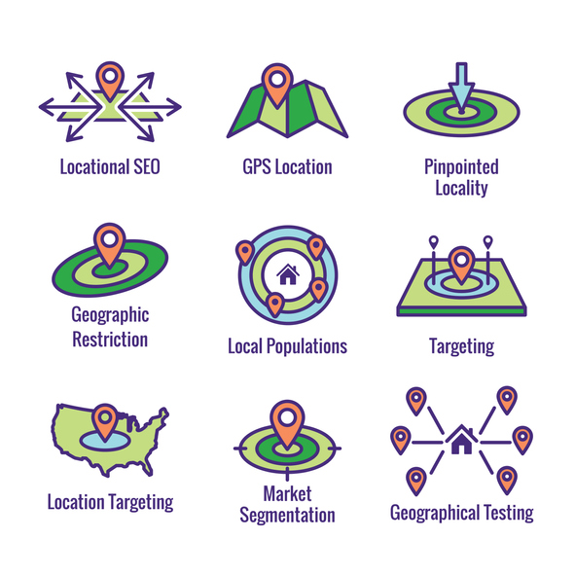
Social networks and vendor security risks
Risks, 1
Geotagging
• Represents the addition of geo-identifying data to photos, videos, websites and text messages by applications that can read your location or are allowed to do so in your settings;
• Be sure to turn off geotagging features in sensitive locations to avoid revealing your exact location, where you work, or where you live.
Notes:
Geotagging is the process of appending geographic coordinates to media based on the location of a mobile device. Geotags can be applied to photos, videos, websites, text messages, and QR codes, and could also include time stamps or other contextual information.
Why is Geotagging Important?
Geotagging provides helpful insight into consumer activity. By using geotags to analyze where and how consumers interact with their brands, organizations can provide specialized offers and messaging. Geotags also reveal where individuals are when engaging with a website, or where they move throughout the day with their mobile device.

Slide 28
Social networks and vendor security risks
Risks,2
"Audience"
• It's a general term that refers to who is able to see and/or comment on your posts;
• Your friend group can change at any time and be able to view a post that contains information about you. You may intentionally share something with your "friends", but what they do with the post is beyond your personal control.
Notes:
"Audience“ is a general term that refers to who is able to see and/or comment on your posts.

Slide 29

Social networks and vendor security risks
Risks, 3
Identity
• Describes the range of information that specifically relates to an individual;
• It should be kept in mind that there are people who use social media as a research method to search for identity information, with possible malicious intent, such as identity theft, fraud, embezzlement or intimidation.
Notes:
The term “identity” is defined as “The effort to recognize and understand individual audience members (including customers, prospects, and other visitors) across channels and devices such that brands can interact with those individuals in ways that are relevant to, meaningful to, and supportive of overarching business objectives.” Businesses can benefit from greater customer engagement and loyalty by providing customers with a platform that keeps their shared information safe. Customers, on the other hand, get the assurance of a secure and confidential experience.

Slide 30

Measures - Improve the Cyber Security
Password
• It is recommended to use a different password for each online account;
• It should be at least 10 characters long and contain uppercase letters, lowercase letters, numbers and special characters;
• It must not be disclosed to anyone, no matter how close or trusted the person we want to tell is;
To be continued
Notes:
Password
• It is recommended to use a different password for each online account;
• It should be at least 10 characters long and contain uppercase letters, lowercase letters, numbers and special characters;
• It must not be disclosed to anyone, no matter how close or trusted the person we want to tell is

Slide 31
Measures - Improve the Cyber Security
Password
• It is recommended not to use personal information when creating a password (eg: parents' names, date of birth, pet's name, etc.);
• Change your password periodically;
• Sign out of your account when you're using a device that's not yours or is being used by someone else.
Notes:
Password
• It is recommended not to use personal information when creating a password (eg: parents' names, date of birth, pet's name, etc.);
• Change your password periodically;
• Sign out of your account when you're using a device that's not yours or is being used by someone else.

Slide 32
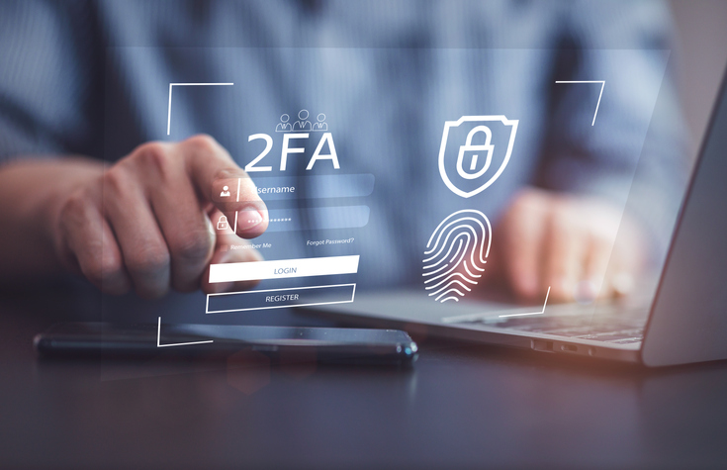
Measures - Improve the Cyber Security
Do your security updates on time!
• Social media platforms regularly introduce new privacy and security settings. These can be found in your account settings and it is recommended that you check them regularly;
• Use the two-factor authentication (2FA) option to make sure someone isn't trying to hack your account.
Notes:
Do your security updates on time!
• Social media platforms regularly introduce new privacy and security settings. These can be found in your account settings and it is recommended that you check them regularly;
• Use the two-factor authentication (2FA) option to make sure someone isn't trying to hack your account.

Slide 33
Measures - Improve the Cyber Security
Do not accept friend requests from anyone!
• Accept or send friend requests only from/to people you meet in real life or to public people you are interested in by taking care to follow their official profiles;
• DO NOT FORGET! If you feel attached to certain accounts you can restrict their access to your posts or you can block the account.
• DO NOT click!
Notes:
Do not accept friend requests from anyone!
• Accept or send friend requests only from/to people you meet in real life or to public people you are interested in by taking care to follow their official profiles;
• DO NOT FORGET! If you feel attached to certain accounts you can restrict their access to your posts or you can block the account. You also have the option to report accounts or posts for reasons such as: fake account, fake name, posts with inappropriate content, incitement to violence, false information, etc.
• DO NOT click!
• Many attackers use social engineering to gain a person's trust in order to later gain access to information;
• Do not open links and attachments from social media if you are not 100% sure of the source (e.g. websites offering prizes are often intended to steal information);
• If from the chats, a friend seems to be behaving differently (asks a lot of questions, becomes very curious about his personal life, asks for money) there is a possibility that his account has been hacked and an attacker is using it for malicious purposes.

Slide 34

Measures - Improve the Cyber Security
Think twice before posting!
• Social media offers as much an opportunity to create a positive online reputation as a negative one, in addition, even if we "delete" a post, once it has appeared online it cannot be permanently deleted;
• Don't reveal too many personal details on social media! "About Me" fields are optional.
Notes:
Think twice before posting!
• Social media offers as much an opportunity to create a positive online reputation as a negative one, in addition, even if we "delete" a post, once it has appeared online it cannot be permanently deleted;
• Don't reveal too many personal details on social media! "About Me" fields are optional.

Slide 35

Measures - Improve the Cyber Security
• The boundary between professional and personal life in the online environment
• Do not disclose information about your employer online
• Don't post work photos or negative messages that put the employer in a bad light.
• Think before you post and don't risk your job.
Notes:
Again, Think twice before posting!
• The boundary between professional and personal life in the online environment
• Do not disclose information about your employer online
• Don't post work photos or negative messages that put the employer in a bad light.
• Think before you post and don't risk your job.

Slide 36
Measures - Improve the Cyber Security
Close old accounts!
• If you have old accounts on social media platforms that you no longer use, or even old accounts on the same platform, try to close them. In this way you create as few links as possible with current accounts being more protected from possible attackers;
• Older accounts or platforms may not be as secure as today's.
Notes:
Close old accounts!
• If you have old accounts on social media platforms that you no longer use, or even old accounts on the same platform, try to close them. In this way you create as few links as possible with current accounts being more protected from possible attackers;
• Older accounts or platforms may not be as secure as today's.

Slide 37
Measures - Improve the Cyber Security
Social media poses great risks
•Social networks pose high security and privacy risks due to their centralized architecture, their huge store of personally identifiable information that any hacker would love to have, and the general ignorance of the population about how to properly use social media. privacy settings to improve their online safety.
Notes:
Social media poses great risks
• Social networks pose high security and privacy risks due to their centralized architecture, their huge store of personally identifiable information that any hacker would love to have, and the general ignorance of the population about how to properly use social media. privacy settings to improve their online safety.

Slide 38
Measures - Improve the Cyber Security
Social media poses great risks
• Another very high risk, especially among teenagers, is trusting other people and the type of personal information disclosed online.
• This can be combated through technological means and the enforcement of security policies.
Notes:
Social media poses great risks
• Social networks pose high security and privacy risks due to their centralized architecture, their huge store of personally identifiable information that any hacker would love to have, and the general ignorance of the population about how to properly use social media. privacy settings to improve their online safety.
• Another very high risk, especially among teenagers, is trusting other people and the type of personal information disclosed online.
• This can be combated through technological means and the enforcement of security policies.
• We should consider information transmitted through social media to be insecure and therefore not transmit sensitive information through social media, thus the primary responsibility to stay safe rests with the USER

Slide 39
Measures - Improve the Cyber Security
Social media poses great risks
• We should consider information transmitted through social media to be insecure and therefore not transmit sensitive information through social media, thus the primary responsibility to stay safe rests with the USER
Notes:
Social media poses great risks
• Another very high risk, especially among teenagers, is trusting other people and the type of personal information disclosed online.
• This can be combated through technological means and the enforcement of security policies.
• We should consider information transmitted through social media to be insecure and therefore not transmit sensitive information through social media, thus the primary responsibility to stay safe rests with the USER

Slide 40
Measures - Improve the Cyber Security
Bad social media habits
• Social networks are widely used platforms by users today. We have a wide range of possibilities available.
• Some are more geared towards uploading photos or videos, others towards our opinion and in other cases simply to keep in touch with friends and family. In any case, we are dealing with platforms that have many users around the world.
Notes:
Bad social media habits
• Social networks are widely used platforms by users today. We have a wide range of possibilities available.
• Some are more geared towards uploading photos or videos, others towards our opinion and in other cases simply to keep in touch with friends and family. In any case, we are dealing with platforms that have many users around the world.
• This also makes hackers set their sights here. We will talk about these habits that should be changed in social networks if we want to keep our privacy and security.
• There are many types of platforms that we can find on the network that give us the opportunity to send messages to friends or family, commenting on photos, videos ...
• This makes them a very popular environment for both private users and businesses.
• However, this also causes you to have some risk to our security and privacy. Hackers can watch here to carry out their attacks. They can especially take advantage of bad user habits when using these platforms.

Slide 41
Measures - Improve the Cyber Security
Bad social media habits
• This also makes hackers set their sights here. We will talk about these habits that should be changed in social networks if we want to keep our privacy and security.
• There are many types of platforms that we can find on the network that give us the opportunity to send messages to friends or family, commenting on photos, videos ...
Notes:
Bad social media habits
• Social networks are widely used platforms by users today. We have a wide range of possibilities available.
• Some are more geared towards uploading photos or videos, others towards our opinion and in other cases simply to keep in touch with friends and family. In any case, we are dealing with platforms that have many users around the world.
• This also makes hackers set their sights here. We will talk about these habits that should be changed in social networks if we want to keep our privacy and security.
• There are many types of platforms that we can find on the network that give us the opportunity to send messages to friends or family, commenting on photos, videos ...

Slide 42
Measures - Improve the Cyber Security
Bad social media habits
• This makes them a very popular environment for both private users and businesses.
• However, this also causes you to have some risk to our security and privacy. Hackers can watch here to carry out their attacks. They can especially take advantage of bad user habits when using these platforms.
Notes:
• This makes them a very popular environment for both private users and businesses.
• However, this also causes you to have some risk to our security and privacy. Hackers can watch here to carry out their attacks. They can especially take advantage of bad user habits when using these platforms.

Slide 43
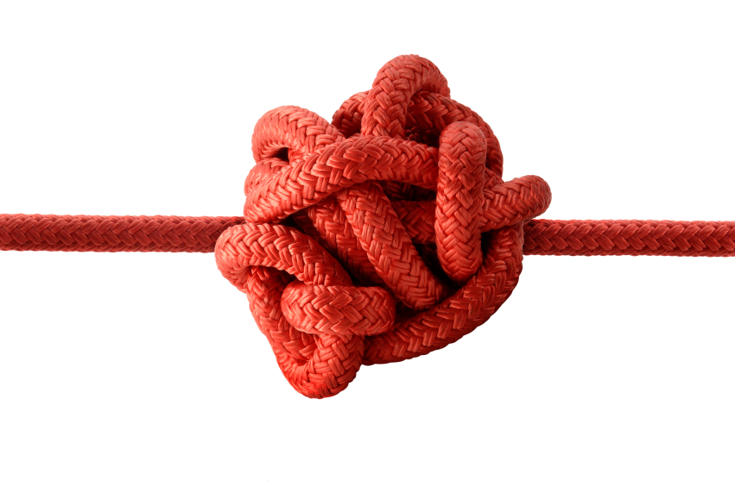
Measures - Improve the Cyber Security
Habits that need to be changed
• Privacy and security are very important factors for users.
• However, they are not always present.
• We can be victims of many types of attacks that compromise these two factors.
• We can also make mistakes when using social media and it affects us.
Notes:
Habits that need to be changed
• Privacy and security are very important factors for users.
• However, they are not always present.
• We can be victims of many types of attacks that compromise these two factors.
• We can also make mistakes when using social media and it affects us.

Slide 44
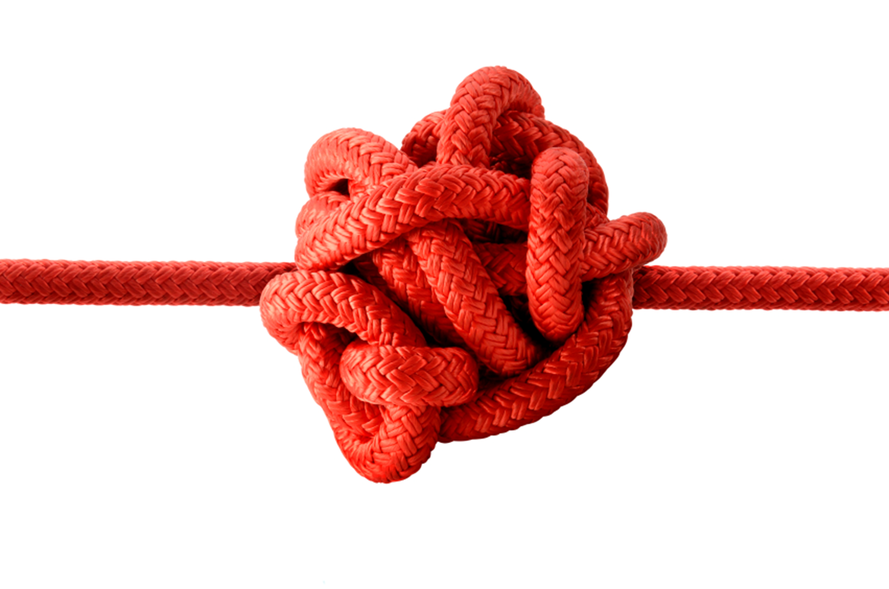
Measures - Improve the Cyber Security
Add any type of contact
• A very common error in social networks is adding any type of contact. This can happen on platforms like Facebook.
• It is possible that what we are adding is a bot rather than a real user.
• You need to know how to differentiate them and avoid adding any type of contact that your invite receives.
Notes:
Add any type of contact
• A very common error in social networks is adding any type of contact. This can happen on platforms like Facebook.
• It is possible that what we are adding is a bot rather than a real user.
• You need to know how to differentiate them and avoid adding any type of contact that your invite receives.

Slide 45
Measures - Improve the Cyber Security
Add any type of contact (2)
• Sometimes bots are designed solely to collect user data. This may compromise our privacy. We need to have a real filter on the contacts we add.
• It is important that we have people among our friends who are not a problem for our security and privacy.
Notes:
• Sometimes bots are designed solely to collect user data. This may compromise our privacy. We need to have a real filter on the contacts we add.
• It is important that we have people among our friends who are not a problem for our security and privacy.

Slide 46
Measures - Improve the Cyber Security
Don't connect with social networks from anywhere
• You often log in through social networks on any site. This is very comfortable, but not the best for privacy.
• Certainly on many occasions we find the possibility to register on a page or to connect to a platform through Facebook or Twitter. We avoid registering on that site and filling out a long form.
The problem is that we provide personal data to that website through Facebook. This data / information we share can be used by third parties for advertising purposes.
Notes:
Don't connect with social networks from anywhere
• You often log in through social networks on any site. This is very comfortable, but not the best for privacy.
• Certainly on many occasions we find the possibility to register on a page or to connect to a platform through Facebook or Twitter. We avoid registering on that site and filling out a long form. The problem is that we provide personal data to that website through Facebook. This data / information we share can be used by third parties for advertising purposes.

Slide 47

Measures - Improve the Cyber Security
Do not provide more information than necessary
• It is definitely one of the worst habits that many users have. They enter a lot of personal data, information that is not really necessary, into social networks.
• For example, data such as our phone number, email address, information about where we live ... All this affects our advertising and could be used for bad purposes.
Notes:
Do not provide more information than necessary
• It is definitely one of the worst habits that many users have. They enter a lot of personal data, information that is not really necessary, into social networks.
• For example, data such as our phone number, email address, information about where we live ... All this affects our advertising and could be used for bad purposes.
• Don't give more information than is really necessary. In this way we will improve our privacy in the network, and we can even avoid certain security problems.
Psychology discipline
• It is necessary to understand the concept and understand the thoughts and behaviours of both the attacker and the victim.
• The methods are important for social engineering because they are used to bypass protections that may be in place, such as firewalls and systems used to identify intruders.
• It helps to understand employee actions that are one of the main causes of data breaches.

Slide 48
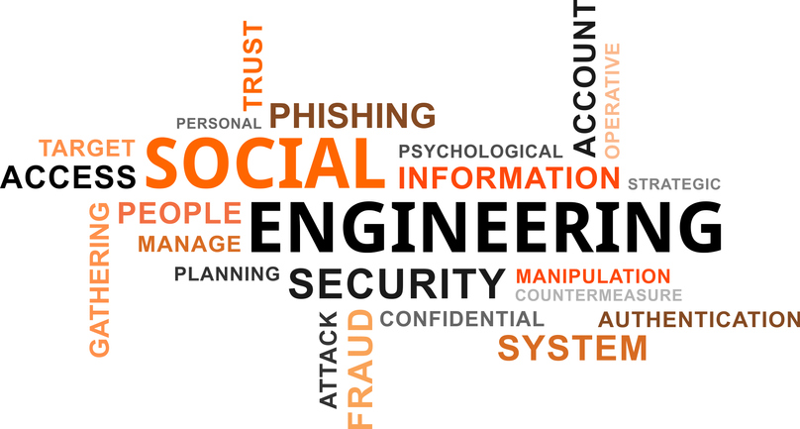
Measures - Improve the Cyber Security
Social engineering from an interdisciplinary perspective
Due to the technique used by hackers, it is necessary to approach an interdisciplinary perspective such as information technology, psychology, business and ethics.
Notes:
We do not protect our privacy
• A final mistake is not properly protecting privacy. For example, we leave our profiles open for anyone to enter.
• We provide information to anyone who might collect it to create a profile for us and even send targeted advertising or perform various attacks that affect our security.
Social engineering from an interdisciplinary perspective
Due to the technique used by hackers, it is necessary to approach an interdisciplinary perspective such as information technology, psychology, business and ethics.

Slide 49
Measures - Improve the Cyber Security
The discipline of information technology
• Social engineering should be discussed in the context of current information systems and their defence used as a form of risk mitigation.
• Multi-factor authentication is a common and often effective way for organizations to confirm that the person accessing systems should actually have that access
• An additional factor could be the use of a virtual private network (VPN), i.e. authentication to further validate the user.
Notes:
The discipline of information technology
• Social engineering should be discussed in the context of current information systems and their defence used as a form of risk mitigation.
• Multi-factor authentication is a common and often effective way for organizations to confirm that the person accessing systems should actually have that access
• An additional factor could be the use of a virtual private network (VPN), i.e. authentication to further validate the user.

Slide 50
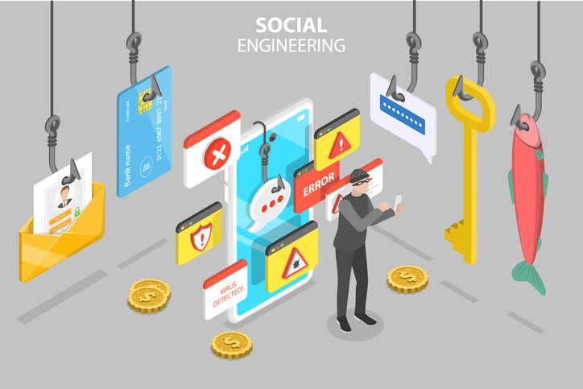
Measures - Improve the Cyber Security
Business perspective
• it is important because social engineering can affect many types of businesses and have implications for how organizations are structured and managed.
• it helps determine the factors that influence social engineering attacks and is beneficial if considered in more specific terms in relation to the following business areas: training and development, documented policies, internal audit procedures, budgets and organizational culture.
• can detect deficiencies in any of the areas that may contribute to attacks.
Notes:
Business perspective
• it is important because social engineering can affect many types of businesses and have implications for how organizations are structured and managed.
• it helps determine the factors that influence social engineering attacks and is beneficial if considered in more specific terms in relation to the following business areas: training and development, documented policies, internal audit procedures, budgets and organizational culture.
• can detect deficiencies in any of the areas that may contribute to attacks.

Slide 51
Measures - Improve the Cyber Security
Ethical perspective
• it is important in the context of social engineering and related research because the idea of manipulating another human being violates many ethical principles.
• helps, in the case of a social engineering event, to treat the victims.
Notes:
Ethical perspective
• it is important in the context of social engineering and related research because the idea of manipulating another human being violates many ethical principles.
• helps, in the case of a social engineering event, to treat the victims.
It is important to consider:
• each discipline, providing information on how to understand and interpret the subject, protect against different types of attacks, and understand the impact of social engineering from both a human and organizational perspective.
• that each discipline's interpretation of the subject is useful only when viewed in the context of the other disciplines.

Slide 52
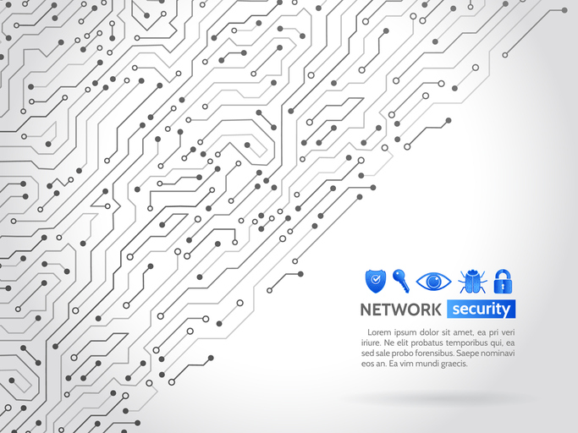
Security techniques
• Equipment inventory
• Inventory of applications and operating systems
• Wireless equipment control
• Network security design
• Limiting and controlling network ports, communication protocols and services
Notes:
Security techniques
• Equipment inventory
• Inventory of applications and operating systems
• Wireless equipment control
• Network security design
• Limiting and controlling network ports, communication protocols and services

Slide 53
Security techniques
• Protection of perimeter areas
• Physical access to locations
• Controlled use of administrative privileges
• Monitoring and controlling user accounts
• Skills assessment and security training
Notes:
• Protection of perimeter areas
• Physical access to locations
• Controlled use of administrative privileges
• Monitoring and controlling user accounts
• Skills assessment and security training

Slide 54
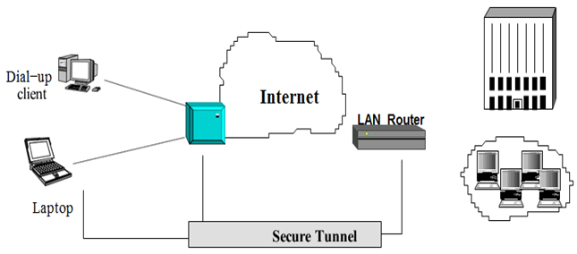
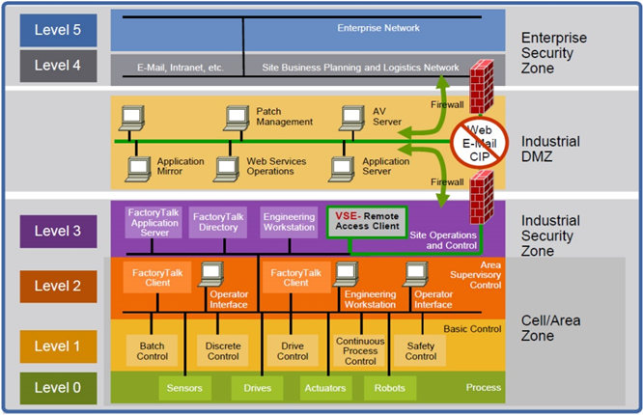
VPN
VPN (Virtual Private Network)
A virtual private network is a secure connection over an insecure network such as the Internet. Virtual means the existence of a unique network, a group of geographically distributed computers that communicate and can be administered as a single network.
Private means a virtual network with access control.
VPN for remote access
Creating a secure industrial infrastructure
Notes:
VPN (Virtual Private Network)
A virtual private network is a secure connection over an insecure network such as the Internet. Virtual means the existence of a unique network, regardless of topology, that is, a group of geographically distributed computers that communicate and can be administered as a single network.
Private means a virtual network with access control. which provides confidentiality, the integrity of messages and authenticates between the users and the computers participating in the communication.
Defense-in-Depth (DiD) supports this approach. Based on the notion that a single point of protection can and likely will be defeated, DiD security establishes multiple layers of protection through a combination of physical, electronic and procedural safeguards.
• A bank uses multiple security measures—such as video cameras, a guard, and a vault—this helps ensure that threats meet more than one line of defense.
• A security-in-depth approach comprises six main components:
1. Policies and Procedures
2. Physical
3. Network
4. Computer
5. Application
6. The device

Slide 55
Questions:
Questions Discussion Forum to be answered with a short explanation. Answers will be discussed with the mentor during the mentoring sessions
1. Which are the Risks in Social Networks
2. Measures to have Security and Privacy in Social Networks
3. Which are the main Security techniques in Social Networks
Self-assessment questions. After answering the learner can see the results and compare them with these saved on the platform
• Risks in Social Networks
• Security and Privacy in Social Networks
• Security techniques

Slide 56
Thank you for your attention
Notes:
Thank you for your attention

