Slide 1


Managementul riscurilor
Notes:
Hello viewers, welcome to this module on risk management. Risk management is a central task of every entrepreneurial activity. As more and more business tasks depend on the functionality of IT services, information security risk management gets more and more important.

Slide 2
Fundații

Slide 3
Motivația
Creează valoare pentru organizație
Esențial pentru a lua decizii
Ajută la tratarea incertitudinii
Notes:
When protecting an organization, it is essential to implement safeguards, which are specifically appropriate for the organization. Risk management supports this endeavor by assessing the risks with regards to the organizations assets and threat landscape. It therefore lays the foundation for an Internal control system, which helps to prevent fraud and ensures the security of products, services and activities
What might happen? What could be causes? What would be the impacts? How could we mitigate the impacts? Are typical questions we are addressed by risk management approaches
Risk management is often a requirement by law … however good risk management can bring significant value for the organization.
Especially when it comes to the questions which investments to make or how much security is enough, risk management plays an essential role
Last but not least risk management is a way to deal with uncertainty in a structured way
One of the most important objectives is to prevent damage and to lay the foundation for informed decisions regarding security spendings

Slide 4
Definirea riscului
“Efectul incertitudinii asupra obiectivelor” (ISO 31000)
Rezultatele pot fi negative sau pozitive
Notes:
But what is risk? It is important to stress that risk is always connected with uncertainty, which means it is not already known.
This makes it sometimes difficult to assess and evaluate risks. Furthermore, risk associated with an organization has a certain probability of occurrence,
If positive
Uncertainty → event with unknown outcome
Likelihood → probability of occurrence
Threat → potential source of harm
Can be positive or negative
Are often measured by impact and likelihood
Will cause damage if they occur
Are caused and increased by risk factors
Can and should be managed
Are reduced by mitigation techniques

Slide 5
Definirea riscului – Termeni de bază
Amenințare
Probabilitate
Impact
Notes:
Threat → potential source of harm, negative event -> malicious, accidental events, natural disasters, …
Likelihood → probability that a threat materializes
Impact -> consequences that arise when an asset is affected by a certain threat … impacts can be measured qualitatively or quantitively

Slide 6
Riscuri de securitate a informațiilor

Slide 7
Risc de securitate a informațiilor
Periclitați obiectivele de securitate a informațiilor :
  Confidențialitatea
  integritate
  disponibilitate
Notes:
Information security risks are those risk which might effect the security protection goals, this includes attacks against information systems but also risks such as human error or natural disasters
IS Risks can affect IT operations, assets, individuals, and the entire organisation
Far-reaching consequences (financial penalties, loss of reputation/partners, …)

Slide 8
Risc de securitate a informațiilor
Amenințări comune la securitatea informațiilor
Surse valoroase.
  BSI Amenințările elementare ale IT-Grundschutz-Compendiu
  ISO 27005 – Anexa C
  Scenarii de risc COBIT…
Notes:
. IT risk encompasses a wide range of potential events, including data breaches, regulatory enforcement actions, financial costs, reputational damage, and more.
Attacks against network
Insider Threats
Social Engineering
Malware/Ransomware
Phishing
DDoS
Supply Chain Attacks
Injection Attacks

Slide 9
Abordarea managementului riscului

Slide 10
Managementul riscurilor
Abordare sistematica
Adaptat organizației
Necesită acceptarea managementului
Notes:
Systematic approach to assess risk in a way that results are comparable over time
The results are vital to define how much money and resources should be spend on security
Good risk management has to be tailored to the organization’s needs and threat landscape
To be successful it is necessary to promote the importance of risk management within the organization
Increases business success rates
Improves corporate governance, product quality, compliance, …
Not a separated activity
Deeply linked to the main activities and processes
Creates value
Integral part of organisational processes
Requires a systematic process

Slide 11

Identificarea riscului
RISK
Notes:
Checklists, Interviews, …
Risk sources can be internal or external
Risk sources can be in our control or outside of it
All possible risks and risk sources should be gathered during the identification process
Identified risks should be assigned to risk owners
Risks should be linked to affected assets
Threats and vulnerabilities should be identified and catalogued
Existing controls and mitigations should be identified
Consequences and effects of the occurrence of risks should be identified

Slide 12
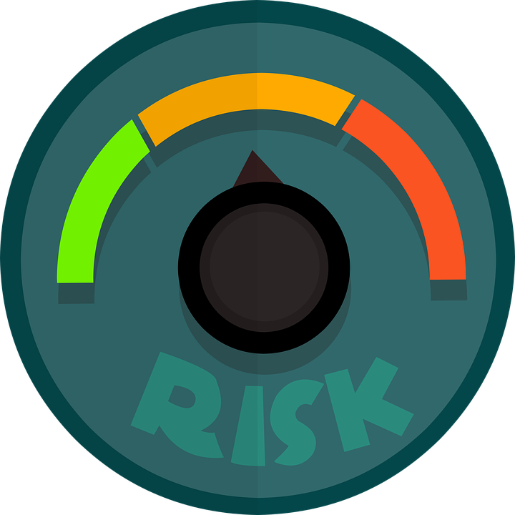
Analiza de risc
Notes:
Level of detail of the analysis should be done according to:
The criticality of the affected asset
The magnitude of the known vulnerability
The likelihood of the occurrence of the risk event
Qualitative Risk Analysis:
Describes risk potential with attributes (i.e. low, medium high)
Good overview, but highly subjective
Quantitative Risk Analysis:
Describes risk potential with numerical values based on existing data
Struggles with new risks without sufficient historical data

Slide 13

Evaluarea riscurilor
Notes:
The previously defined risk evaluation criteria are used in this phase
Consistency of the evaluation criteria during this process is important
Risk acceptance is possible, but accepting many risks can multiply existing problems.
Context of the organisation and its stakeholders should be considered
Results of the risk evaluation:
Decision whether any activity is needed for the evaluated risk
Prioritised list for risk treatment activities

Slide 14

Tratamentul riscului

Slide 15
Cadre de evaluare a riscurilor
Cadre comune de evaluare a riscurilor :
  Evaluarea amenințărilor critice operaționale, a activelor și a vulnerabilităților (OCTAVE)
  Analiza factorială a riscului informațional (FAIR)
  Cadrul de management al riscului NIST (NIST-RMF)
  Evaluarea riscului agentului de amenințare (TARA)
  COSO Enterprise Risk Management (COSO ERM)
  ISO 31000 Managementul riscurilorISO 27005 Managementul riscurilor de securitate a informațiilor
Notes:
Offer a guiding approach towards assessing and managing risks for organisations
Include set procedure on how to identify, analyse, evaluate and sometimes mitigate risks
Present information in a way that is understandable for non-technical personnel
Include templates and best practice guidelines
Include objective evaluation and assessment criteria
Help organisations to prioritise risks and risk treatment

Slide 16
OCTAVE Allegro

Slide 17
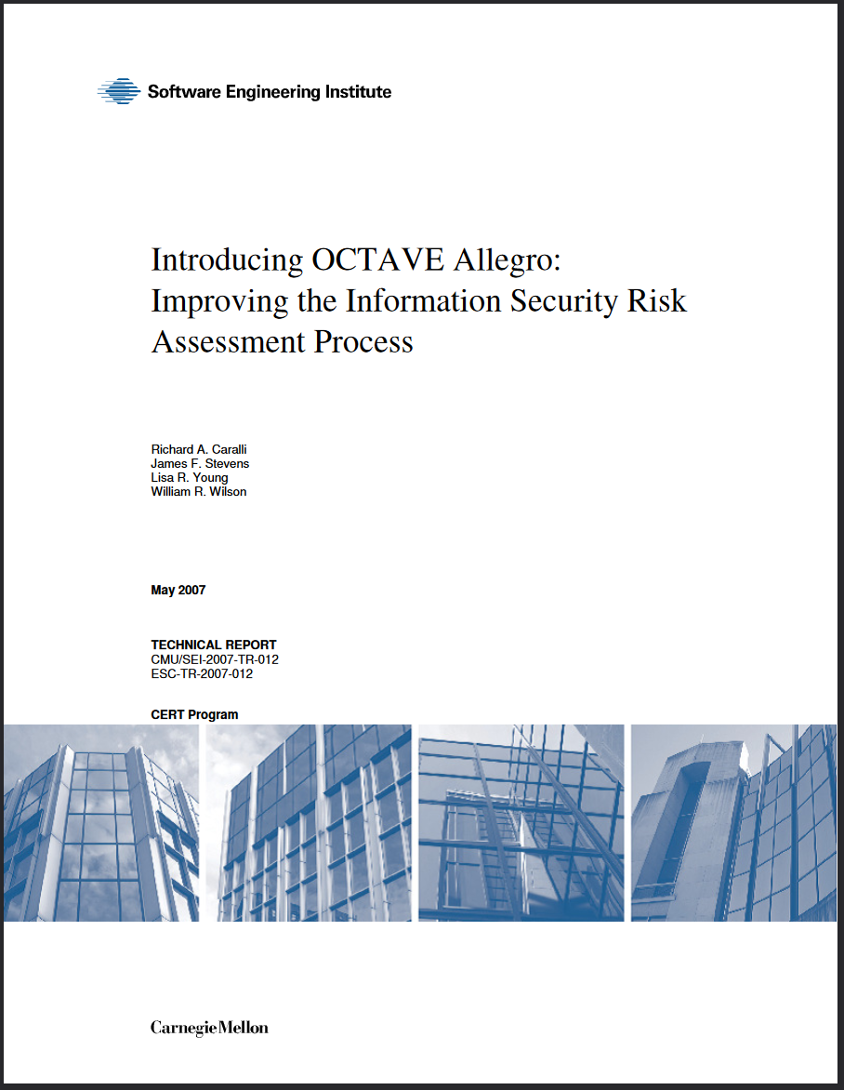
OCTAVE Allegro
Abordare bazată pe activele informaționale
Ușor de folosit
Potrivit pentru companii mici
Notes:
Information Asset is in the center of the method OCTAVE Allegro
Methodology to support assessing information security risks
focusing primarily on information assets in the context of how they are used, where they are stored, transported, and processed, and how they are exposed to threats, vulnerabilities, and disruptions as a result.
Supports the creation of risk evaluation criteria
Highlights organisation’s risk tolerance levels
Strong focus on organisational assets
Allocates risks to threats and vulnerabilities
Assesses possible impacts and consequences
Supports risk mitigation strategy development

Slide 18
OCTAVE Allegro
Stabilirea directiilor
Active de profil
Identificați amenințările
Identificați/Reduceți Riscurile
Pasul 1 - Stabiliți criteriile de măsurare a riscului
Pasul 2 - Dezvoltați un profil de active de informații
Pasul 4 - Identificați zonele de îngrijorare
Pasul 6 - Identificați riscurile
Pasul 3 - Identificați containerele de active de informații
Pasul 5 - Identificați scenariile de amenințare
Pasul 7 - Analizați riscurile
Pasul 8 - Selectați abordarea de atenuare

Slide 19
Pasul 1 – Stabiliți criteriile de măsurare a riscului
Criterii calitative de măsurare a riscului
Luarea în considerare a diferitelor zone de impact, cum ar fi :
  Reputație/încrederea clientului
  Financiar
  Productivitate
  Securitate si sanatate
  Amenzi/ sancțiuni legale…
Notes:
OCTAVE Allegro uses qualitative risk measurement criteria as a foundation
If also suggests to assess different impact areas, such as financial, reputation or legal
It is important to stress that the impact areas and criteria should be well elaborated as those should be used throughout all assessments in order to make results comparable amongst each other
When all impact areas are defined, it is recommended to prioritize and weight the individual impact areas

Slide 20
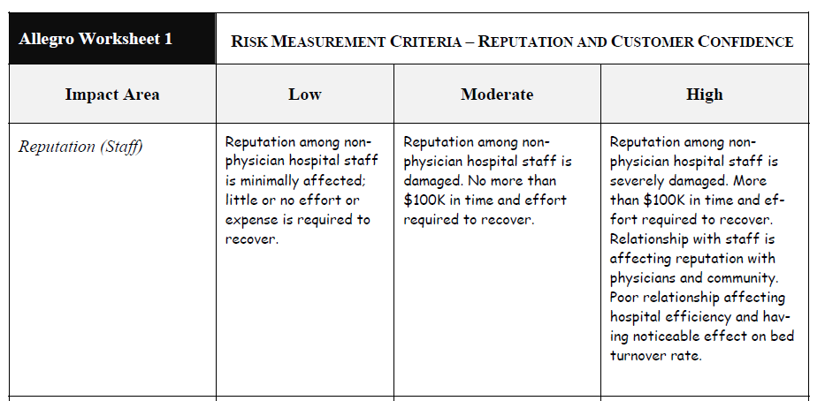
Pasul 1 – Stabiliți criteriile de măsurare a riscului
Source: SEI 2007

Slide 21
Pasul 2 – Dezvoltați un profil de active de informații
Identificarea bunurilor informaționale
Concentrați-vă pe cele mai critice active
Crearea profilurilor de active informative
Atribuiți proprietari la activele critice
Notes:
Typical questions in this step are “which information are of most value for your organization” or “which information is required to perform our main business processes”
Identification and collection of information assets
Focus on the most important/critical assets
Creation of information asset profiles describing the characteristics and security requirements
Descriptions must be clear and consistent
Assign owners to critical assets

Slide 22
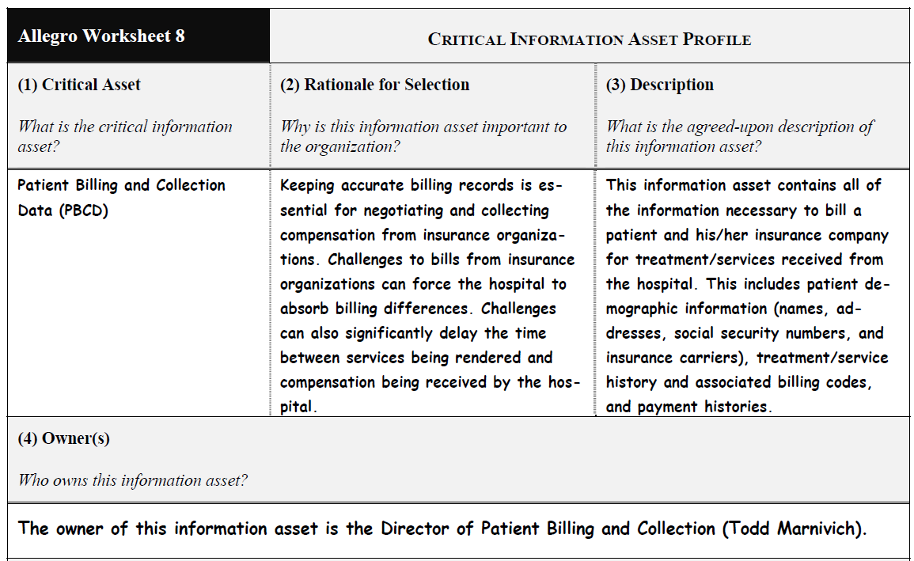
Pasul 2 – Dezvoltați un profil de active de informații
Sursă : SEI 2007

Slide 23
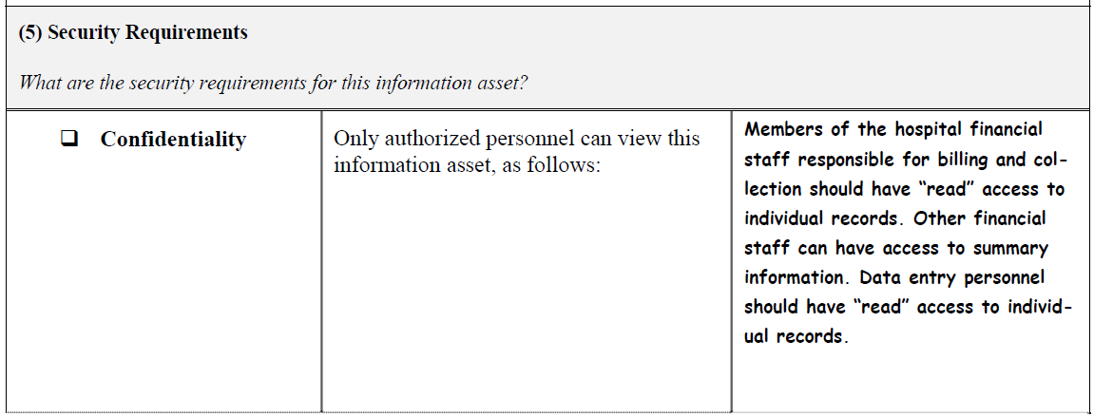
Pasul 2 – Dezvoltați un profil de active de informații
Sursă : SEI 2007

Slide 24
Pasul 3 – Identificați containerele de active de informații
Containere de active informative
  stocarea, transportarea, procesarea informațiilor
  tehnice, fizice și de oameni
Notes:
Containers outline where information assets are
Stored
Transported
Processed
Points of vulnerability and threats that put the information asset at risk
e.g. software, hardware, network, people
owner of the container often takes custodianship of your information asset -> helps to identify appropriate risk mitigation measures
Information asset containers can include
Technology and technical assets
Written assets and documentation
Knowledge and competency assets of people

Slide 25
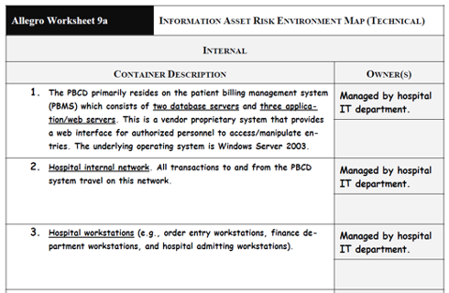
Pasul 3 – Identificați containerele de active de informații
Sursă : SEI 2007

Slide 26
Pasul 4 – Identificați zonele de îngrijorare
Primul pas în identificarea riscului
Brainstorming despre posibile amenințări și consecințe
Luați în considerare cerințele de securitate și fiți specific
Notes:
Area of concern is a statement about an event that could impact an identified information asset – so in this step possible threats are identified and documented
It is suggested to identify possible threats
Areas of concern form the foundation for the upcoming steps
The purpose of this step is not to capture a complete list of all possible threat scenarios for an information asset; instead, the idea is to quickly capture those situations or conditions that come immediately to mind that could affect your asset and record them.
Brainstorming about
Possible conditions threatening the information asset
Possible consequences
Consider the various actors, motives, and outcomes inherent in the area of concern. Keep in mind the security requirements that you have set for your information asset and how they might be compromised

Slide 27
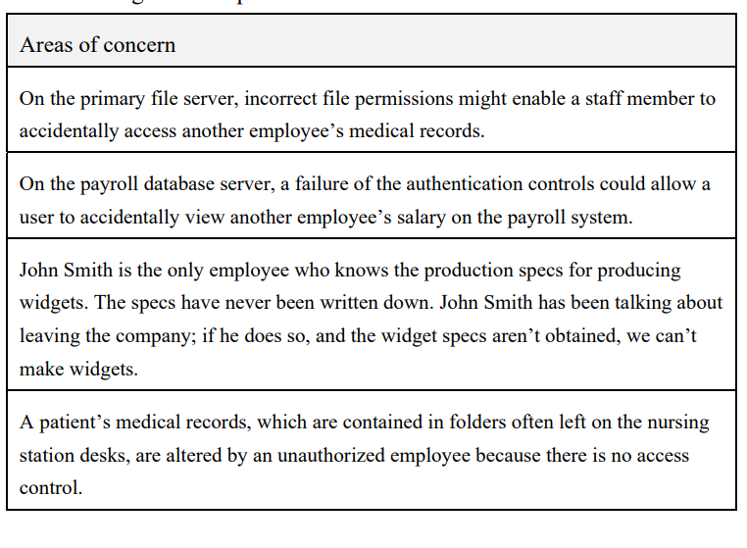
Pasul 4 – Identificați zonele de îngrijorare
Sursă : SEI 2007

Slide 28
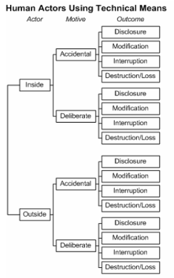
Pasul 5 – Identificați scenariile de amenințare
Domeniile în cauză sunt detaliate în
continuare
  Actori umani care folosesc mijloace tehnice
  Actori umani care folosesc accesul fizic
  Probleme tehnice
  Alte probleme
Notes:
areas of concern are expanded into threat scenarios that further detail the properties of a threat
Asset – something of value to the enterprise
Access/means – how the asset is accessed by an actor (technical means, physical access). Access applies only to human actors.
Actor – who or what may violate the security requirements (confidentiality, integrity, availability) of an asset
Motive – the intent of an actor (e.g., deliberate or accidental). Motive applies only to human actors.
Outcome – the immediate result (disclosure, modification, destruction, loss, interruption) of violating the security requirements of an asset
Areas of concerned are expended into threat scenarios (trees)
Human actors using technical means
Human actors using physical access
Technical problems (software crashes, hardware defects, malicious code)
Other problems (natural disasters, third party disruptions, power supply)

Slide 29
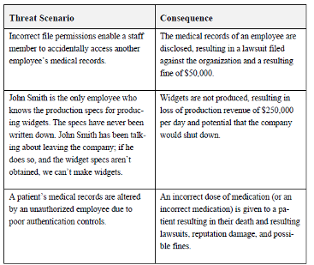
Pasul 6 – Identificați riscurile
Creați declarații de impact detaliate
Definirea consecințelor anumitor scenarii de amenințare
Source: SEI 2007

Slide 30
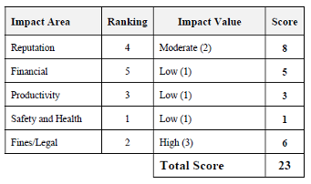
Pasul 7 – Analizați riscurile
Evaluarea riscurilor în termeni calitativi
  Impact
  Probabilitate
Scorurile de risc susțin prioritizarea
Source: SEI 2007
Notes:
Starting from the threat scenario and consequences of the previous step an impact value is assigned for each impact area. The upcoming risk score helps to prioritize in the later steps
A qualitative value assigned to describe the extent of impact to an organization when a threat scenario and resulting impact is realized. The impact value is derived from the risk measurement criteria.
Impact ExampleDefine what levels of impact mean in the context of the organization

Slide 31
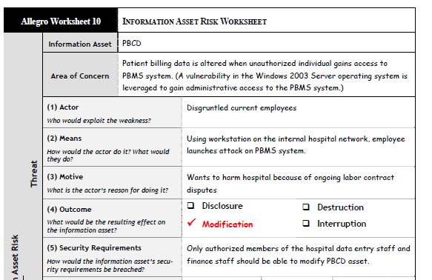
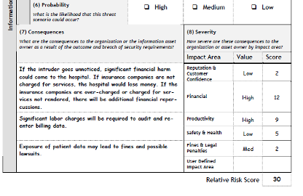
Pasul 7 – Analizați riscurile
Sursă : SEI 2007
Notes:
As a result you now get a a good information asset risk profile for each asset as seen in the example

Slide 32

Pasul 8 – Selectați abordarea de atenuare
Determinarea strategiei de risc.
  Accept
  Amâna
  Atenuează
  Transfer
Determinarea controalelor.
Evaluați riscul rezidual
Notes:
Select mitigation approach

Slide 33
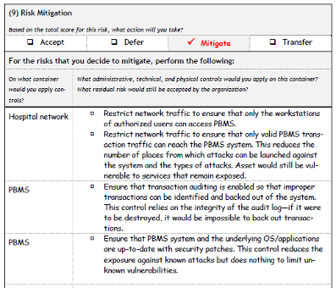
Pasul 8 – Selectați abordarea de atenuare
Sursă : SEI 2007

Slide 34
Vă mulțumim pentru atenție

Slide 35

FH-Prof. Mag. Dr. Simon Tjoa
simon.tjoa@fhstp.ac.at

