Slide 1


Module Privacy & Data Protection

Slide 2
Agenda:
1. Encryption of disks and partitions.
  Theoretical basics: principle of operation, encryption algorithms.
  Installing the programme (configuration, defining the disk, choosing parameters, generating keys).
2. Cryptography – introduction

Slide 3
Encryption of disks and partitions
VeraCrypt is a free open source disk encryption software for Windows, Mac OSX and Linux.
VeraCrypt is brought to you by IDRIX (https://www.idrix.fr) and based on TrueCrypt 7.1a.

Slide 4
Encryption of disks and partitions
VeraCrypt main features:
  Creates a virtual encrypted disk within a file and mounts it as a real disk.
  Encrypts an entire partition or storage device such as USB flash drive or hard drive.

Slide 5
Encryption of disks and partitions
VeraCrypt main features:
  Encrypts a partition or drive where Windows is installed (pre-boot authentication).
  Encryption is automatic, real-time (on-the-fly) and transparent.
  Parallelization and pipelining allow data to be read and written as fast as if the drive was not encrypted.

Slide 6
Encryption of disks and partitions
VeraCrypt main features:
  Encryption can be hardware-accelerated on modern processors.
  Provides plausible deniability, in case an adversary forces you to reveal the password: Hidden volume (steganography) and hidden operating system.
  More information about the features of VeraCrypt may be found in the documentation
  https://www.veracrypt.fr/en/Home.html

Slide 7
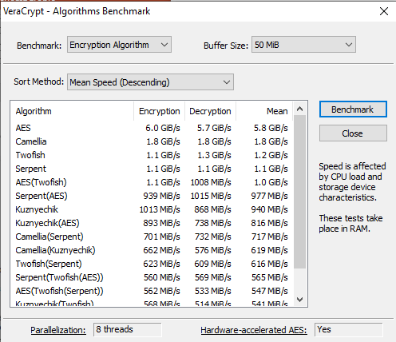
Encryption of disks and partitions
VeraCrypt enables encryption using the following algorithms: AES, Camellia, Kuznyechik, Serpent and Twofish; as well as multiple encryption with: AES-Twofish, AES-Twofish-Serpent, Serpent-AES, Serpent-Twofish-AES, Twofish-Serpent.

Slide 8
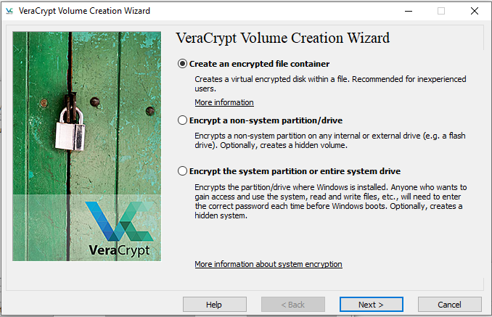
Encryption of disks and partitions – step-by-step
Step 1 – Open Volume Creation Wizard and select option „Create an encrypted file container”

Slide 9
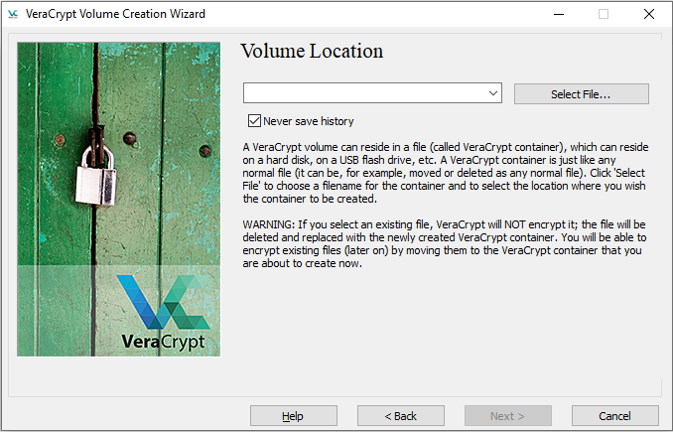
Encryption of disks and partitions – step-by-step
Step 2 – Select option „Standard VeraCrypt volume”

Slide 10
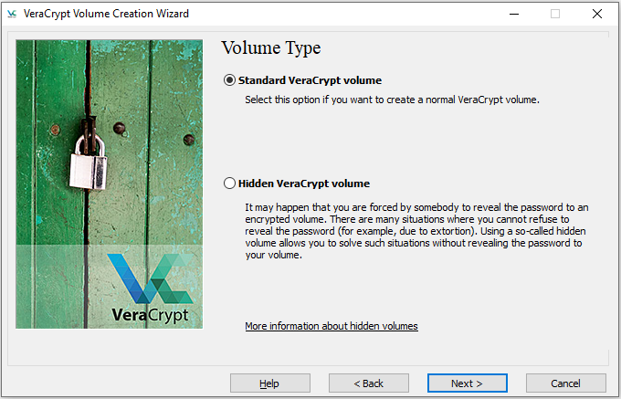
Encryption of disks and partitions – step-by-step
Step 3 – Specify Volume location

Slide 11
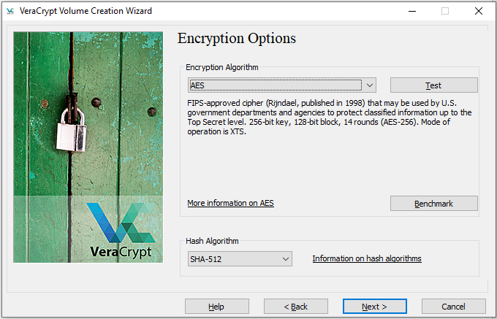
Encryption of disks and partitions – step-by-step
Step 4 – Select an encryption algorithm

Slide 12
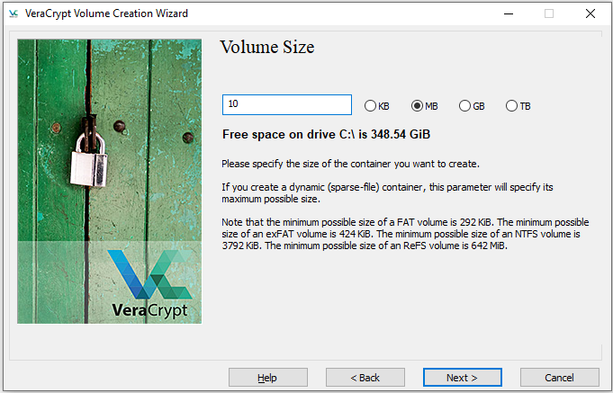
Encryption of disks and partitions – step-by-step
Step 5 – Specify Volume Size

Slide 13
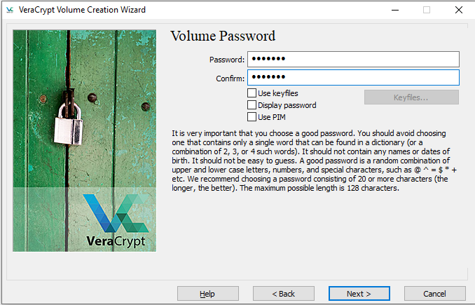
Encryption of disks and partitions – step-by-step
Step 6 – Create Volume Password

Slide 14
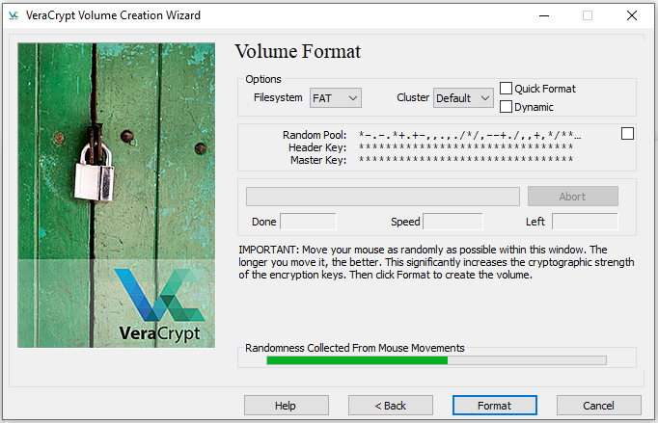
Encryption of disks and partitions – step-by-step
Step 7 – Format Volume

Slide 15
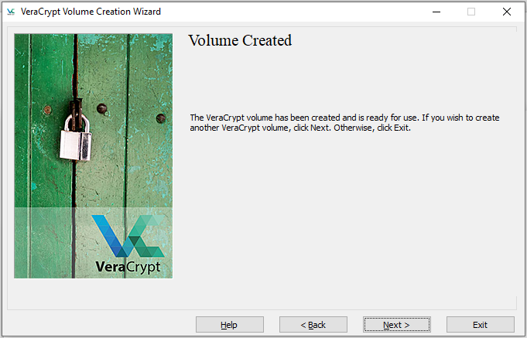
Encryption of disks and partitions – step-by-step
Step 8 – Final monit –Volume ready to use.

Slide 16

Encryption of disks and partitions – step-by-step
View the "test" file in notepad

Slide 17
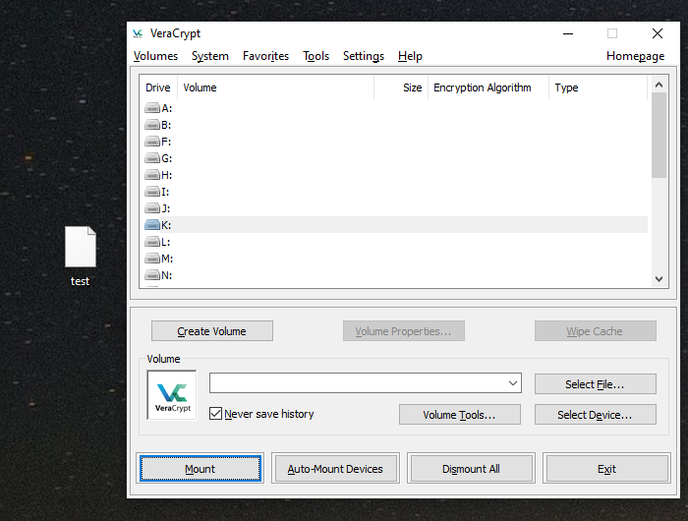
Encryption of disks and partitions – step-by-step
How to use VeraCrypt?

Slide 18
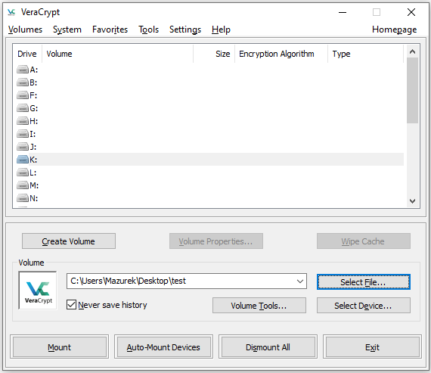
Encryption of disks and partitions – step-by-step
Step 1 – Select file – conatiner VeraCrypt

Slide 19
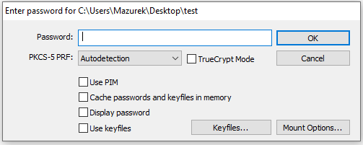
Encryption of disks and partitions – step-by-step
Step 2 – Select the Drive (for example letter K) and press buton „Mount”
Step 3 – Put correct password and press OK button

Slide 20
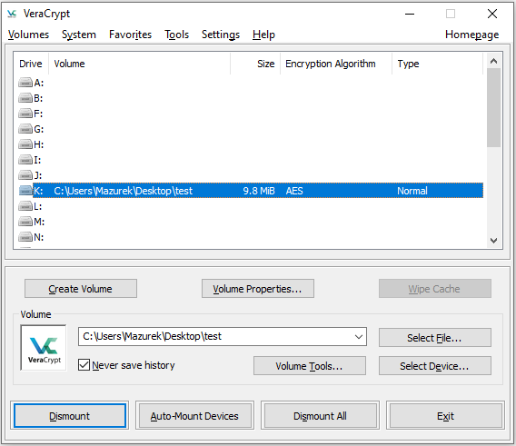
Encryption of disks and partitions – step-by-step
Step 4 – Volume correctly connected – ready to use

Slide 21
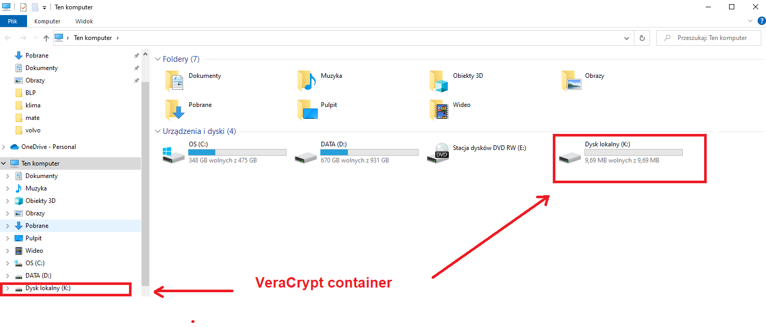
Encryption of disks and partitions – step-by-step
Step 5 – Now You have new virtual disk in Yours file system

Slide 22
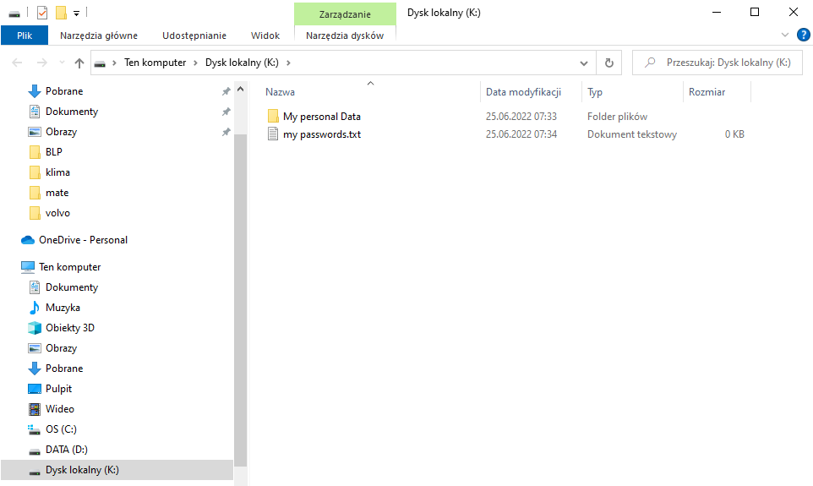
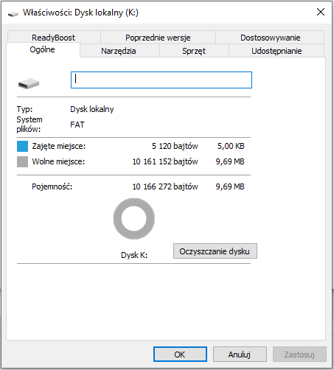
Encryption of disks and partitions – step-by-step
Step 6 – In the created VeraCrypt container, you can create new folders and any files, remembering only to limit the size of the created container.

Slide 23
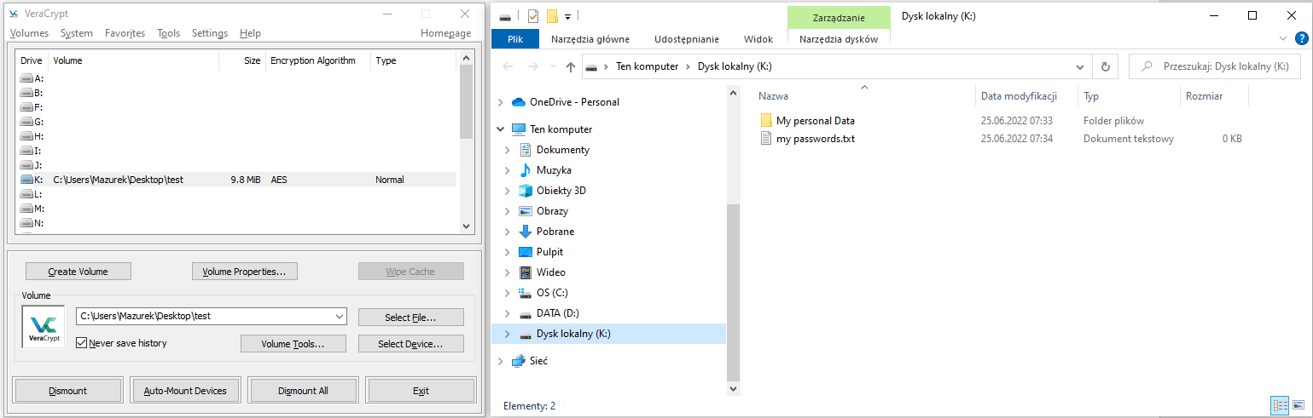
Encryption of disks and partitions – step-by-step
Step 7 – Safe termination of work with the VeraCrypt file – disk Dismount
Step 8 – Press the button Exit

Slide 24
Cryptography - basic definitions
Cryptography - the art of data protection in such a way that only a designated person can read it. It is implemented using encryption. The reverse process to encryption is called decryption.
Cryptanalysis - the art of reading encrypted messages without having the appropriate permissions (key, algorithm) - breaking codes.
Cryptology - a combination of cryptography and cryptanalysis.

Slide 25
Cryptography - basic definitions
Cryptogram (encrypted information) - it is ordinary information (so-called public) processed by the encryption function into an illegible form.
Encryption function (E) - converts (explicit) information (M) into unreadable (encrypted) (C)
Decryption function (D) - converts encrypted (unreadable) information (C) into explicit (decrypted) information (M).
E(M) = C, D(C) = M, D(E(M)) = M

Slide 26
Basic principles of cryptography
The opponent should not be underestimated.
The security of the cryptographic system must not be based on the secrecy of the algorithm.
Successful cryptographic systems should not be tweaked.

Slide 27
Basic principles of cryptography
Always consider the possibility of cryptographic errors or violating encryption discipline.
Correct use of the cryptographic system does not exempt from the use of other security measures.

Slide 28
Basic encryption errors
Simultaneous transmission of secret and open text.
Using the same key to encrypt two different plaintexts.
Using two different keys to encrypt the same plaintext.
Repeating stereotypical phrases in encrypted text.

Slide 29
Basic encryption errors
Using simple passwords and keys.
Use of short passwords and keys.
Use of punctuation marks.
  The frequency of spaces is at least twice the frequency of the most common vowel
Stylistic and spelling correctness.

