Slide 1


Social Networking

Slide 2
Introduction
Social networks
became very popular over the past few years, providing a platform for users to communicate with their family, friends, and colleagues.
and Social networking refers to the use of internet-based social media sites for connection and communication with friends, family, colleagues, customers, or clients.
have their servers in data centres co-located with major Internets Network Access Points (NAPs).

Slide 3
Social networking roles
Social networking roles Figure 1 shows some fields in which social networks play a role:
Entertainment
building business opportunities
making a career,
improving social skills
developing relationships with other individuals

Slide 4

Social networking roles
Figure 1: Social network roles

Slide 5
Social networking roles
Social networking:
is a base for marketers who seek customers, for increasing brand recognition, encouraging brand loyalty, improving conversion rates, providing access to and interaction with new, recent, and old customers.
makes possible, by sharing blog posts, images, videos, or comments on social media, that more people will visit the company’s website and become customers.
makes challenging to keep up with changes, and also influences a company’s marketing success rate.

Slide 6
Social networking roles
Most popular social networking sites in the United States and Europe are:
Facebook
Instagram
Twitter
YouTube
WhatsApp
LinkedIn which helps connect professionals with co - workers, business contacts and employers.

Slide 7

Social networking roles
Figure 2: Number of users on platforms (https://www.dreamgrow.com/top

Slide 8
Functionality of Social Networking
Social networking is based on the development and maintenance of personal and business relationships using technology and social networking sites allowing people and corporations to connect with one another, developing relationships, sharing information, ideas, and messages
Family members could remain connected through personal social networking sites like Facebook, share photos and send other messages from their lives.
People can also connect with others (strangers) who share the same interests.
There are also disadvantages related to social media, including the spread of misinformation and the high cost of using and maintaining social network profiles.

Slide 9
Functionality of Social Networking
Functionality of social platforms can be classified into:
Networking functions serve to foster social relationships amongst users within the virtual platforms and provide functionality for building and maintaining the social network graph.
Data functions are responsible for the management of user-provided content and communication amongst the users contributing to the improvement (extended) of users’ interaction and making the platform more attractive
Access control functions aim to implement the user-defined privacy measures and to restrict unauthorized access to the user-provided data and information.

Slide 10

Functionality of Social Networking
Figure 3: Main functionality of a typical social networking platform
(https://hal.archives-ouvertes.fr/hal-00687145

Slide 11

Social engineering attack techniques
Social networking sites can be classified
into objectives:
social connections
multimedia sharing
Professional
discussion forums
Social Connection
Multimedia sharing
Social
Networking
sites
Professional
Discussion Forums
Figure 4: Social networking sites (Jain et al, 2021

Slide 12
Advantages and Disadvantages of Social Networking
Advantages
Social networking allows individuals:
to keep in contact with family and friends
to connect with other individuals who share the same interests and develop new relationships.

Slide 13
Advantages and Disadvantages of Social Networking
Disadvantages
Social networking:
can contribute to the spread of misinformation
can have detrimental impact on companies because criticism of a brand spread very quickly on social media
requires for building and maintaining a company profile hour of work and costs each week.

Slide 14
Security and privacy in social networks
The information shared in social networks and media spreads very fast, which makes it attractive for attackers to gain it.
Security and privacy issues related to the user’s shared information when a user uploads personal content such as photos, videos, and audios should be respected because the attacker can maliciously use shared information for illegitimate purposes.
Lack of awareness among users regarding security and privacy has the potential to lead to various cyber-attacks through social media.

Slide 15
Security and privacy in social networks
The threats can be divided into three categories:
Conventional threats include threats that users have been experiencing from the beginning of the social network.
Modern threats are attacks that use advanced techniques to compromise accounts of users.
Targeted attacks are attacks that are targeted on a particular user which can be committed by any user for varied personal vendettas.

Slide 16

Security and privacy in social networks
Figure 5: Classification of threats (Jain et al., 2021)

Slide 17

Security and privacy in social networks
16
%
Espionage
10
%
44
%
For personal profit
For corporate profit
30
%
To promote political or social cause
Figure 6: Classification of threats (Jain et al., 2021)

Slide 18
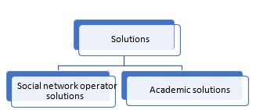
Solution of threats
Solutions and some approaches have been proposed and could be classified into:
social network operator solutions,
academic solutions.
Figure 7: Classification of solutions of threats (Jain et al, 2021)

Slide 19
Social network operator solutions
Authentication procedures such as CAPTCHA, multi-factor authentication, and photos-of-friend identification have been proposed.
Security and privacy setting to empower the client to put personal information from undesirable access by outsiders or applications.
Reports of users about any form of abuse or policy violations by any user in their network. i.e., when Facebook receives a user report, it is reviewed and removed according to the Facebook community standards.

Slide 20
Academic research-based solutions
Phishing detection by using i.e., anti-phishing techniques like the PhishAri technique for real-time identification of phishing attacks occurring on Twitter.
Cyberbullying means the use of electronic media such as emails, chats, phone conversations, and online social networks to oppress a person. Machine learning techniques can be applied to detect cyberbullying.

Slide 21
Academic research-based solutions
Clickjacking detection by using an automated system which can analyse web pages to protect consisting of a code that can detect overlapping clickable elements. NoScript tool, which has an anti-clickjacking feature included can be used.
Cyberstalking detection supported by encryption techniques available for devices on recent versions of Android and iOS. If a device is stolen, the thief cannot read the contents if encryption is enabled. There are various technologies which can be used against stalkers like smartphone fingerprint lock.

Slide 22
Interdisciplinarity in social networks
The interdisciplinary field social network analysis (SNA) referring social networks:
includes insights from other social science disciplines such as sociology, anthropology, psychology, communication.
is part of an even larger interdisciplinary field in charge of studying all types of networks called network science which includes work in physics, computer science, data science, biology, engineering, mathematics, and other fields
is showed in Figure 8 (https://bookdown.org/omarlizardo/_main/1-2-what-is-a-social-network.html).

Slide 23
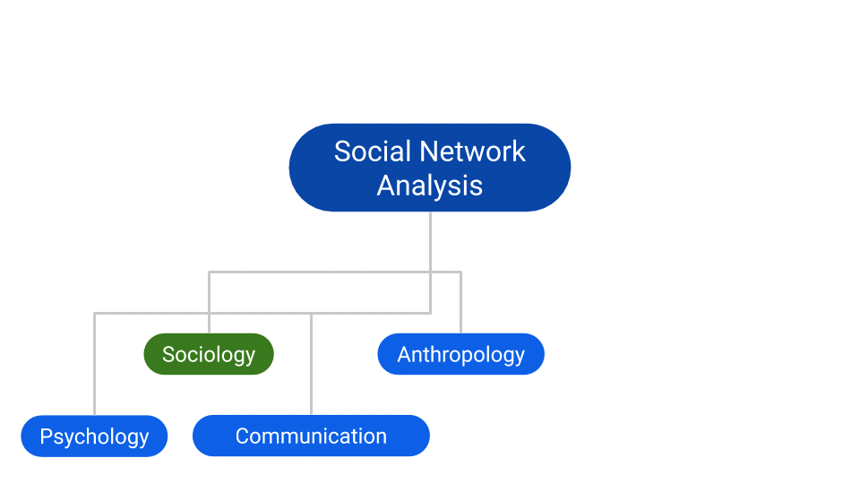
Interdisciplinarity in social networks
Figure 8: Relationships between field in SNA
(https://bookdown.org/omarlizardo/_main/1-2-what-is-a-social-network.html

