Slide 1


Information Security for Managers
Unit-3 for Managers 1
Week 5

Slide 2

Information Security Management 3
Cyber security is the practice of defending computers, servers, mobile devices, electronic systems, networks, and data from malicious attacks.
It's also known as information technology security or electronic information security.
The term applies in a variety of contexts, from business to mobile computing, and can be divided into a few common categories.
Notes:
Cyber security is the practice of defending computers, servers, mobile devices, electronic systems, networks, and data from malicious attacks. It's also known as information technology security or electronic information security. The term applies in a variety of contexts, from business to mobile computing, and can be divided into a few common categories

Slide 3
Cyber Security for Entrepreneurs and SMEs
Businesses are often so concerned with their day-to-day operations that they forget to invest heavily in network security.
Others understand the need for comprehensive network security, but have a lenient strategy in regard to their IT, which can be just as detrimental in the event of a data leak.
Understanding what network security entails, as well as the best practices that you can adhere to that will ensure your company’s network is secure
Notes:
It is utmost important that the training on cyber security for SMEs – managers and employees – is concrete and interactive – as well has hands-on because the small SMEs do not have time, motivation nor resources to spent on this issue why it is very important that the training is relevant and manageable for the managers who participate. Hence, this module is plan on basis of this.

Slide 4

Content of This Module
How To Effectively Use The Cyber Kill Chain in Your Cybersecurity Strategy:
Detect Analyse and find the intrusion attempts.
Deny Stop the attacks as they happen.
Disrupt Stop the data communication
Degrade Reduce and limit the efficacy of the
attack.
Deceive Lead the attackers in the wrong
direction.
Contain Conceal and restrict the attack’s reach
so that it only affects a portion of the
organization.
Notes:
Overall in this unit module
How To Effectively Use The Cyber Kill Chain in Your Cybersecurity Strategy

Slide 5

Information security management (ISM)
ISM defines and manages controls that an organization needs to implement to ensure that it is sensibly protecting the confidentiality, availability, and integrity of assets from threats and vulnerabilities.
Malware, or “malicious software,” is an umbrella term that describes any malicious program or code that is harmful to systems.
Notes:
Hostile, intrusive, and intentionally nasty, malware seeks to invade, damage, or disable computers, computer systems, networks, tablets, and mobile devices, often by taking partial control over a device’s operations. Like the human flu, it interferes with normal functioning. The motives behind malware vary. Malware can be about making money off you, sabotaging your ability to get work done, making a political statement, or just bragging rights. Although malware cannot damage the physical hardware of systems or network equipment, it can steal, encrypt, or delete your data, alter or hijack core computer functions, and spy on your computer activity without your knowledge or permission.

Slide 6
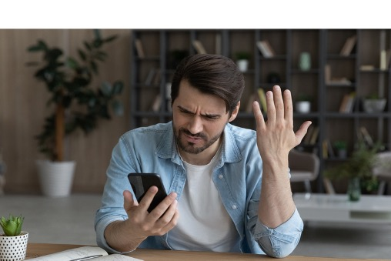
Top Cyber Threads
Malware
Notes:
Malware represents any program whose function is to cause software or hardware damage to a computer (e.g., viruses)

Slide 7
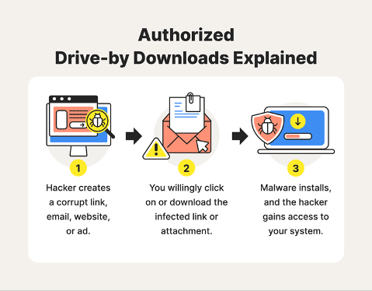
Top Cyber Threads
Notes:
Drive-by exploits can automatically exploit existing vulnerabilities in software installed on a PC without interacting with the legitimate user; they expanded their scope in 2012 to mobile terminals as well. it focuses almost entirely on compromising legitimate websites. vulnerabilities in the browser, its plugins, or the operating system can be exploited to install malware on the PC without the user's knowledge the infection can be initiated by simple internet browsing.

Slide 8
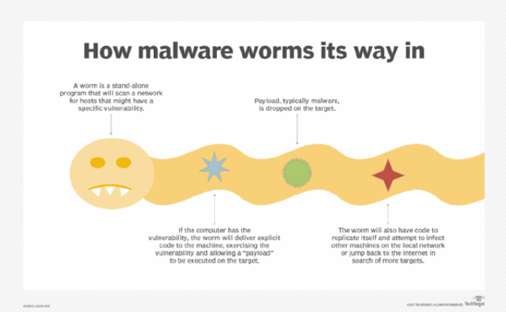
Top Cyber Threads
Notes:
Worms are self-replicating programs; use the network of computers to send their own copies to other nodes (computers in the network), managing to do this without the intervention of any user, unlike a computer virus, a computer worm does not need to be attached to an existing program, it causes damage to the network, even just by taking up bandwidth.

Slide 9

Top Cyber Threads
Trojan
Notes:
Trojan presents itself in the form of legitimate programs, which, in reality, are created with the aim of stealing confidential data, or to allow unauthorized users or programs access to the infected system; constitute the vast majority of infections (80%).

Slide 10

Top Cyber Threads
Track ware
are the programs that use some web browser vulnera-bilities to send a server or people information about the sites accessed
Notes:
Track ware are the programs that use some web browser vulnerabilities to send a server or people information about the sites accessed, the information searched and the browsing habits of the user; Viruses aim to infect as many personal computers as possible, while spyware aims to spread across the Internet, Viruses usually have a dangerous payload, they want to cause damage to the infected computer, while spyware only slows down computer processes, adds popups and destabilizes the browser and has other "annoying" effects.

Slide 11
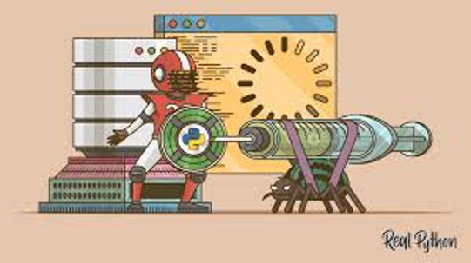
Top Cyber Threads
SQL Injection (Code Injection)
Notes:
SQL Injection (Code Injection) occurs when an attacker can insert any data into an SQL query sent to a database; by injecting the syntax, the logic of the statement is modified so that it performs a different action, is the most common vulnerability. The best SQL injection defence strategy is based on implementing strong input validation routines so that the attacker cannot enter data other than what the application needs.

Slide 12

Top Cyber Threads
Spyware
Notes:
Spyware it is generally defined as a program that takes advantage of the vulnerabilities of a system for the benefit of a third party, it can slow down your computer, make it vulnerable to virus infection, and collect confidential information such as usernames for various applications, passwords, and credit card/bank account information.

Slide 13

Top Cyber Threads
A keylogger is a small "smart" program that hackers place on your computer without you noticing
Notes:
A keylogger is a small "smart" program that hackers place on your computer without you noticing. Here it can lie for several months or years and keep an eye on every single keystroke you make on the keyboard. All data is sent to the hackers, who can then use different algorithms and tools to get the best out of your data. Over time, they find out different things about your behaviour and, not least, where you use different passwords you have entered on the keyboard. It can then be used to take over your entire digital identity in a matter of minutes.

Slide 14
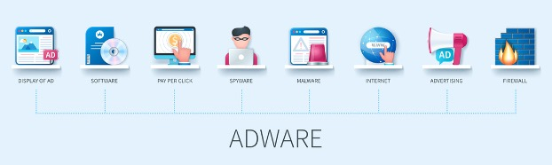
Top Cyber Threads
Adware is a sub-category of spyware and is a program that advertises products or services. Often these adds appear even after the program has been uninstalled.
Notes:
Adware is a sub-category of spyware and is a program that advertises products or services. Often these ads appear even after the program has been uninstalled. Exploitation kits are automated software that assists less experienced attackers in compromising systems by exploiting client-side vulnerabilities, particularly those in web browsers or applications that can be accessed by websites; relies on drive-by download attacks, where malicious code is injected into compromised websites; can exploit vulnerabilities in the browser or its plugins.

Slide 15
Top Cyber Threads
And many more ... like
Botnet
  Botnet represents a set of computers that are under the control of an attacker
Denial of Service
  Denial of Service is an attempt to affect the availability of computer systems/services or electronic communications
Rogue ware/scareware
  Rogue ware/scareware is type of threat that takes the form of fake software
Ransomware
  Ransomware is one of the most dangerous and aggressive forms of cybercrime
Notes:
And many more … like Botnet represents a set of computers that are under the control of an attacker; A botnet can be used for multiple purposes: Distributed Denial of Service - DDoS attacks, spamming, identity theft, malware distribution, infecting computer systems
Denial of Service is an attempt to affect the availability of computer systems/services or electronic communications. The target system is attacked by sending a very large number of illegitimate requests, which consume its hardware or software resources, making it unavailable to legitimate users.
Rogue ware/scareware is type of threat that takes the form of fake software; A particular case of rogue ware/scareware is fake security software that once installed in the system provides false security alerts and invites the user to purchase a special disinfection tool.
Ransomware is one of the most dangerous and aggressive forms of cybercrime. The hackers use a piece of extremely complex code to lock down the functionality of a computer or computer-controlled system. The owner of the system is then contacted by the hacker with a demand for a ransom to reactivate the system or "unlock" information in the system.

Slide 16

Types of Attacks
Targeted Attacks
Target a specific person or organization
Aims to either collect personal/confidential data or compromise target computer systems
Generally, has a phase in which the attacker informs himself through various techniques (e.g. social engineering) about the targeted IT system and then triggers the attack
Often his actions appear legitimate because they appear to be coming from a trustworthy person
Notes:
Targeted attacks
• target a specific person or organization
• aims to either collect personal/confidential data or compromise target computer systems
• generally, has a phase in which the attacker informs himself through various techniques (e.g. social engineering) about the targeted IT system and then triggers the attack
• often his actions appear legitimate because they appear to be coming from a trustworthy person

Slide 17
Types of Attacks
Theft/Losses/Physical Destruction
Due to the increased mobility offered by laptops, smart phones or tablets, this type of threat is about to become a major one
Consistent data backup and content encryption can be a solution to limit actual data loss or disclosure of confidential data to outsiders
Notes:
Theft/Losses/Physical Destruction
• due to the increased mobility offered by laptops, smart phones or tablets, this type of threat is about to become a major one
• consistent data backup and content encryption can be a solution to limit actual data loss or disclosure of confidential data to outsiders

Slide 18
Types of Attacks
Identity Theft
Identity theft is a real threat in an increasingly online environment
Access credentials or personal data are the target of attackers today
Once in their possession, the attacker can carry out fraudulent transactions (especially financial) or obtain confidential data
Notes:
Identity theft
• is a real threat in an increasingly online environment
• access credentials or personal data are the target of attackers today
• once in their possession, the attacker can carry out fraudulent transactions (especially financial) or obtain confidential data

Slide 19
Types of Attacks
Information Leak
Intentional or unintentional disclosure of information to an unauthorized person
Information such as geolocation and phonebook contacts can easily fall into the hands of attackers and be used for fraudulent purposes
Notes:
Information leak
• intentional or unintentional disclosure of information to an unauthorized person
• information such as geolocation and phonebook contacts can easily fall into the hands of attackers and be used for fraudulent purposes

Slide 20
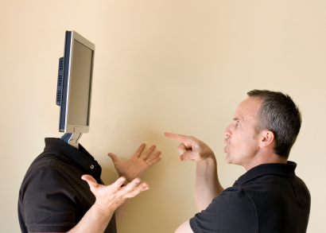
Types of Attacks
Search Engine Manipulation (SEP)
Manipulates search engines to display search results that contain references to malicious websites.
Thus, an infected web page redirects the users to malicious sites and if the victims access the respective sites, they infest their computers with malware.
Notes:
Search Engine Manipulation (SEP)
• manipulates search engines to display search results that contain references to malicious websites. Thus, an infected web page redirects the users to malicious sites and if the victims access the respective sites, they infest their computers with malware

Slide 21

Types of Attacks
Fake digital certificates
are used by attackers to digitally sign resources (websites, applications, source codes, etc.) used in various cyber-attacks in order to pass undetectable to the end user
are often used to sign malicious web applications such as e-banking or e-commerce, which use the HTTPS protocol
can be created or stolen by exploiting vulnerabilities in the PKI (Public Key Infrastructure) systems of certification authorities that issue digital certificates for secure websites.
Notes:
Fake digital certificates
• are used by attackers to digitally sign resources (websites, applications, source codes, etc.) used in various cyber-attacks in order to pass undetectable to the end user

Slide 22
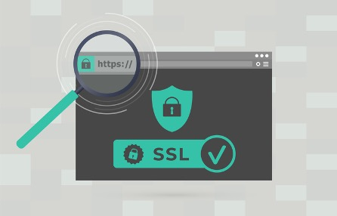
Secure Web Server – SSL
Notes:
The protocol that implements public key encryption is called SSL (Secure Socket Layer), developed by Netscape. This protocol is used by browsers and web servers to transmit data securely, so it was created to be used by the HTTP protocol.
Connecting to a secure web server is done by mentioning the https protocol instead of http in the URL - that is, access to the secure web page is indicated by the protocol, and not the name of the server.
A secure web server offers: Secure transfer of information: the data transmitted between the server and the navigator cannot be decrypted in case of their interception.
Server authentication: If the web server has received a certificate from a certification authority (CA)

Slide 23
Security check list 1
Desktop and Mobile Firewall
Start by securing your outer perimeters by making sure your point's (digital devices') firewalls work. It sounds basic, but it is also in the very basics that you have to start. There are typically three to four different types of firewalls on your network:
Firewall on your operating system (Android, iOS, Windows, etc.).
Firewall on your antivirus/security program.
Firewall on your internet router.
Firewall on your ASA box or intelligent switch (Typically only larger companies).
Notes:
Start by securing your outer perimeters by making sure your point's (digital devices') firewalls work. It sounds basic, but it is also in the very basics that you have to start. There are typically three to four different types of firewalls on your network:
• Firewall on your operating system (Android, iOS, Windows, etc.).
• Firewall on your antivirus/security program.
• Firewall on your internet router.
• Firewall on your ASA box or intelligent switch (Typically only larger companies).

Slide 24

Security check list 2
Backup
Notes:
Backup should really be at the top of the list, like it shouldn't be news. Backup can save you from having to pay a ransom to have your data unlocked. However, make no mistake about the size of the company, most of the attacks with this type of malware are aimed at small businesses and individuals.

Slide 25
Security check list 3
Rules for safer browsing (1)
Use the latest browser version
Orient yourself towards other types of browser (eg Google Chrome, Opera, Firefox, Safari, etc.), especially when accessing potentially unsafe web pages;
Most malware affects Microsoft Internet Explorer (used by over 50% of users)
Check the real destination of the links by passing the mouse cursor over it and viewing the real address in the lower left part of the browser
Notes:
Rules for safer browsing
• use the latest browser version
• orient yourself towards other types of browser (eg Google Chrome, Opera, Firefox, Safari, etc.), especially when accessing potentially unsafe web pages;
• most malware affects Microsoft Internet Explorer (used by over 50% of users)
• check the real destination of the links by passing the mouse cursor over it and viewing the real address in the lower left part of the browser

Slide 26
Security check list 4
Rules for safer browsing (2)
Be careful what plugins you install, often they come with malicious software
Do not click on links in pop-up windows
Check for "https://" at the beginning of the web address before entering personal information
Regarding making an online purchase, greater attention must be paid to the security level of the page, if one opts for online payment with a bank card
Notes:
Rules for safer browsing
• be careful what plugins you install, often they come with malicious software
• do not click on links in pop-up windows
• check for "https://" at the beginning of the web address before entering personal information
• regarding making an online purchase, greater attention must be paid to the security level of the page, if one opts for online payment with a bank card

Slide 27

Security check list 5
Sending and receiving e-mail
Avoid sending or receiving sensitive information by e-mail;
Avoid social engineering or phishing attempts
Look for an email provider that offers strong anti-spam filtering
Do not respond to spam and avoid cascade or pyramid emails
Notes:
Sending and receiving e-mail
• avoid sending or receiving sensitive information by e-mail;
• avoid social engineering or phishing attempts
• look for an email provider that offers strong anti-spam filtering
• do not respond to spam and avoid cascade or pyramid emails
•

Slide 28
Security check list 6
Sending and receiving e-mail
Do not respond to spam and avoid cascade or pyramid emails
Do not use the same name for your personal and work e-mail account; the use of distinct names for these accounts reduces the risk of them being the target of a computer attack
Avoid storing critical information in personal e-mail accounts or in other networks outside the institution/company where you work
Notes:
Sending and receiving e-mail
• do not use the same name for your personal and work e-mail account; the use of distinct names for these accounts reduces the risk of them being the target of a computer attack
• avoid storing critical information in personal e-mail accounts or in other networks outside the institution/company where you work
The truth is that email has never traditionally been a secure medium for communication. After all, only criminals really need to concern themselves with securing their communications. This is an extremely common, yet entirely flawed, way of thinking, and Snowden himself has famously discredited this type of mentality.

Slide 29

Security check list 7
Sending and receiving e-mail
Arguing that you don't care about privacy because you have nothing to hide is like arguing that you don't care about free speech because you have nothing to say.
Notes:
Arguing that you don't care about privacy because you have nothing to hide is like arguing that you don't care about free speech because you have nothing to say.
While many people may still subscribe to the mindset that they have nothing to be concerned about if they have nothing to hide, the reality is that there is plenty to be concerned about, and there are plenty of concrete reasons for people to encrypt their email communications and protect their privacy. This is true whether you’re an investigative journalist, dissident, whistle-blower, or just an ordinary average citizen.

Slide 30
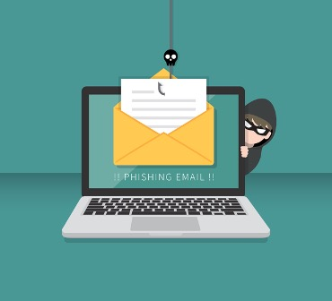
Security check list 8
Why anyone would need to send a secure email
To protect against threats posed by cybercriminals
To prevent email providers from monitoring emails and sharing data with advertisers
To protect against government surveillance efforts
Notes:
Have you ever sent sensitive personal information in an email and thought, ‘welp, I sure hope that email doesn’t somehow end up in the wrong hands’? This is a truly disconcerting thought, because if someone other than the intended recipient(s) gets their hands on the email – especially if that someone happens to be a cybercriminal – the results could potentially be catastrophic.
Sending an email containing sensitive personal data like your medical information, financial account information, social security number, address, or phone number, can be extremely risky because cybercriminals need only a minimal amount of personal data to exact maximum harm. With access to sensitive personal data like this, cybercriminals can compromise your online profiles, drain your bank accounts, and even steal your identity.
Sending an encrypted email preserves your privacy and effectively makes it impossible for other entities to snoop on your secure email communications. This is especially important for those whose job responsibilities require complete confidentiality in their communications, but it’s also vital for anyone who generally doesn’t want the government trampling on their privacy rights.

Slide 31
Security check list 9
How to send a secure email?
What options are available to you if you want to send a secure email?
Encrypt emails in popular email clients
Many of the big-name web-based email providers will allow users to encrypt their emails using either one of the two main email encryption protocols, S/MIME or OpenPGP.
Notes:
This is why sending secure emails is critical, particularly if the email you’re sending contains sensitive personal information.
Now that you know the reasons why you’d want to send a secure email, we’re guessing you’ll probably want to know how to actually do it. There are a couple of ways to go about doing so, each with certain inherent advantages and disadvantages, but the bottom line is that if you’re going to send a secure email, then your email message will need to be encrypted. When you encrypt an email message, you’re essentially scrambling the contents of that message and making it impossible for anyone without the encryption key to unscramble the message.
For example, if you want to send a secure email on Gmail, you will first need to enable S/MIME encryption by signing into Gmail using a GSuite administrator account. GSuite accounts are primarily for business purposes, but you could theoretically set up an account for your personal use. The other issue with this is that the recipient(s) you are emailing will also need to have S/MIME encryption activated in order for this to work.
Similarly, Outlook also supports S/MIME encryption, and you’ll need to enable it manually, but before you do so, you’ll need to obtain a certificate (or digital ID) from your organization’s administrator. This, admittedly, isn’t the most streamlined process, nor is it likely to be a very practical solution for most personal email users. Check out our how to encrypt outlook emails for more information about this.

Slide 32
Security check list 10
How to send a secure email?
What options that are available to you if you want to send a secure email?
Use a dedicated secure email provider
If you don’t want to go through the trouble of manually enabling S/MIME or OpenPGP encryption on your traditional web-based email account, a much easier way to send a secure email is to create an account with a secure email provider
Notes:
You can, however, bypass these issues by installing a free third-party tool like Mailvelope to encrypt your emails with ease. Mailvelope works with many of the most popular email services like Gmail, Yahoo!, Outlook, Hotmail, and GMX. But again, the recipient(s) of your encrypted email message will also need to be using similar PGP/OpenPGP software to decrypt the email and read the contents.
With a secure email provider like ProtonMail, you’ll be able to send secure, encrypted emails to others regardless of whether they use the same secure email provider that you use, and your recipient(s) will also be able to respond securely. Many secure email providers implement OpenPGP encryption to secure users’ emails and will allow users to easily send and receive secure, encrypted emails with others who have OpenPGP encryption enabled with their email clients. If your recipient does not have PGP enabled, then you’ll still be able to send an email securely to that recipient that can only be opened using a shared secret.
Basically, when you use a secure email provider you'll be able to easily protect sensitive messages by encrypting them, all on a platform that is typically as simple to use as the big-name email providers like Gmail, Yahoo!, or Outlook. But unlike those big-name providers, a secure email provider won’t annoy you with advertisements or monitor your emails (since it can’t even access them thanks to end-to-end encryption).
The downside is that, in order to access a secure email provider’s full slate of features, expanded storage, and unrestricted messaging, you’ll need to pay. Many of the best secure email providers do, however, offer a free tier (with certain limitations) that will allow you to send and receive secure emails for free. If you’re only going to be sending a limited number of secure emails, then a free option could certainly be a viable solution, but if you’re planning on conducting the majority of your email correspondence in a secure manner, then purchasing a premium subscription will be necessary.

Slide 33
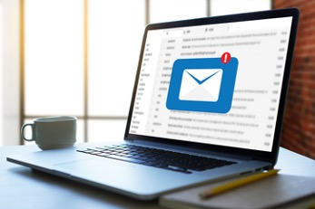
Security check list 11
When you receive an email
Pay attention to the identity of the sender is not guaranteed
Do not open attachments coming from unknown persons
First the attachment must be downloaded and scanned with the installed antivirus solution
E-mails containing links, do not directly access that link
Do not respond to e-mails containing requests for personal or confidential data
Notes:
When you receive an email, pay attention to
• the identity of the sender is not guaranteed: it checks the relationship between the sender and the content of the message;
• do not open attachments coming from unknown persons or associated with legitimate accounts, but with messages with suspicious subject and content. They may contain malicious software (malicious software or malware, such as worms, trojans, spyware, forms of adware, etc.);
• if it is absolutely necessary to open an attachment, even from legitimate e-mails, it must first be downloaded and scanned with the installed antivirus solution and then opened with the associated application;
• in the case of e-mails containing links, do not directly access that link in the body of the message; possibly, that link can be copied and opened from another browser tab;
• do not respond to e-mails containing requests for personal or confidential data (eg PIN code and bank card number).

Slide 34
Security check list 12
Methods that give a false feeling of strong passwords
Phonetic method: RULOSTIM2 "Are you lost I am too!"
First letter method: "This is a random sentence, I came up with in 5 minutes or so."
=> "Tiars,Icuwi5mos."
Substitution method (usually vowels): Replace certain letters with numbers symbols within a word. For example, change apple to @ppl3.
Notes:
Methods that give a false feeling of strong passwords
phonetic method, first letter method, substitution method, reverse and substitution method, upper/lower case, number/symbol and substitution method
All of these methods can be easily automated with scripts or other tools and used against websites and online systems.
Do not use:
• the name of you, someone else in the family or your favorite animal,
• elements of your address: building name, street, country,
• the name of the institution, the project, etc.,
• phone number, registration number
• the name of the favorite star or character (or of the film, book, etc.),
• dictionary words;
• the name of the account for which you set the password;

Slide 35
Security check list 12
Methods that give a false feeling of strong passwords
Reverse and substitution method: I love vacations
  r0d@3l11d3cn0c
Upper/lower case, number/symbol and substitution method: I love holidays
  @D0rC)nC3d11L3
Notes:
Do not use these methods! While they represented once the norm, CPU power made them mostly irrelevant. Today’s password cracking tools capabilities reduce the effectiveness of the methods mentioned earlier.

Slide 36
Security check list 12
Passphrases
Combine a group of words into a sentence that makes sense to you, but not to others
Do not use common phrases or famous quotes
Add spaces within and between the words
Use capital letters and capitalize some of the words
Add punctuation and special characters that make sense to you
Use unusual spellings of words
Another way to develop a passphrase is to link to a personal story or private memory. Keywords can be used to tell the story.
Notes:
A better way to create passwords is to use whole phrases, while including upper-case, lower-case, numbers, and preferably special characters. In that way automated scripts that easily use archaic methods, like the ones discussed, need a huge amount of effort to brute force or guess your password. The new method is called “passphrases” and it can reach up to 100 characters or more.

Slide 37

Thank you for your attention
Notes:
Thank you for your attention

