Slide 1


Resilience
Notes:
Hello viewers, welcome to this InCyt module on resilience. Resilience is getting more attention as it became obvious that breaches will occur and negative events which might have not expected materialize

Slide 2
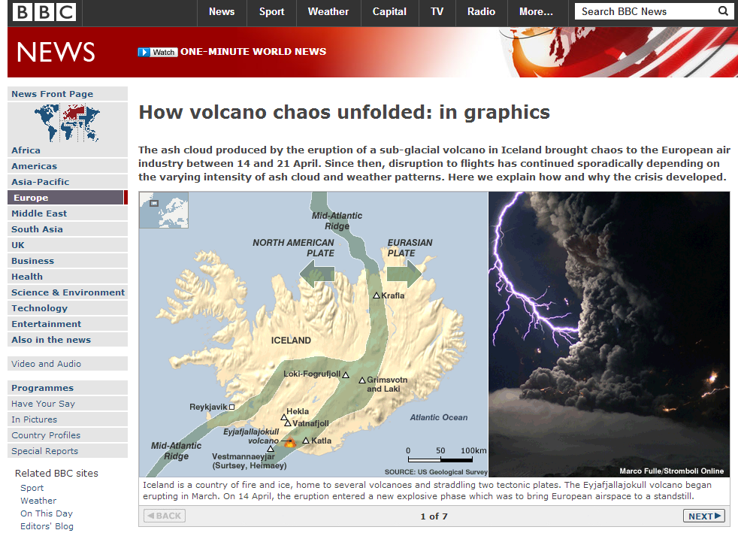

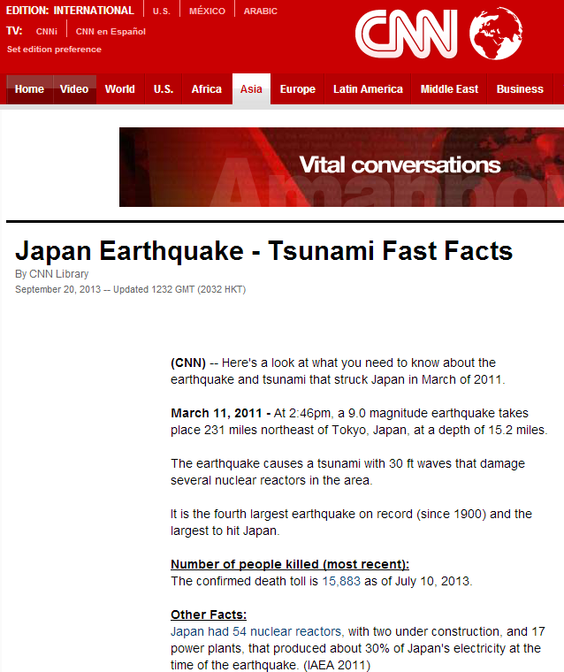

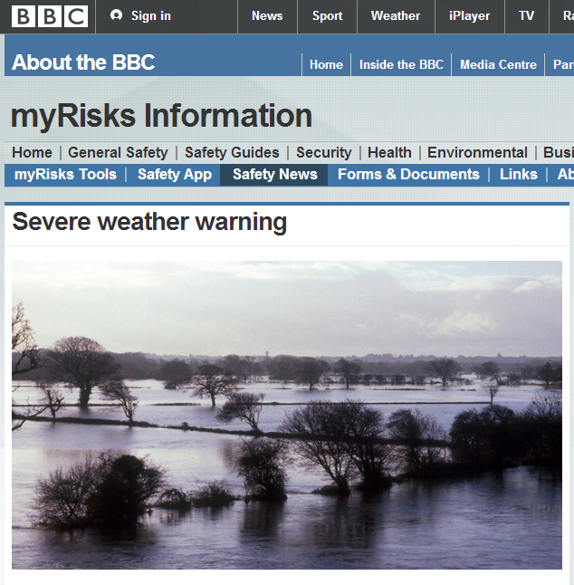
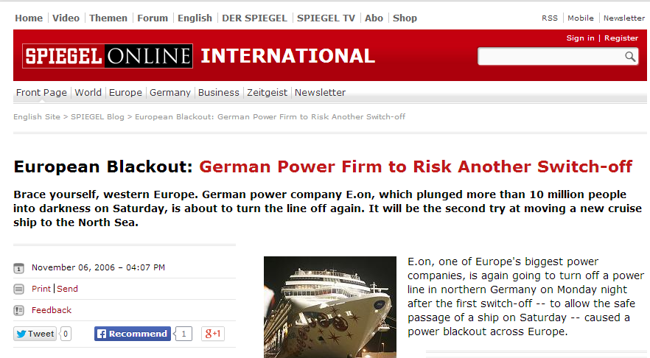
Threads in the news

Slide 3
Silent catastrophes
Loss of key personal
Insider attacks
Industrial espionage, …
Loss of business critical information
Inappropriate or corrupt backups …
Severe hardware or software failures
Notes:
sabotage of disgruntled employees, secret selling of confidential information
Defect storage media,
Strong dependence on customer or supplier

Slide 4
Why a structured approach?
Reaction to major disruptions and incidents
Clear understanding how the organization works
Protection of organization, its brand and reputation
Demonstration of due care and due diligence
Notes:
dependencies (internal / external – customer / supplier)
documentation of important business processes
Identification of inefficient workflows and single point of failures
Compliance to regulatory and legal requirements
Contribution to corporate governance
as well as employees

Slide 5



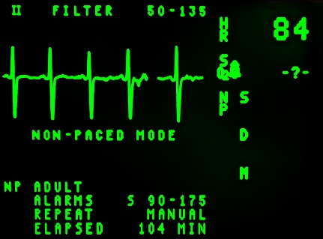



What if...
Customer
Profit
Health & Safety
Environment
…
Notes:
What if your most important process is disrupted?

Slide 6
Business Continuity
Target
Resumption
Time
Maximum
Acceptable
Time
Level of operations
Incident
Normal Operations
Recovery with BCM
Minimum acceptable
level of operations
Recovery without BCM
Time

Slide 7
Terms & Definitions
Strategic and tactical capability of the organization to plan for and respond to incidents and business disruptions in order to continue business operations at an acceptable predefined level.
Source: The BCI, Good Practice Guidelines 2010, …
Capability of the organization to continue delivery of products or services at acceptable predefined levels following a disruptive incident.
Source: ISO 22300:2012

Slide 8
ISO 22301
1. About Standard
2. Normative Reference
3. Definitions
4. Context of Organization
5. Leadership
6. Planning
7. Support
10. Improvement
Act
Plan
9. Performance & Evaluation
Check
Do
8. Operation

Slide 9




Understanding the Organization
External context
…
Political & Legal Environment
Supply Chain
Internal context
…
Products & Services
Structure, Processes

Slide 10
Needs of Interested Parties
The Organization
Citizens
Management
Competitors
Top Management
Customers
Media
Those accountable for BCM policy and its implementation
Distributors
Commentators
Those who implement and maintain the BCMS
Shareholders
Those who maintain business continuity procedures
Trade groups
Investors
Owners of business continuity procedures
Neighbors
Owners
Pressure groups
Incident response personnel
Insurers
Those with authority to invoke
Emergency services
Government
Appropriate spokespeople
Other response agencies
Regulators
Response teams
Transport services
Recovery service
suppliers
Other staff
Contractors
Dependents of staff

Slide 11
Leadership and Commitment
Management commitment
  operational involvement in steering groups
  active participation in exercising and testing
  inclusion of BCM as a standing item at management meetings
Policy
  provides a framework for BCMS
Organizational roles, responsibilities and authorities
  Overall responsibility should be at top management
  Top management should appoint responsible for business continuity program -> BCM manager
Notes:
Top management should provide evidence of its commitment to the development and implementation of the
BCMS and continually improving its effectiveness by:
- complying with applicable legal requirements
- establishing business continuity policy and objectives
- appointing one or more persons with the appropriate authority and competencies to be responsible for the
BCMS
- ensuring that BCMS roles, responsibilities and competencies are established
- ensuring the availability of sufficient resources
- communicating to the organization the importance of fulfilling business continuity policy
- ensuring that internal BCMS audits are conducted
- conducting effective management reviews of the BCMS
BC policy should state the scope in terms of
what to protect
maximum extent of damage, loss or interruption the organization can survive
BCM is a continually evolving process to overcome problems of cost and complexity

Slide 12
Planning and Support
Planning
  Consistency of business continuity objectives and business continuity policy
  Alignment with business objective
Support
  Resources to plan, implement, maintain and improve the BCMS
Awareness
  Policies
  Role in case of incidents
Communication
  Procedures for internal and external communication
Documented Information

Slide 13
Business Impact Analysis
Notes:
Business continuity management is a management method which ensures operation of vital process during or following an incident. Scenarios which are often addressed by business continuity comprise major IT or infrastructure outages, loss of building, key personnel or supplier.
Today we will start with a short introduction in one of the most important tools in the BCM process (the BIA). In the second part we will take a detailed look into the ISO standard 22317 and ISO 22301. The practical assignments will be done tomorrow.

Slide 14
Business Impact Analysis
Foundation work for the whole BCM process
Identifies
  core activities, products and outputs
  IT services and infrastructure supporting these activities
  internal and external dependencies
Notes:
Foundation work for the whole BCM process
Identify and determine significance of
core activities, products and outputs
IT services and infrastructure supporting these activities
internal and external dependencies (e.g. services or suppliers)
Identifies, quantifies and qualifies business impacts of a loss, interruption or disruption (e.g., backlogs)
Identification of mission (time!) critical activities → old
terminology (< ISO22301)
Prioritized activities, time sensitive and urgent (ISO 22301)
Why undertaking a BIA
Provides information how quickly the organization needs to respond when a disruption occurs
Essential input for the recovery strategy
If BIA is not undertaken, recovery requirements are normally guessed leading to
Underestimate
Overestimate
Further it quantifies and qualifies business impacts of a loss, interruption or disruption (e.g., backlogs)
Identification of mission (time!) critical activities

Slide 15
Core Terms
Maximum Acceptable Outage (MAO) or
Maximum Tolerable Period of Disruption (MTPD)
Recovery Time Objective (RTO)
Recover Point Objective (RPO)
Notes:
Maximum acceptable outage (MAO) or maximum tolerable period of disruption (MTPD)
Seasonality and variability may affect the MTPD
E.g. financial year-end, contract with time penalties, holiday periods
MTPD is also influenced by the time a process takes and whether it can be interrupted or not
E.g. laboratory experiments often have to be restarted from the scratch whereas manufacturing processes may be able to be resumed at several different points
Recovery Time Objective (RTO)
Is the period of time following an incident within which a product / activity must be resumed or resources must be recovered
Must be less then MTPD
Is determined during Design stage, however initial estimates can be done during BIA
Recover Point Objective (RPO)
The point to which information must be restored to enable an activity to operate on resumption (maximum data loss)

Slide 16

BIA explained
Service 1
Process A
Process B
Process C
Process D
Process E
Impact?

Slide 17






BIA explained
Service 1
Process A
Process B
Process C
Process D
Process E
Impact?
Financial
Environmental
Health / Safety
Legal
Brand

Slide 18
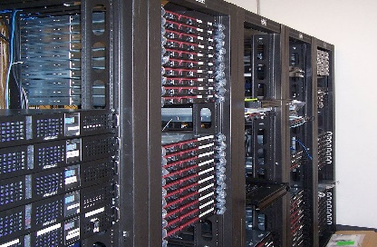




BIA explained
Service 1
Process A
Process B
Process C
Process D
Process E
Dependencies
Information Systems
Supplier
Special Equipment
… and many more

Slide 19
BIA Process
Prerequisites:
Context & Scope
Roles
Commitment
Resources
Product & Service
Prioritization
Process
Prioritization
Obtain Top Management
Endorsement of BIA Results
After the BIA –
Business Continuity
Strategy Selection
BC Requirements
Project Planning
and Management
Activity
Prioritization
Analysis &
Consolidation

Slide 20
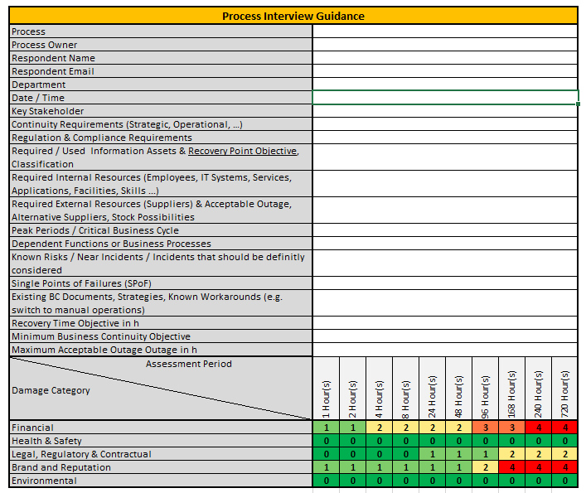
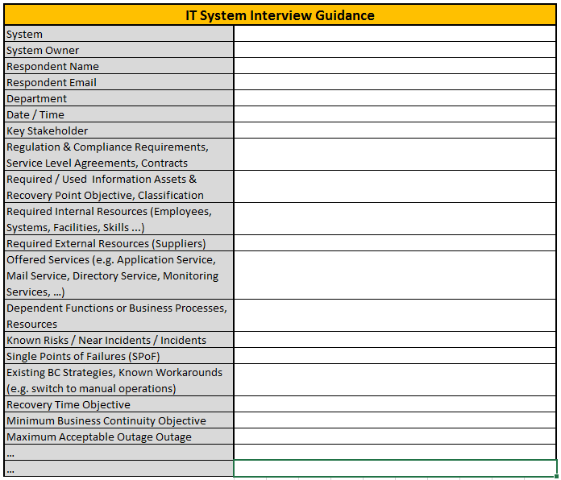
Example

Slide 21
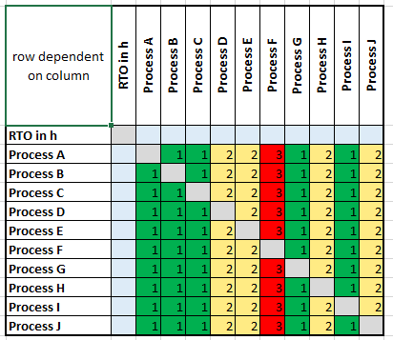
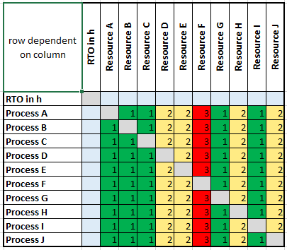

Example

Slide 22
Business Continuity Strategy

Slide 23
Determine Strategy
Identify Recovery Time Objectives (RTO) – shorter than MAO
  Usually: shorter RTO causes higher costs
Evaluation of existing strategies
  Gap analysis
Ensure agreed and signed-off options
  Including financial and resource provisions
Notes:
Provide management strategic evaluation
Key deliverable:
Strategy for each product and service within the programme that allows selection of alternatives

Slide 24
Example Strategies
Workplace
Personnel
Information Technology
Component
Notes:
Workplace
Distributed business activities
Dedicated internal alternate workplaces
Non-dedicated internal solution
…
Personnel
Substitutes through versatility and cross-training
Technical personnel from external providers
Knowledge management
Information Technology
Limited IT operation
Redundant IT sites
Component
Storing components / spare parts
Purchasing replacements
Supplier agreements

Slide 25
Business Continuity Procedures

Slide 26





Business Continuity Plans
Process for activating
Roles and responsibilities
Response & recovery activities
…
Communication strategy
Workarounds, …

Slide 27
Business Continuity Plan
Used in high pressure situations
Characteristics for an effective BCP include:
  Direct
  Adaptable
  Concise
  Relevant
Notes:
Is intend to be used in high pressure situations when people are under stress → must be taken into account to make the document easy to use
Direct: plans should provide clear, action oriented and time-based direction while allowing quick access to relevant support information
Adaptable: should enable the organization to respond to a wide range of disruptive events including those the organization may not have expected
Concise: plans should only contain guidance, information and tools that are likely to be used in a disruptive incident
Relevant: the information in the plan should be current and applicable to the team that will use it

Slide 28
Business Continuity Plan
Core elements:
  Purpose and scope
  Objective and assumptions
  Incident management structure
  Response team responsibilities
  Team mobilization
  Plan activation
  Invocation (of recovery arrangements)
  Contact details (usually held as appendices)
Notes:
Purpose and scope
Objective and assumptions
Incident management structure
Response team responsibilities / membership (leader, primary members, deputies), Individual responsibilities
Team mobilization
Plan activation
Invocation (of recovery arrangements)
Contact details (usually held as appendices)
Detection of a disaster is of major importance
Agree on a decision point
Decision point: latest moment to invoke emergency procedures to ensure continued viability of the enterprise
Criteria have to be:
Clear and objective
Measurable
Criteria should NOT…
… depend on estimates
(e.g. how the situation may evolve over time)

Slide 29
Exercising and Testing

Slide 30
Why is Testing Important?
Improve awareness
Improve business continuity procedures
Improve confidence
Notes:
Improve awareness
Improve application of business continuity procedures;
Improved confidence in business continuity response;
Assess utility and applicability of the BCM options;
Evaluate adequacy of developed capabilities and resource allocations
Identify undocumented requirements and practices employed in managing an incident
Identify inadequacies in the written business continuity procedures

Slide 31
Exercising and Testing
Discussion based exercises vs. operation based (“doing”)
Examples for discussion-based exercise methods include
  Desk-Check
  Walk-Trough
  Workshop
  Tabletop exercise
  Discussion based games
  …

Slide 32
Plan, Do, Check, Act
4. Context of Organization
5. Leadership
6. Planning
7. Support
10. Improvement
Act
Plan
9. Performance & Evaluation
Check
Do
8. Operation
“Difficulties mastered are opportunities won.”
(W. Churchill)

Slide 33
Thank You for Your Attention

