Slide 1


Introduction to Cryptography

Slide 2
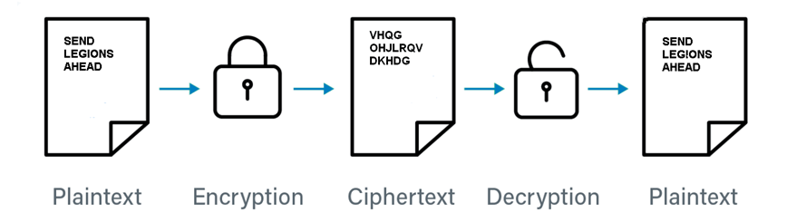
Cryptography
Mechanism by which the content of a message is hidden from other entities
Encryption deals with encrypting messages and making the content of the message unintelligible

Slide 3
Cryptanalysis
How to decrypt the message without knowing the key
Cryptographers and cryptanalysts are actually the same people

Slide 4
Redundancy
Information in messages is generally redundant
The redundancy of information facilitates cryptanalysis
It makes possible to identify valid messages by discarding those that do not carry true information

Slide 5
Redundancy
Example: Encoding a sequence of the four colors BLUE, GREEN, RED and YELLOW
These can be coded:
  with 2 bits (00, 01, 10, 11)
  as 4 different uppercase letters
  encrypting the color names

Slide 6
Redundancy
First case
The minimum number of entities (bits) is used
Substituting each color name with the corresponding 2 bits conceals the original sequence
The order of the entities is the same
Color and values are not associable

Slide 7
Redundancy
Second case
The sequence can be identified
Third case
If the words are also known just counting the number of letters is enough to identify the original words.

Slide 8
Redundancy
An encryption algorithm hides also redundant information
Applying a compression algorithm to an encrypted message does not bring much advantage, because it would reduce compression rate
To appropriately use compression and encryption: compression, then encryption

Slide 9
Redundancy
Some types of cryptographic attacks and algorithms rely on knowing part of the text
Knowing part of the text can make it possible to trace the key and then access the rest of the text
Significant example: network packets, the header contains the sender and recipient addresses

Slide 10
Cesar’s Cypher
Each letter is substituted by another one later in the alphabet
For example, if we slide them by 3, all the 'A's become ‘D's, all the 'B's become 'E's, and so on
Very simple cipher, still used today in naive applications

Slide 11
Properties of the EXOR logic operator
The EXCLUSIVE OR ⊕ (EXOR) logical operator is applied to a two logical operands
Logical operands are values True and False
The EXOR operands produces a True result only if the two operand are different
In binary arithmetic True=1 and False=0,
the EXOR truth table is show on the right:
Properties of the EXOR
  if X ⊕ Y → Z then
  Z ⊕ Y → X
  Z ⊕ X → Y
0 ⊕ 0 = 0
0 ⊕ 1 = 1
1 ⊕ 0 = 1
1 ⊕ 1 = 0

Slide 12
The One Time Pad Algorithm
Very simple encryption algorithm
Very simple and fast implementation
“Perfect”: it is proven that without knowing the key it is impossible to go back to the original text.
Based on the EXCLUSIVE OR ⊕ (XOR) logical function
Used to transfer a message (PlainText) from two parties (Alice A and Bob B)

Slide 13
The One Time Pad Algorithm
Setup phase:
A random sequence of exactly n bytes is generated (this is the One Time Pad (OTP) or simply the Key)
The OTP is securely shared between the two parts in some way (given in advance, sent in an already secured channel, etc.)

Slide 14
The One Time Pad Algorithm
When both parties have the key, they can use it to transmit messages.
In case Alice wants to send a message to Bob:
  Alice calculates a bit by bit EXCLUSIVE OR of the PlainText with the Key:
  Encryption: PlainText ⊕ Key → CypherText
  CypherText is transmitted to Bob over a possibly insecure channel
  Bob calculates the bit by bit EXCLUSIVE OR of the CypherText and the Key:
  Decryption: CypherText ⊕ Key → PlainText

Slide 15
The One Time Pad Algorithm
Example
Alice and Bob have already agreed upon a random OTP (Key)
Alice wants to send “HELLO” to Bob (in ASCII Code, spaces are here introduced for ease of reading):
H E L L O
PlainText: 01001000 01000101 01001100 01001100 01001111
⊕
Key: 10101001 01110010 10110010 10000110 11000110
=
CypherText: 11100001 00110111 11111110 11001010 10001001

Slide 16
The One Time Pad Algorithm
Example (continuation)
Bob receives the CypherText and applies the Key:
CypherText: 11100001 00110111 11111110 11001010 10001001
⊕
Key: 10101001 01110010 10110010 10000110 11000110
=
PlainText: 01001000 01000101 01001100 01001100 01001111
H E L L O
The PlainText has been recovered.

Slide 17
The One Time Pad Algorithm
The Key is a random sequence, there is no way to know if a certain bit of the sequence is '0' or '1‘
Without the Key, given a CypherText bit, it is impossible to guess the original bit
This is true for single bits, for the whole message, for any fragment of our message
If a part of the Key is known, it is possible to recover the corresponding part in the PlainText only
To discover the remaining part of the original message, the remaining part of the Key is needed

Slide 18
One Time Pad Problems
The transmission of the OTP has the same problems as the message
In some cases this problem is easily solved (a diplomatic briefcase with a ribbon containing a very long key provided to an embassy)
Very peculiar uses, but quite effective

Slide 19
One Time Pad Problems
In network communication the real uses of the One Time Pad are very limited
  One time use: using the key more than one time would weaken the security of the method
  Offline transmission in advance: key agreement is the most important problem of using cryptography
  Generating random numbers in a deterministic system is very difficult: computers are deterministic machines, only pseudorandom numbers can be generated

Slide 20
Algorithms other than OTP
The other algorithms use fixed length keys
An n bit sequence allows to have 2^{n} different keys
If the value of n is big enough a brute force attack (trying all the possible keys) would require an excessive amount of time
For example, with one of the fastest supercomputers available, checking a 256 bit key would require 3.67×10⁵⁵ years
Algorithms are classified into Symmetric and Asymmetric algorithms

Slide 21
Symmetric Algorithms
Most typical and old family of cryptographic algorithms
Called after the symmetry of the encryption and decryption operations
They use a single key
The key that must be known to both the sender and the recipient
The key is used to encrypt a message and then to decrypt it

Slide 22
Symmetric Algorithms
A simple symmetric schema could be the same as the OTP
The difference with OTP is that the Key has a fixed length (e.g. 256 bits) and it is repeated in some way, possibly after some complex change each time:
  Encryption:
  encryption_function(PlainText, Key) → CypherText
  Decryption:
  decryption_function(CypherText, Key) → PlainText
In general, even if the Key is the same the function used to decrypt is not necessarily the same used to encrypt (e.g. in Caesar's cipher the shift is reversed but the key is the same: number 3)

Slide 23
Some Important Symmetric Key Algorithms
DES (Data Encryption Standard)
This historical algorithm, now outdated
Uses a 56-bit key that in the late 1970s (when the algorithm was developed) was absolutely adequate for many uses
Today the DES algorithm would not last even a few minutes of a home computer
Very important aspect: the length of the key must be chosen based on the actual available computing capabilities

Slide 24
Some Important Symmetric Key Algorithms
AES (Advanced Encryption Standard, original name Rijndael)
Chosen based not only on robustness, but also on the efficiency of implementation in typical architectures
An algorithm that is safe but too slow, too expensive in terms of computing resources, would be not usable
This constraint was set to be as the most difficult for competitors to overcome, compared to that of robustness
Key length: 128, 192, or 256 bits

Slide 25
Asymmetric
(or Public Key) Algorithms
Do not use just one key, but two
One key is used to encrypt and the other to decrypt
These keys are generated and managed in pairs
What a key (any of the pair) encrypts can be decrypted only by the other key of the pair
The subject that generates the keys generally keeps one private/secret (private key) and makes the other public (public key)
The two keys have such mathematical properties that discovering one key from the other is quite complex and requires an enormous amount of time

Slide 26
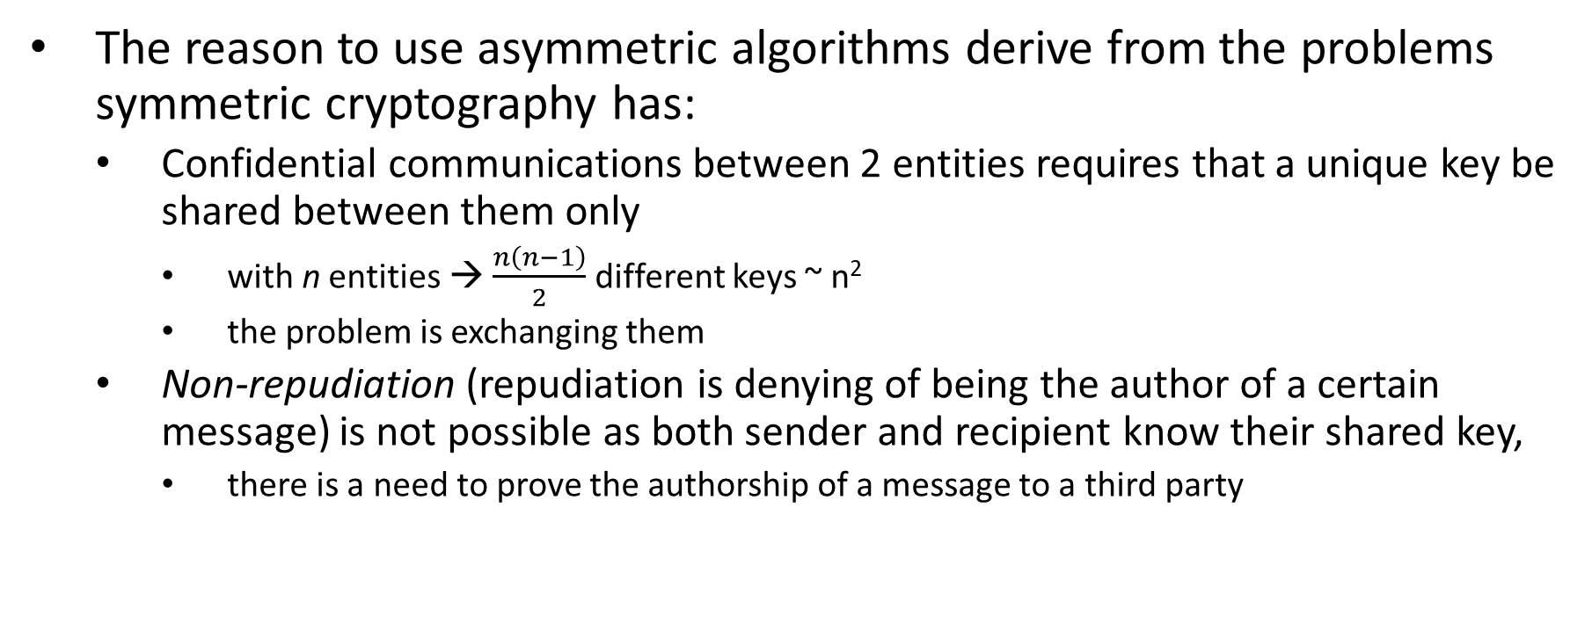
Asymmetric
(or Public Key) Algorithms

Slide 27
Asymmetric
(or Public Key) Algorithms
The asymmetric schema is similar to the symmetric one, but the keys used are the two that are generated in pair:
  Encryption: encryption_function(PlainText, Key1) → CypherText
  Decryption: decryption_function(CypherText, Key2) → PlainText
Key1 and Key2 have been used instead of EncryptionKey and DecryptionKey because the two keys are operationally interchangeable
n subjects can communicate to each other with just 2∙n keys: ~n, not ~n² like in symmetric algorithms

Slide 28
Asymmetric Algorithm Uses
Confidentiality:
  public key is publicly available and its owner is the sole to know the corresponding private key
  anyone can use it to encrypt a message
  only the owner of the corresponding private key will be able to decrypt the message
Just one key (the receiver’s public key) is needed for everyone to send a confidential message to a subject

Slide 29
Asymmetric Algorithm Uses
Non repudiation:
  the subject is the only owner of a private (secret) key
  anyone can verify (decrypt) messages encrypted with the private key of the subject
  only the subject that has that private key could have encrypted the message
  A problem to be solved: ensuring that a public key is really associated to the legitimate subject: a Public Key Infrastucture

Slide 30
Asymmetric Algorithms
Advantages and Disadvantages
The total number of keys is significantly decreased
Since public keys are made publicly available, there is no need for previous agreements between different subjects
Public keys are very important in e-commerce: customers cannot require that there is an a priori agreement of the seller with customers
Asymmetric algorithms are much more complex in terms of mathematical problems than symmetric algorithms
These mathematical problems essentially require slower algorithms than symmetric algorithms and the use of longer keys
On one hand there is a greater flexibility, on the other they are more onerous in terms of computing resources

Slide 31
Some Important Asymmetric Key Algorithms
RSA (from the initials of Ronald Rivest, Adi Shamir, and Leonard Adleman)
Based on the complexity of prime factorization: complex/intractable to find the two primes from the result
It is not easy to find very high prime numbers
Legitimate operations can be done with limited computing resources

Slide 32
Some Important Asymmetric Key Algorithms
Elliptic Cryptography (ECC - Elliptic Curve Cryptography)
Based on the complexity of computation of the discrete logarithm (in a finite field)
The ECC problem is more complex than prime factorization
The same security is achieved with shorter keys than RSA
ECC algorithms are faster than RSA

Slide 33
Comparison of Symmetric and Asymmetric Algorithms
Asymmetric algorithms exploit mathematical problems other than those of symmetric cryptography
The lengths of the keys are not comparable to those of symmetric cryptography
With symmetric encryption the key should be long enough to prevent trying all possible numbers that could match a key
Today’s symmetrical algorithms typically use 128-, 256- and sometimes 512-bit keys

Slide 34
Comparison of Symmetric and Asymmetric Algorithms
For asymmetric algorithms not all keys are possible, because they are related to some characteristic (e.g. not all numbers are prime)
To have the same algorithm robustness (difficulty from the computational point of view) of a 128-bit symmetric algorithm, the RSA algorithm needs a key of the order of 1024 bits
Today’s asymmetrical algorithms typically use 1024, 2048 and 4096 bit keys

Slide 35
Hash Functions
Hash functions calculate a short fixed length summary of a text of arbitrary length
This summary is called a digest
A hash function must be simple and fast to calculate.
Hash functions are “one- way functions”: it is very complex and slow from the digest to recover a possible text that generates it
Even if a text is found to have the given digest, it is extremely improbable it is the original text or even makes sense

Slide 36
Hash Function as Integrity Check
Given a message M, its digest D is computed by means of a hash function H: D = H(M)
A secure transmission of digest D enables to ensure that message M is correct:
  the receiver of message M calculates the digest on it and compares it with the one (D) received
  if they are the identical, the message has not been modified
  it is essential that the digest is transmitted in a secure way
Also used to check if a file or transmission suffered from changes instead of CRCs (Cyclic Redundancy Checks)

Slide 37
Some Important Hash Algorithms
MD5 (Message Digest #5, 1991)
Low computational power
128-bit hash
Over time it has been gradually weakened to be completely unreliable for security purposes
Still useful in non-cryptographic applications (instead of CRC-32)

Slide 38
Some Important Hash Algorithms
SHA-3 (Secure Hash Algorithm #3, 2015)
SHA are actually a family of secure hash algorithms
SHA-3 is the last version
SHA-3 is the result of a competition among cryptographers
Can be tuned balancing security with speed
Hash values of 224, 256, 334 and 512 bits
2-3 times slower than MD5
No weakness have been found so far

Slide 39
(Digital) Signatures
Electronic signature in the legislation of some countries
Calculate a hash of a message and encrypt it with the secret key of an asymmetric algorithm → signature
A digital signature then does not encrypt the original message, just guarantees the corresponding text has not been modified
Provides non repudiation

Slide 40
(Digital) Signatures
Message Authentication Codes (MACs) are similar to digital signatures
These ensure the integrity and authenticity of a message
Digest computed hashing the text to be protected and a symmetric algorithm key
No assurance of non-repudiation
Example: HMAC: Keyed-hash MAC

Slide 41
Public Key Infrastructures
Required for confidentiality, integrity and authenticity of messages, and digital signature operations
These assure the authenticity of the owner of a public key, thus establishing a relationship of trust between the parties involved
A Certificate Authority (CA):
  is a part of a hierarchical trust model that guarantees for the user's identity
  it must be recognized as “trusted” by all entities
A CA signs with its own private key a digital certificate that links the subject to its public key
The digital certificate can be validated by using CA’s public key

Slide 42
Public Key Infrastructures
A Public Key Infrastructure (PKI) is a hierarchical structure of Cas
Every CA has its public key signed by the previous level CA
The Root Certificate Authority is the top level CA
The Root CA certificate is self-sign
The root CA certificate must be made public in many trusted locations and ways so to make it impossible to substitute it with a forged one
The Operating Systems are shipped with a set of root and trusted intermediate Cas certificates. The following Figure shows an excerpt of the Root Certificates list from a MS Windows 10 operating system.

Slide 43
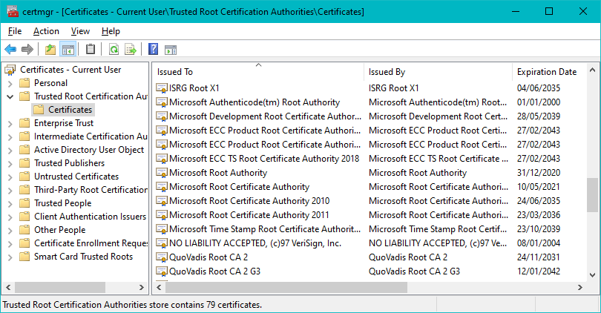
Public Key Infrastructures
Windows 10 Certificate Manager

Slide 44
Public Key Infrastructures
Components
Certification Authority (CA):
  manages the cryptographic keys and certificates of the PKI
  holds the real keys
  performs the cryptographic operations
  also the most critical element of the certification authority
Certificate Server:
  directory where user certificates are published and made searchable
  the directory follows the X.500 standard
  queried by using the LDAP protocol

Slide 45
Public Key Infrastructures
Components
Registration Authority (RA):
  manages certificate requests and provides issued certificates
  deals with the distribution of cryptographic tokens and software (it is the front-end of the CA)
  can be a physical counter or a website
  the type is associated to different levels of security
  can also assist the user in generating the key pair and managing these certificates securely

Slide 46
The Digital Certificate
The digital certificate structure and format is described by the ITU-T X.509 standard (it is a standard of the International Telecommunication Union numbered X.509).
An X.509 digital certificate must contain at least the following fields:
  DN (distinguished name) user: Gaius Julius Caesar
  CN (common name): Julius Caesar
  O (organization): Government
  OU (organization unity): Senate
  C (country): Roman Empire
  There may be an IP address or a URL that corresponds to an X.500 Directory path (e.g. LDAP – Lightweight Directory Access Protocol):
  IT / Roman Empire / Government / Julius Caesar / Gaius Julius Caesar

Slide 47
The Digital Certificate
An X.509 digital certificate must also contain at least the following fields:
  DN Issuer: name of the Authority in X.500 format
  Serial Number: assigned to it by the authority, identifies uniquely a certificate
  NotBefore: activation date
  NotAfter: expiration date
  Public Key: the public key of the certified subject (the certificate contains personal data and the public key)
  Public Key Algorithm: the algorithm the public key is suitable for
  Signature Algorithm: the algorithm used by the Authority to sign the Certificate
  Signature: the signature affixed to the Certificate by the Certificate Authority (the element that guarantees the authenticity of the certificate itself)
  KeyUsage: the purposes the key can be used for

Slide 48
The Digital Certificate
Generation and Revocation
The RFC 2314 standard (from PKCS # 10) defines the format of the certificateRequest message
The request contains the public key and data of the applicant (both given to an RA)
The request message requires the so-called proof of possession of the private key:
  the certificateRequest message must be signed with the private key of the applicant
  the authority, by verifying this signature substantially verifies that the applicant actually possesses this key

Slide 49
The Digital Certificate
Generation and Revocation
Certificate is considered "expired” on the date corresponding to the "notAfter" attribute
Expiration also serves to limit the time a certificate is used
Expiration can refer to:
  the certificate
  the associated keys
An expired certificate cannot be used by its owner
The certificate is available to verify and decrypt messages issued before expiration
In some cases, it is possible to “renew” a certificate

Slide 50
The Digital Certificate
Generation and Revocation
A certificate can be made invalid prior to expiration through revocation
The reason could be, for example:
  the key associated with the certificate has been compromised,
  the subject is no longer associated to the company or changed unit,
  the CA that issued the certificate (or one of its higher level CAs) has been compromised
A revoked certificate cannot be used anymore, except when it is just kept “on hold”

Slide 51
The Digital Certificate
Generation and Revocation
An “on hold” certificate is temporarily inserted in the Certificate Revocation List (CRL) because of specific reasons, for example:
  possible key compromise
  request of revocation by a person other than the owner
  temporary non-use of the certificate
Its validity could be restored later
In case of “reactivation” from suspension, a new entry in the CRL is inserted with a with a special reason code: removeFromCRL

Slide 52
The Digital Certificate
Generation and Revocation
Certificate Revocation List (CRL) lists the certificates that lost validity
Issued periodically by the issuer Certification Authority and propagated (actively or passively) to all the users
Signed periodically by the CA
Includes a field called the “nextUpdate” which contains the date and time in which the new Certificate Revocation List will be available
If the nextUpdate date belongs to the past it means that the CRL is “expired”
Each revoked certificate includes the reason of revocation
The CRL is provided as a service via the LDAP protocol

Slide 53
The Digital Certificate
Generation and Revocation
Large CRLs can be partitioned
The CA just provides pieces of the Certificate Revocation List, for example referring to a certain period of time
Only the piece of CRL of interest is downloaded
Alternatively, Online Certificate Status Protocol (OCSP) service can be used to find if a certain certificate number is in the CRL
OCSP servers responses are signed by the CA in order to be trusted

Slide 54
The Chain of Trust
The verification of a certificate requires that all the chain of the intermediate CAs starting from a trusted one be verified, possibly the root CA
First the certificate to check is verified against the issuer CA, then the CA certificate is verified against its parent CA, and so on up to an intermediate trusted (by the user) CA or the root CA itself

Slide 55
KeyUsage
Keys can be used for different purposes and a certificate specify the allowed uses, among them:
  nonRepudiation: the key can be used for producing a signature
  dataEncipherment: the key can be used to encrypt data
  keyAgreement: the key can be used to securely exchange keys

Slide 56
TimeStamping
A PKI can also be used to time stamping documents
Document timestamping prove its existence in a point in the past
A CA will sign the document and includes a temporal mark
The signature also ensure that the document has not been altered after affixing the timestamp
A Time Stamp can extend the validity of an electronic signature beyond the lifetime of the digital certificate associated with the keys used

Slide 57
Standard Mechanisms and Formats
PKCS #7 - Public key cryptography standard #7
describes the format of messages/files signed, encrypted (with symmetric and asymmetric algorithms) and verifiable by MAC (digested data)
S/MIME - Secure Multipurpose Mail Extension
extension of the MIME standard
describes the encryption of mail messages
PKCS #7 entities are substantially translated into new MIME entities

Slide 58
Exchange and Storage Formats
PKCS #12 - Personal Information Exchange Syntax Standard #12
Defines a format for the exchange and secure storage (on file) of cryptographic keys and digital certificates
Storage is safe because it is based on encryption of both the keys and the certificates, and of the entire chain of certificates a subject chooses to trust
It is the format used by browsers, e-mail clients and operating systems when a user exports a signature and encryption key and a certificate
A PKCS #12 message encrypts the data with a symmetrical algorithm whose key is derived from a password provided by the user

Slide 59
Exchange and Storage Formats
It guarantees the integrity of the content through HMAC, or through a digital signature
Advantages of using PKCS #12 include:
  no implementation costs (format available in many libraries)
  already existing support by most operating systems and software
  use of “strong” symmetric algorithms
  portability on different devices
Disadvantages of using PKCS #12 include:
  can be deleted, copied, transmitted
  the private key must be used directly by the signing/decryption software
  it possible to perform a brute force attacks

Slide 60
Cryptographic Tokens
Hardware devices that natively implement encryption algorithms
Do not allow direct access to cryptographic material from outside, they are the only enabled to access and use the key
These operations can generally be executed only after the user authenticate to the token, for example by entering a PIN
Tokens can have a small Operating System through which the user requests key generation, encryption and data signature operations
The secure destruction of the token often requires not only the cancellation, but also the inability to access the memory areas where the key was written

Slide 61
The Challenge-Response Mechanism
Allows two parties to authenticate without exposing useful information on the communication channel
The mechanism is as follows:
  one party A “challenges” the other party B to operate on a random number (called nonce) with its own key, for example with a One-Way function H
  then B returns N=H(nonce) to A
  If B returns what A expects, A is sure about the identity of B
Simple example: B encrypts the nonce with a secret key known to A

Slide 62
The Challenge-Response Mechanism
Authentication based on a password that has not been sent over the channel, so it is not possible to trace the key
What makes the mechanism effective is the fact that the random number is different for each session
Since the information read on the channel is different for each session, it is not useful for subsequent authentication
No synchronization is needed (differently from the OTP mechanism)
Uneasy to be used by humans, typically used in machine-to-machine authentication
Found in the network authentication mechanisms of ADSL routers to the provider authentication server

